Slide 1
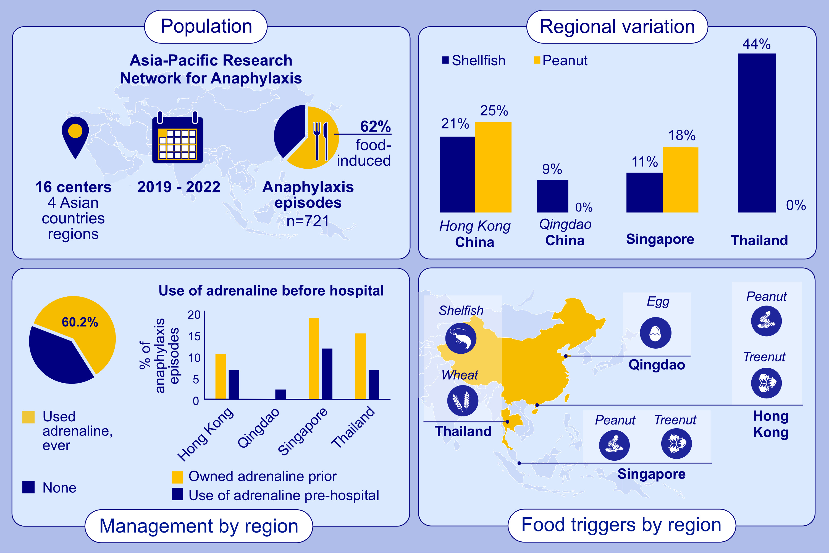
Disparities in pediatric anaphylaxis triggers and management across Asia
Agnes Sze Yin Leung, Elizabeth Huiwen Tham, Punchama Pacharn, Yuhan Xing, Hoang Kim Tu Trinh, et al.
Allergy. Page: 1317-1328
https://doi.org/10.1111/all.16098
© 2019 EAACI and John Wiley and Sons A/S. Published by John Wiley and Sons Ltd.
Notes:
HIGHLIGHTS
• The APRA identified food as the primary trigger of anaphylaxis in children, but causative allergens differed across Asian countries.
• Shellfish was a common trigger, more so in Thailand, while nuts were common anaphylaxis elicitors in Singapore and HK.
• Fewer than two-thirds of cases received adrenaline treatment, with low pre-hospital usage and suboptimal device prescriptions. .

