Slide 1
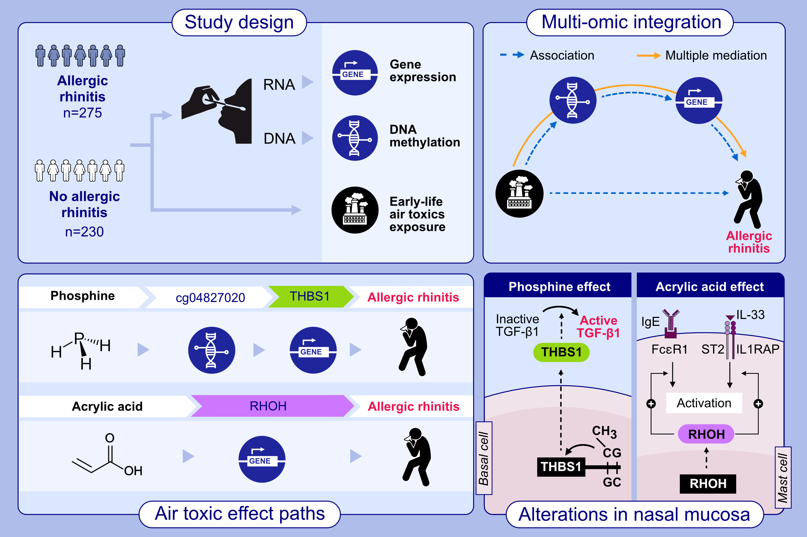
Multi-omic integration reveals alterations in nasal mucosal biology that mediate air pollutant effects on allergic rhinitis
Haritz Irizar, Yoojin Chun, Hsiao-Hsien Leon Hsu, Yan-Chak Li, Lingdi Zhang, et al.
Allergy. 2024; pages: 3047-3061
https://doi.org/10.1111/all.16174
© 2019 EAACI and John Wiley and Sons A/S. Published by John Wiley and Sons Ltd.
Notes:
HIGHLIGHTS
• In a cohort of 505 participants, we examined the effects of air toxics on allergic rhinitis development and their mediation by nasal DNA methylation and nasal gene expression.
• Multi-omic integration revealed methylation and gene expression paths involving THBS1 and RHOH mediating the effects of acrylic acid and phosphine on AR development.
• Increased mast cell degranulation and TGF-β1activation are potential mechanisms of air toxic effects on AR development.
Abbreviations: FcεRI, Fc epsilon RI; IgE, immunoglobulin E; IL-33, interleukin 33; RHOH, ras homolog family member H; ST2, suppression of tumorigenicity 2; TGF-β1, transforming growth factor beta 1; THBS1, thrombospondin 1.
.

