Slide 1
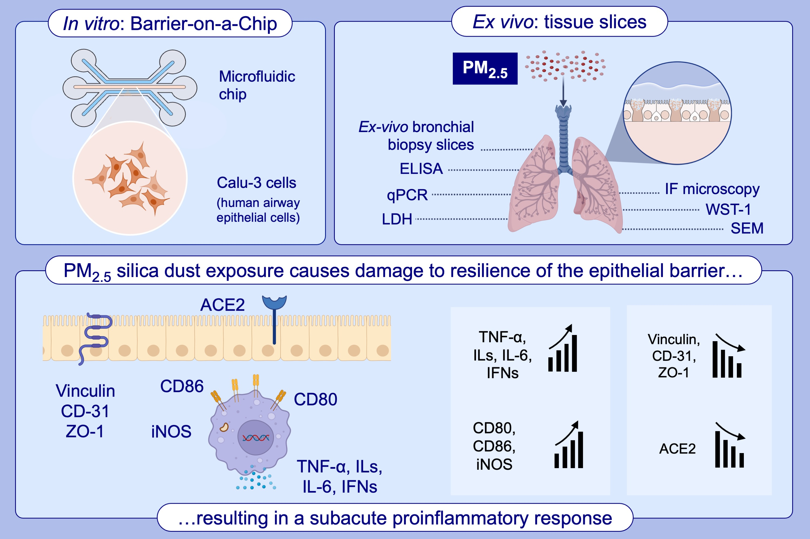
Comprehensive analysis of resilience of human airway epithelial barrier against short-term PM2.5 inorganic dust exposure using in vitro microfluidic chip and ex vivo human airway models
Ozlem Goksel, Meryem Irem Sipahi, Sena Yanasik, Pelin Saglam-Metiner, Sema Benzer, et al.
Allergy. 2024; pages:2953-2965
https://doi.org/10.1111/all.16179
© 2019 EAACI and John Wiley and Sons A/S. Published by John Wiley and Sons Ltd.
Notes:
HIGHLIGHTS
• Biomimetic microfluidic platform based dynamic AEB-on-a-chip model developed in order to recapitulate PM2.5 silica particle exposure.
• Quantitative and qualitative characterization tests were carried out for cell barrier disruption and inflammatory immune responses.
• Our easy-to-use AEB on-a-chip model and ex vivo bronchial biopsy slices were investigated comperatively.
•
Abbreviations: ALI, air-liquid interface; CXCL8, chemokine C-X-C motif ligand 8; CX3CR1, CX3C motif chemokine receptor; IFN, interferon; IL, interleukin; NEC, nasal epithelial cells, RSV, respiratory syncytial virus; PRR, pattern recognition receptor; RNA-seq, RNA sequencing; TLR, Toll-like receptor.
.

