Slide 1
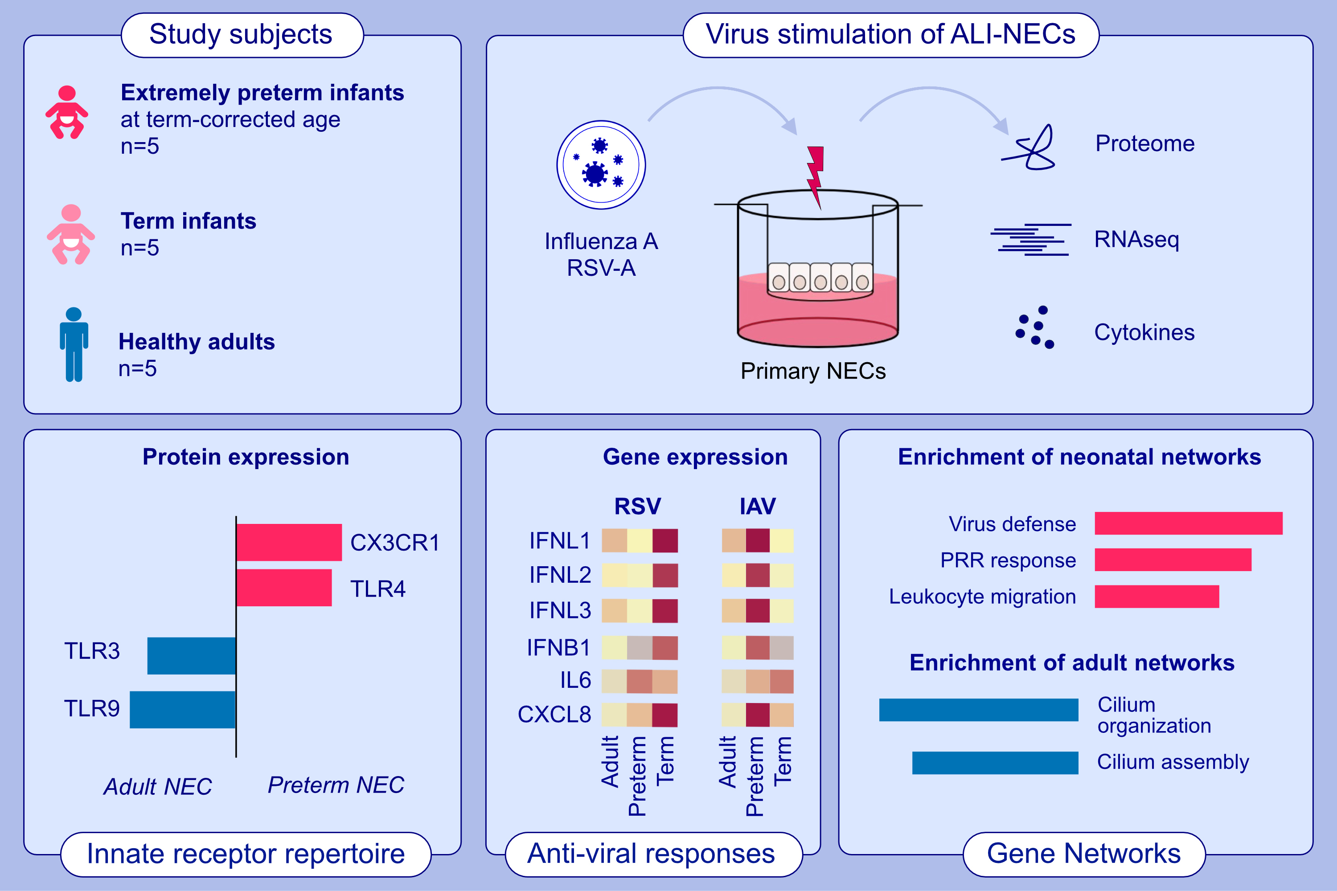
Network analysis reveals age- and virus-specific circuits in nasal epithelial cells of extremely premature infants
Lukas Wisgrill, Anke Martens, Rajmund Kasbauer, Michael Eigenschink, Linda Pummer, et al.
Allergy. 2024; pages: 3062-3081
https://doi.org/10.1111/all.16196
© 2019 EAACI and John Wiley and Sons A/S. Published by John Wiley and Sons Ltd.
Notes:
HIGHLIGHTS
• Extremely premature infants have a higher susceptibility to respiratory virus infections.
• NEC are critical in defending against respiratory infections.
• Age-dependent differences in innate NEC responses to influenza A and RSV were identified, revealing distinct receptor repertoires and antiviral network-circuits in neonatal versus adult cells.
• This highlights the significance of NEC immunity in age-related responses to viral infections.
Abbreviations: ALI, air-liquid interface; CXCL8, chemokine C-X-C motif ligand 8; CX3CR1, CX3C motif chemokine receptor; IFN, interferon; IL, interleukin; NEC, nasal epithelial cells, RSV, respiratory syncytial virus; PRR, pattern recognition receptor; RNA-seq, RNA sequencing; TLR, Toll-like receptor.

