Slide 1
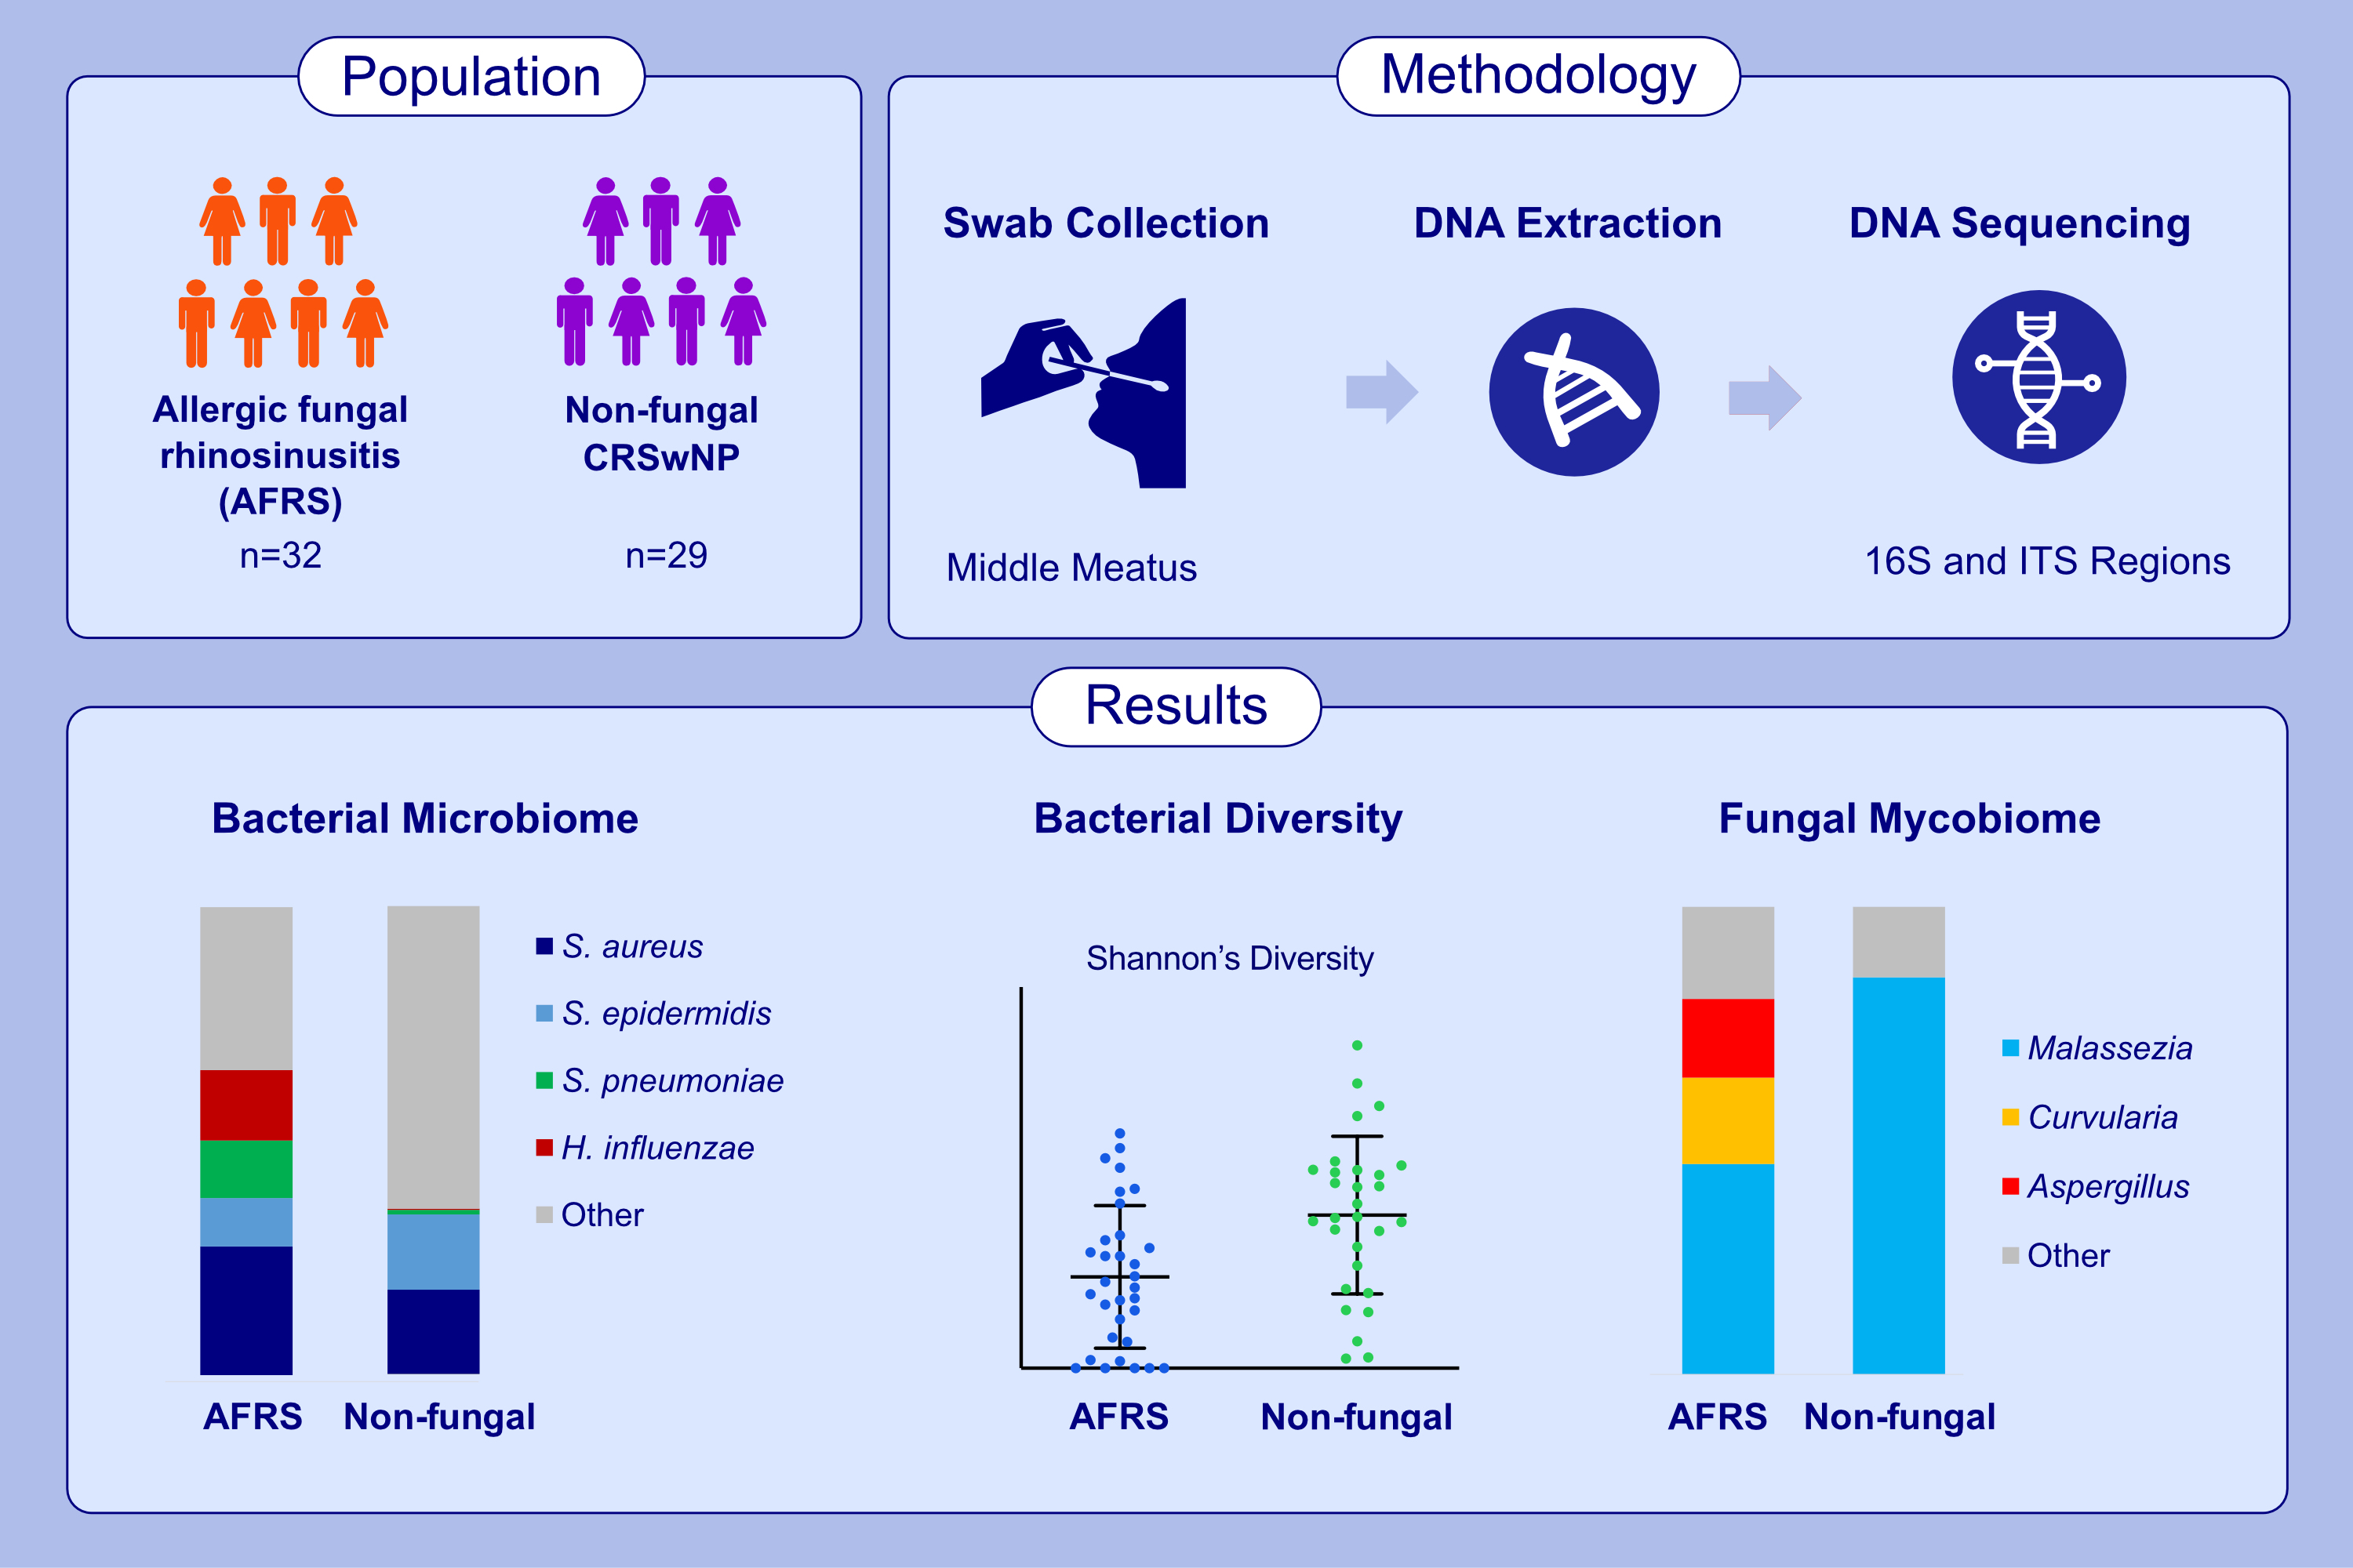
Characterising the allergic fungal rhinosinusitis microenvironment using full-length 16S rRNA gene amplicon sequencing and fungal ITS sequencing
J. T. Connell, G. Bouras, K. Yeo, K. Fenix, C. Cooksley, et al.
Allergy. 2024; pages:3082-3094
https://doi.org/10.1111/all.16240
© 2019 EAACI and John Wiley and Sons A/S. Published by John Wiley and Sons Ltd.
Notes:
HIGHLIGHTS
• Sinonasal swabs from 61 patients underwent DNA extraction and multimodal gene amplicon sequencing to define the microbiome and mycobiome of AFRS.
• The AFRS microbiome exhibited low bacterial diversity and was dominated by Staphylococcus aureus, Streptococcus pneumoniae and Haemophilus influenzae.
• The AFRS mycobiome was dominated by Malassezia, Aspergillus and dematiaceous fungi.
Abbreviations: AFRS, allergic fungal rhinosinusitis; CRSwNP, chronic rhinosinusitis with nasal polyps; H. influenzae, Haemophilus influenzae; ITS, internal transcribed spacer; S.aureus, Staphylococcus aureus; S. epidermidis, Staphylococcus epidermidis; S. pneumoniae, Streptococcus pneumoniae

