Slide 1
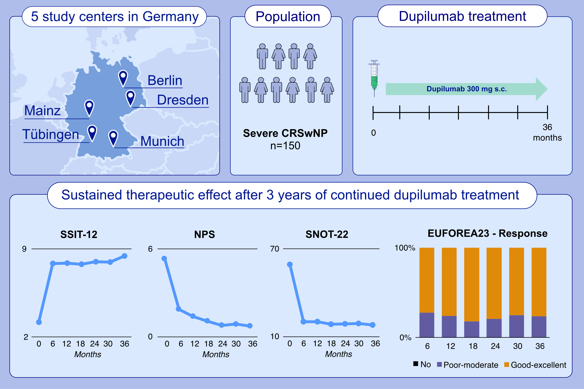
Real-world data show sustained therapeutic effects of dupilumab in chronic rhinosinusitis with nasal polyps (CRSwNP) over 3 years
Patrick Huber, Ulrike Förster-Ruhrmann, Heidi Olze, Sven Becker, Friederike Bärhold, et al.
Allergy. 2024; pages:3108-3117
https://doi.org/10.1111/all.16263
© 2019 EAACI and John Wiley and Sons A/S. Published by John Wiley and Sons Ltd.
Notes:
HIGHLIGHTS
• Over the course of 36 months, this study examined the efficacy and safety of dupilumab in individuals with severe CRSwNP.
• In a multicentric design involving 150 patients, dupilumab significantly improved disease-related impairment, rhinosinusitis symptoms, and nasal polyp burden.
• Notably, 76.5% of patients achieved an “good-excellent" treatment response.
Abbreviations: CRSwNP, chronic rhinosinusitis with nasal polyps; EUFOREA, European Forum for Research and Education in Allergy and Airway Diseases; NPS, Nasal Polyp Score; SNOT-22, Sino-Nasal Outcome Test-22; SSIT-12, Sniffin’ Sticks 12-item identification test; VAS, Visual Analogue Scale for disease activity.

