Slide 1
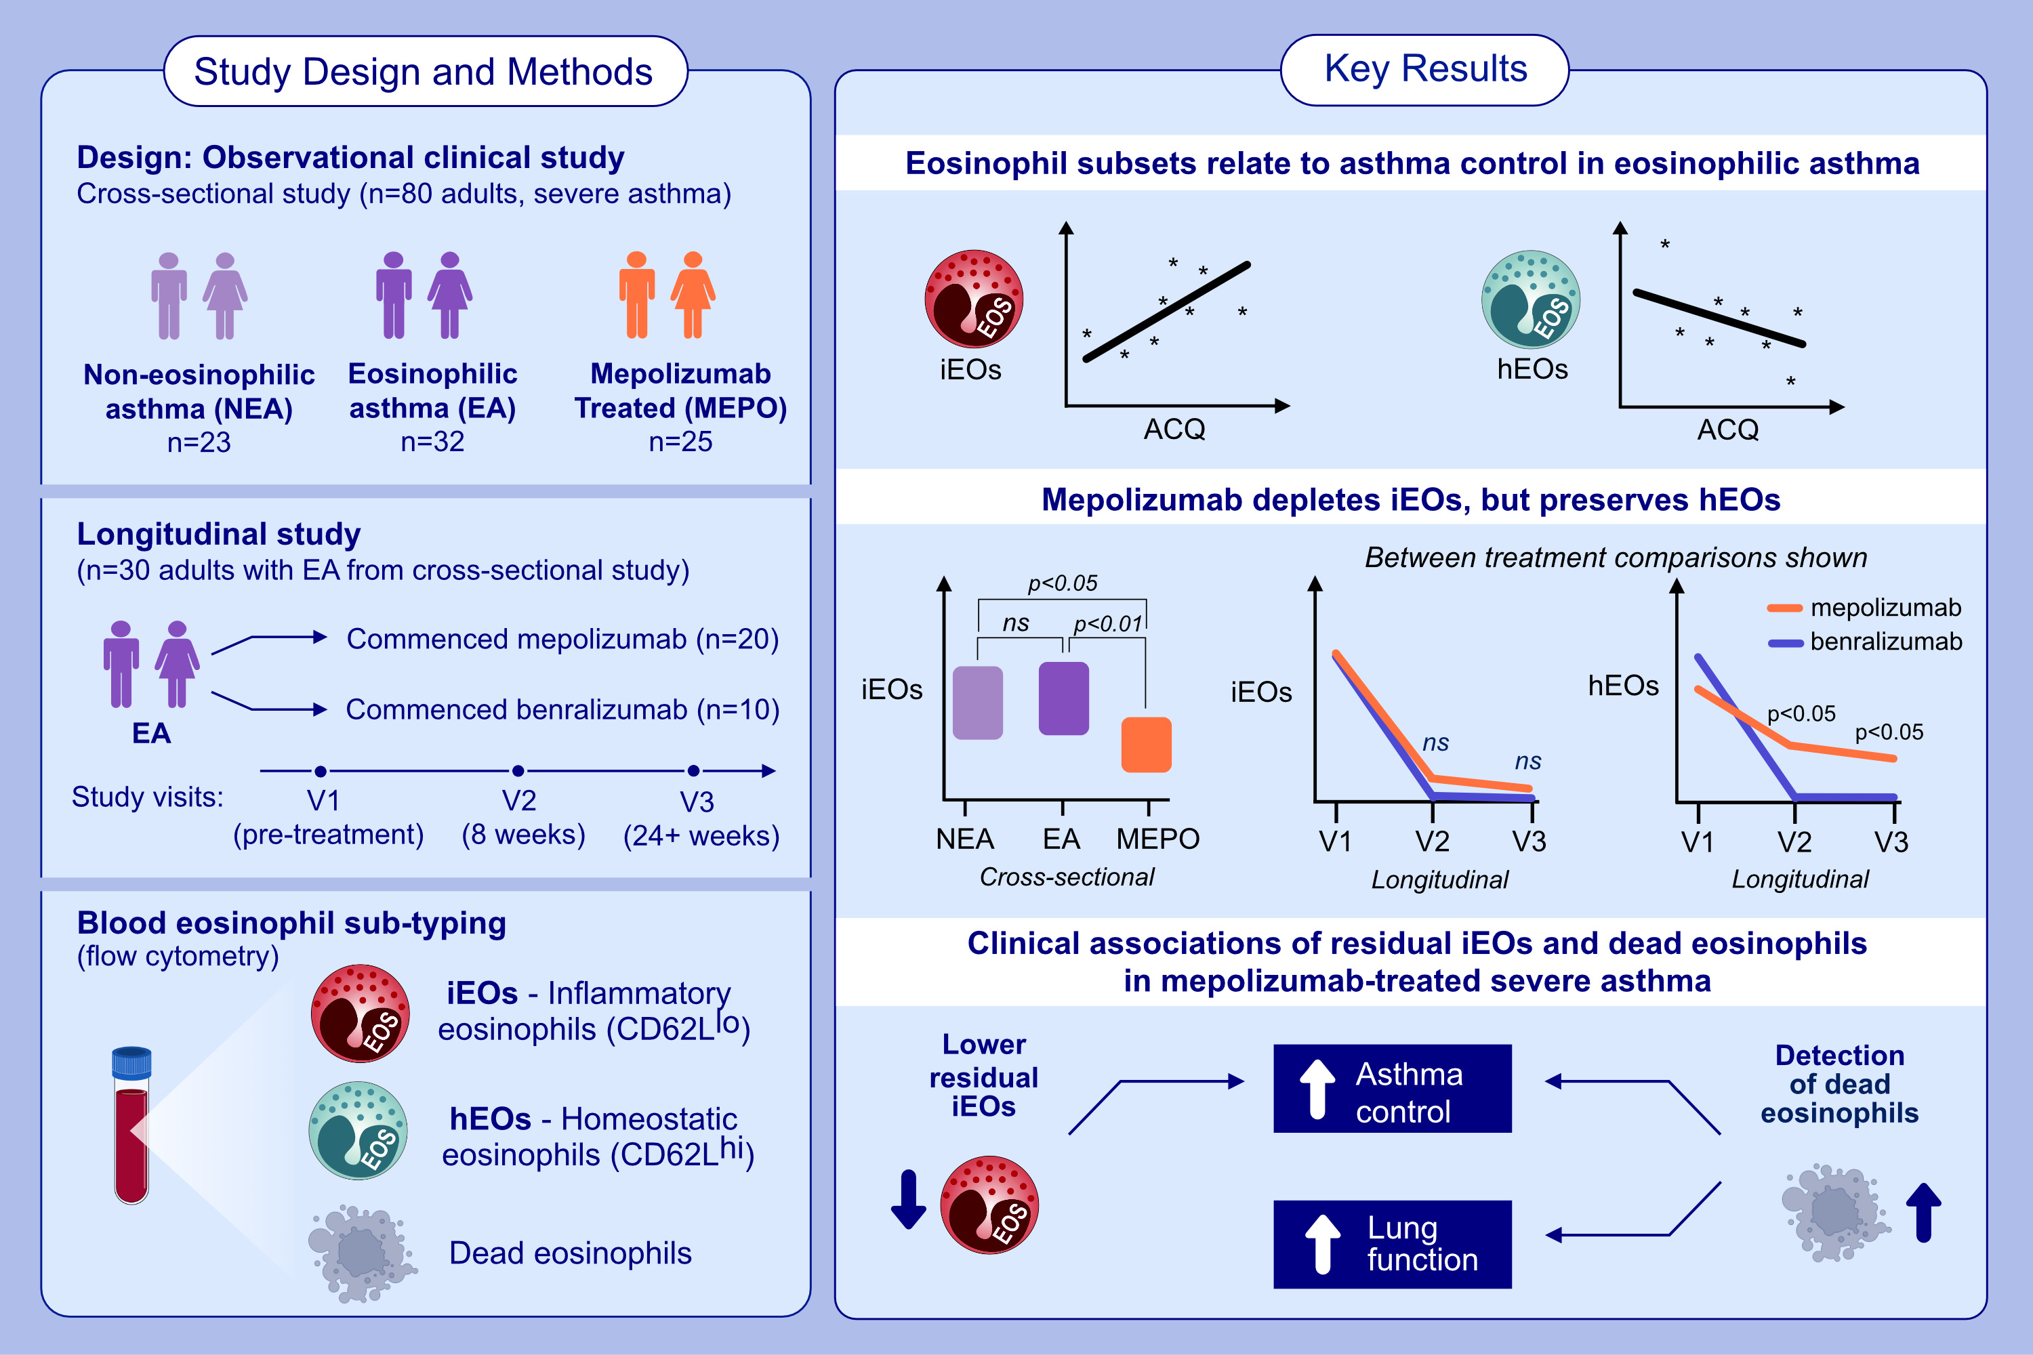
Mepolizumab depletes inflammatory but preserves homeostatic eosinophils in severe asthma
Michael Fricker, John Harrington, Sarah A. Hiles, Peter G. Gibson
Allergy. 2024; pages:3118-3128
https://doi.org/10.1111/all.16267
© 2019 EAACI and John Wiley and Sons A/S. Published by John Wiley and Sons Ltd.
Notes:
HIGHLIGHTS
• Mepolizumab depletes inflammatory eosinophils (iEOs) but preserves a residual population of homeostatic eosinophils (hEOs) in severe asthma.In contrast benralizumab treatment fully depletes both iEOs and hEOs.
• Mepolizumab treatment is associated with variable appearance of non-viable circulatory eosinophils measured by flow cytometry.
• Higher iEO abundance and eosinophil viability correlated with poorer clinical outcomes following mepolizumab treatment.
Abbreviations: ACQ, Asthma Control Questionnaire; CD62L, cluster of differentiation 62/L-selectin; EA, eosinophilic asthma; hEOs, homeostatic eosinophils; iEOs, inflammatory eosinophils; MEPO, mepolizumab-treated severe asthma; NEA, non-eosinophilic asthma; V1/2/3, study visit.
.

