Slide 1
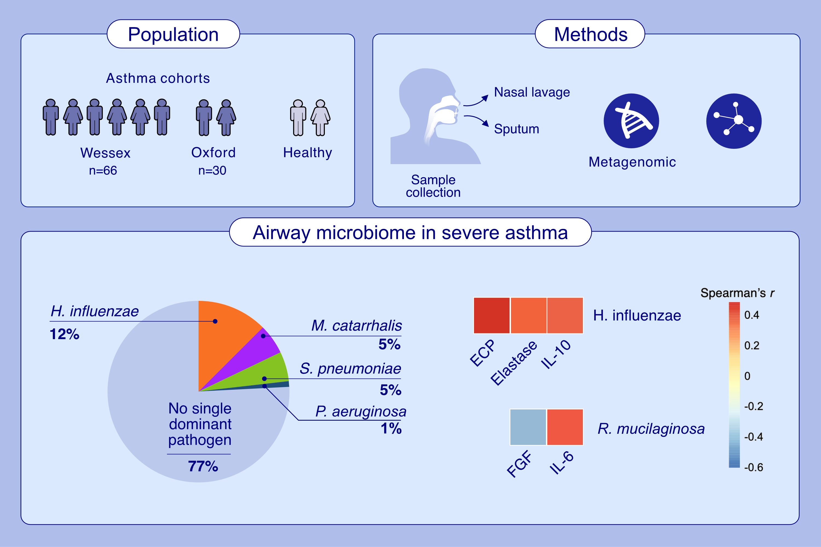
Species-level, metagenomic and proteomic analysis of microbe-immune interactions in severe asthma
Maisha F. Jabeen, Nicholas D. Sanderson, Mariaenrica Tinè, Gillian Donachie, Clair Barber, et al.
Allergy. 2024; pages:2966-2980
https://doi.org/10.1111/all.16269
© 2019 EAACI and John Wiley and Sons A/S. Published by John Wiley and Sons Ltd.
Notes:
HIGHLIGHTS
Paired long-read metagenomic sequencing and proteomics in sputum and nasal lavage identified a single dominant respiratory pathogen (H. influenzae more than M. catarrhalis and S. pneumoniae) in 23% of severe asthma sputum samples.
Nasal and sputum microbiomes were highly discordant.
H. influenzae load correlated with ECP, elastase and IL-10 suggesting eosinophil activation and a potential immune evasion mechanism.
Abbreviations: ECP, eosinophil cationic protein; FGF, fibroblast growth factor; IL, interleukin; H. influenzae, Haemophilus influenzae; M. catarrhalis, Moraxella catarrhalis; P. aeruginosa, Pseudomonas aeruginosa; R. mucilaginosa; Rothia mucilaginosa; S. pneumoniae; Streptococcus pneumoniae.

