Slide 1
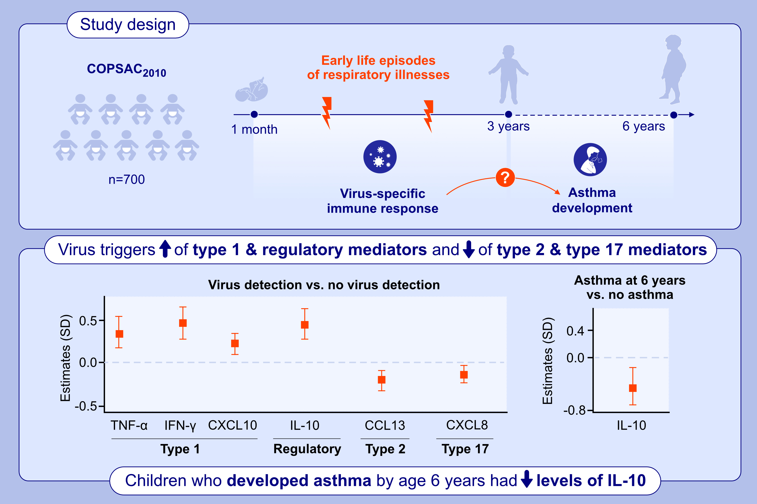
Asthma development is associated with low mucosal IL-10 during viral infections in early life
Mathias Elsner Melgaard, Signe Kjeldgaard Jensen, Anders Eliasen, Casper-Emil Tingskov Pedersen, Jonathan Thorsen, et al.
Allergy. 2024; pages: 2981-2992
https://doi.org/10.1111/all.16276
© 2019 EAACI and John Wiley and Sons A/S. Published by John Wiley and Sons Ltd.
Notes:
HIGHLIGHTS
• This study investigated virus-specific immune mediator levels in the upper airways during respiratory illnesses in early life and the association with later asthma development.
• The airway immune profile during viral respiratory illnesses was characterized by high levels of type 1 and regulatory immune mediators, and low levels of type 2 and type 17 immune mediators.
• Children later developing asthma had a reduced regulatory (IL-10) immune mediator level during viral respiratory illnesses in early life.
Abbreviations: CCL, C-C motif ligand; COPSAC₂₀₁₀, Copenhagen Prospective Studies on Asthma in Childhood 2010; CXCL, C-X-C motif ligand, IFN-γ, interferon gamma; IL, interleukin; SD, standard deviation; TNF-α, tumor necrosis factor alpha.

