Slide 1
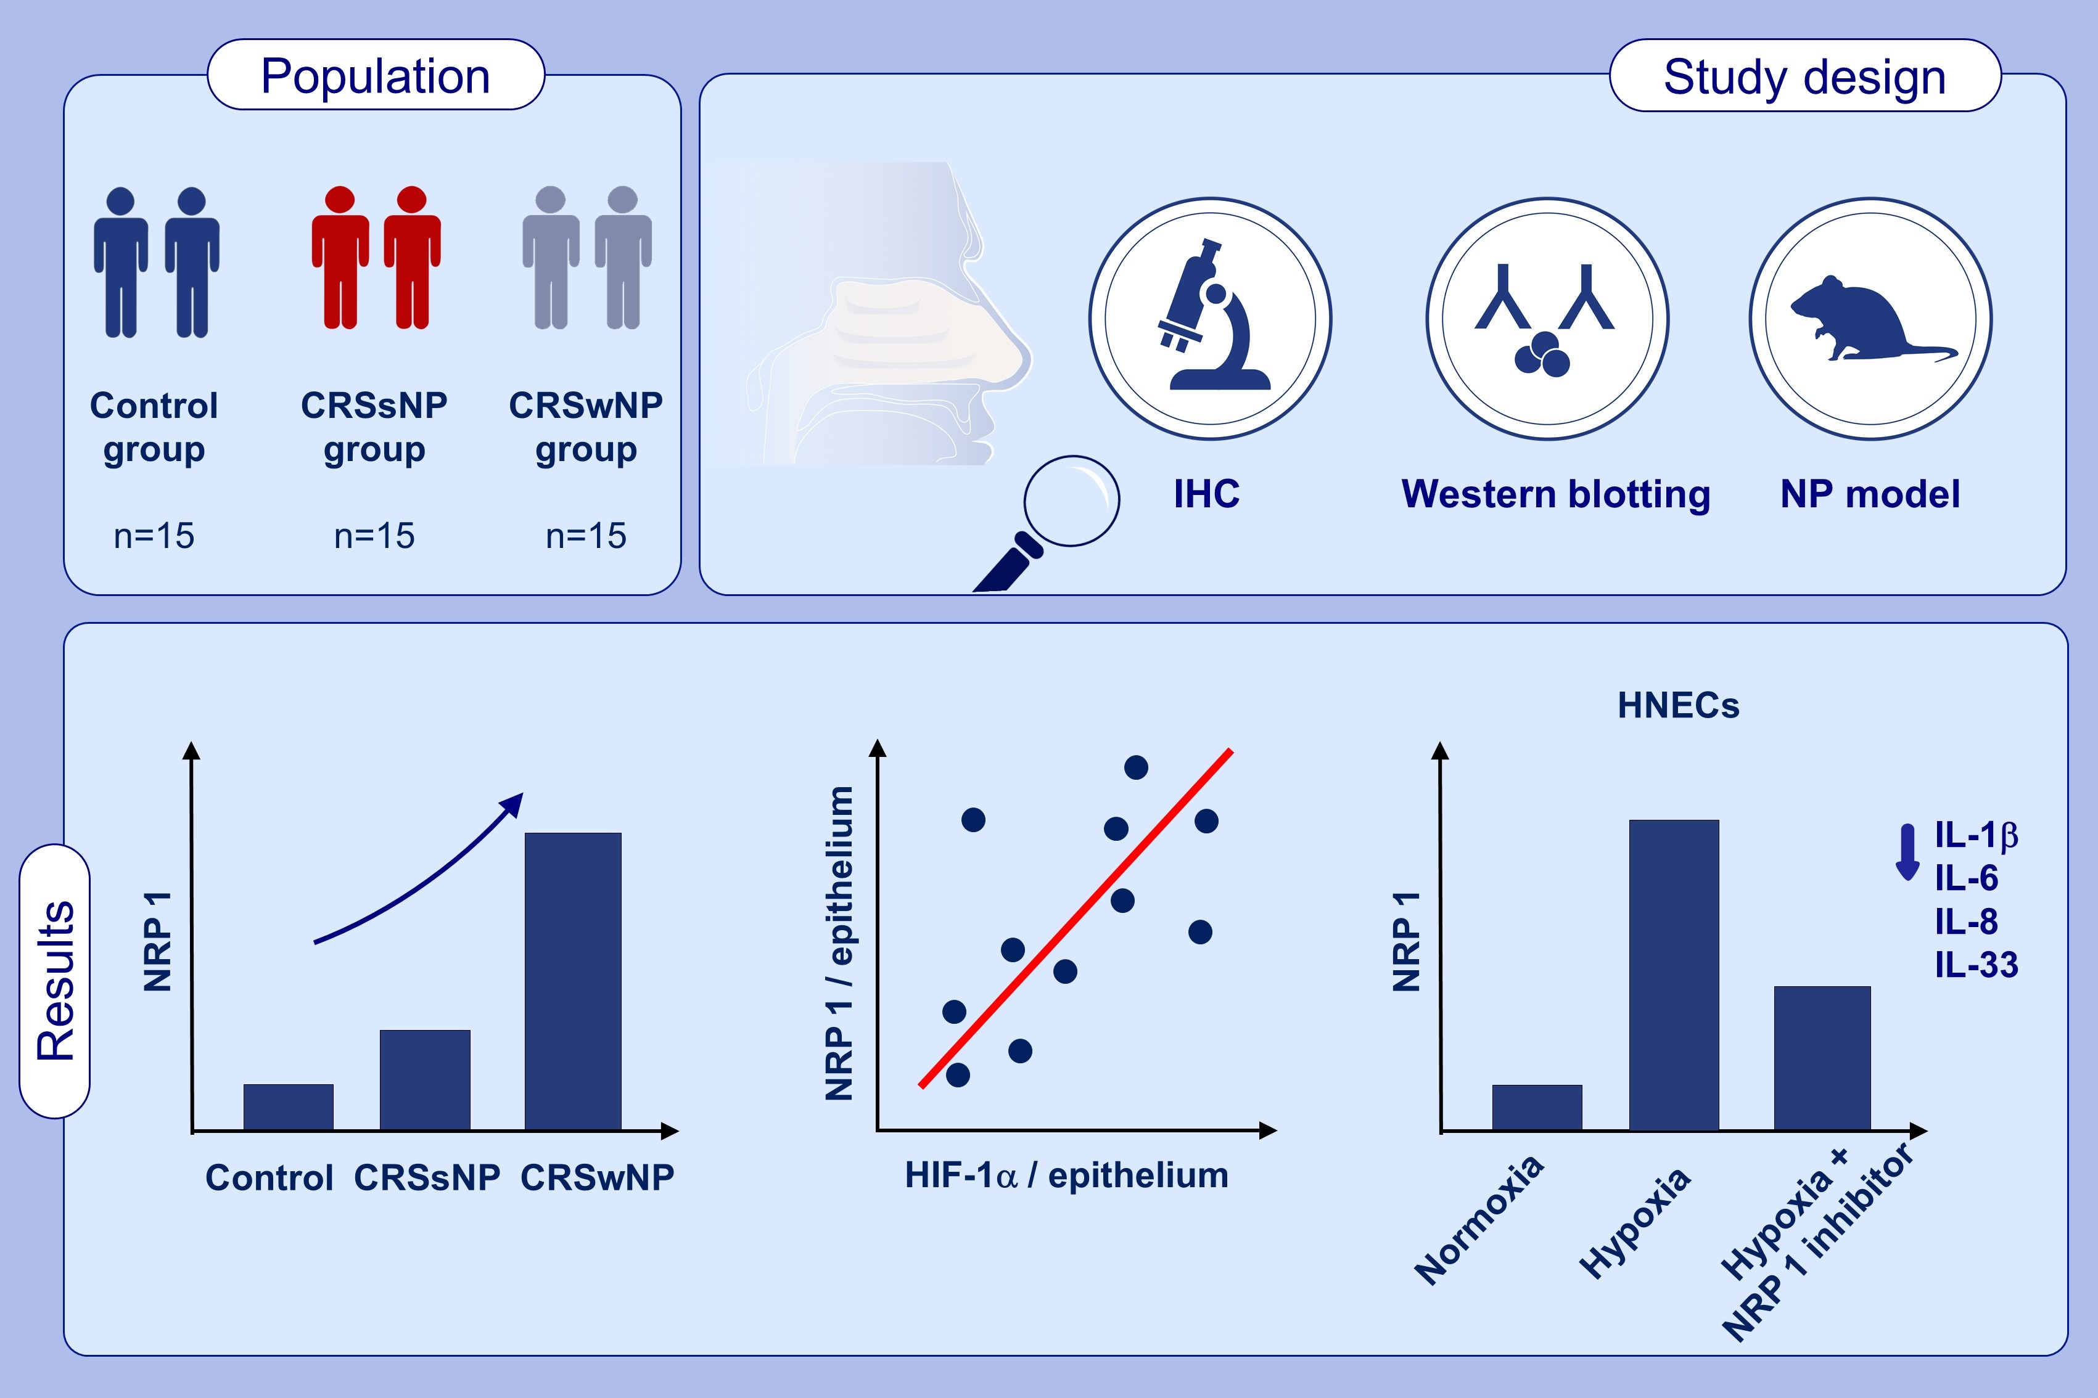
NRP1 antagonism as a novel therapeutic target in nasal polyps of patients with chronic rhinosinusitis
Roza Khalmuratova, Jae-Sung Ryu, Ji Hyeon Hwang, Yi Sook Kim, Suha Lim, et al.
Allergy. 2024; pages: 3095-3107
https://doi.org/10.1111/all.16285
© 2019 EAACI and John Wiley and Sons A/S. Published by John Wiley and Sons Ltd.
Notes:
HIGHLIGHTS
• This study aims to elucidate the role of NRP1 in CRSwNP.
• Expression of NRP1 is increased in the epithelium in patients with CRSwNP.
• Hypoxia upregulates NRP1 expression in human nasal epithelial cells.
• The inhibition of NRP1 attenuates secretion of IL-1β, IL-6, IL-8, and IL-33.
Abbreviations: CRSsNP, chronic rhinosinusitis without nasal polyps; CRSwNP, chronic rhinosinusitis with nasal polyps; HIF-1α, hypoxia-inducible factor 1 alpha; HNECs, human nasal epithelial cells; IHC, immunohistochemistry; IL, interleukin; NP, nasal polyp; NRP1, neuropilin 1.

