Slide 1
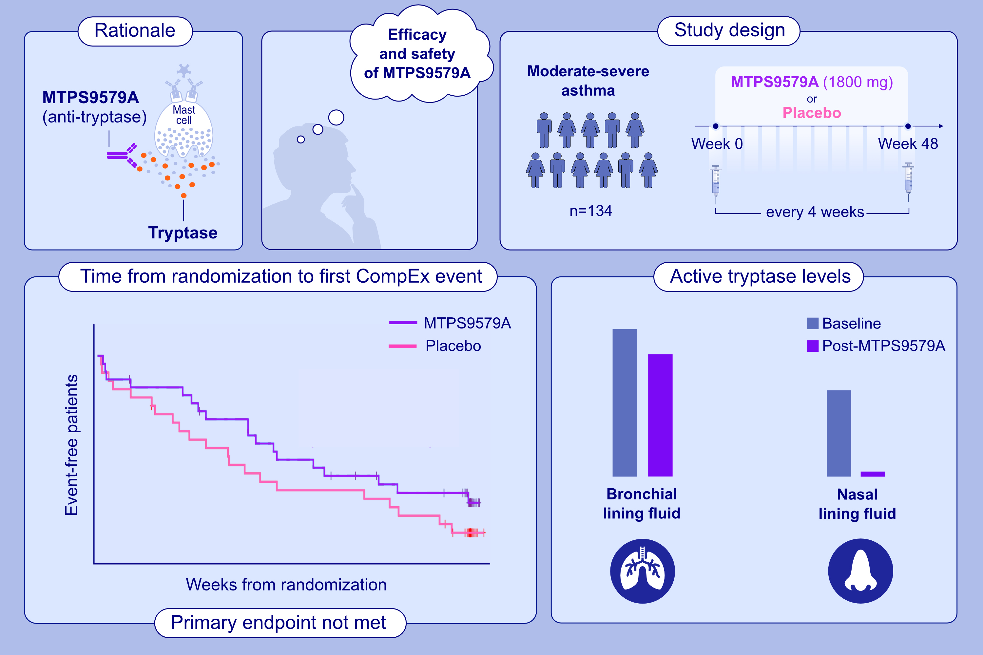
Airway tryptase levels inform the lack of clinical efficacy of the tryptase inhibitor MTPS9579A in asthma
Horace Rhee, Lindsay M. Henderson, Rebecca N. Bauer, Kit Wong, Tracy L. Staton, et al.
Allergy. 2024; pages:2993-3004
https://doi.org/10.1111/all.16309
© 2019 EAACI and John Wiley and Sons A/S. Published by John Wiley and Sons Ltd.
Notes:
HIGHLIGHTS
• We evaluated MTPS9579A, an anti-tryptase antibody, in a Phase 2a randomized trial for uncontrolled asthma and a Phase 1c study of activity in the upper and lower respiratory tract.
• Phase 2a showed lack of MTPS9579A efficacy versus placebo.
• Phase 1c revealed bronchial MTPS9579A concentrations were insufficient to inhibit the high bronchial active tryptase levels, which likely contributed to the observed lack of efficacy.
Abbreviation: CompEx, composite exacerbation.

