Slide 1
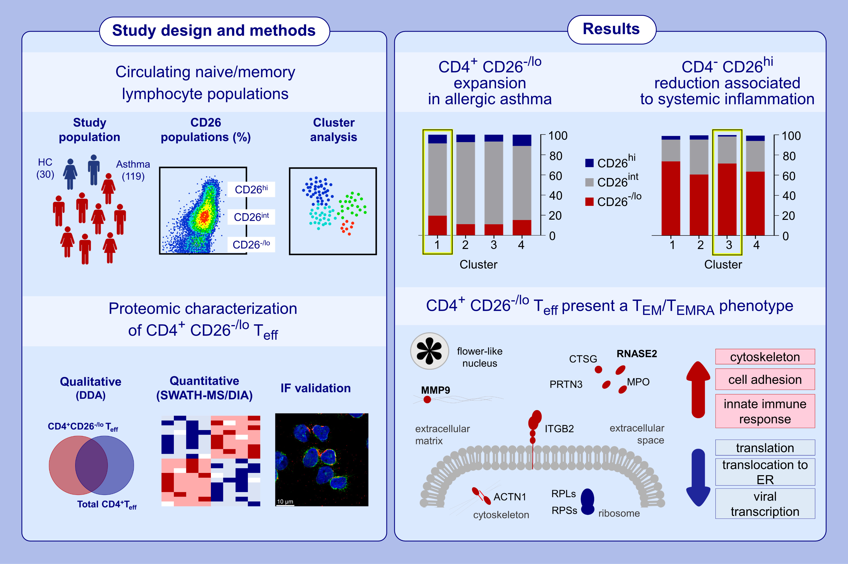
Exploring CD26−/lo subpopulations of lymphocytes in asthma phenotype and severity: A novel CD4+ T cell subset expressing archetypical granulocyte proteins
Sara Vázquez-Mera, Laura Martelo-Vidal, Pablo Miguéns-Suárez, Susana Belén Bravo, Paula Saavedra-Nieves, et al.
Allergy. 2024; pages:3005-3021
https://doi.org/10.1111/all.16327
© 2019 EAACI and John Wiley and Sons A/S. Published by John Wiley and Sons Ltd.
Notes:
HIGHLIGHTS
• There is an association between CD26 levels in different lymphocyte subsets and asthma phenotype/severity.
• Reduction of CD4−CD26hi lymphocytes is associated to a higher degree of systemic inflammation (higher BMI, IL-6/TNF-α levels, and disease severity) in adult asthma.
• CD4+CD26−/loTEMRA cells, expressing innate proteins specific to eosinophils/neutrophils, could be relevant in sustaining long-term inflammation in adult allergic asthma.
Abbreviations: ACTN1, alpha-actinin-1; BMI, body mass index; CTSG, cathepsin G; DDA, data-dependent acquisition; DIA, data-independent acquisition; ER, endoplasmic reticulum; HC, healthy control; IF, immunofluorescence; IL, interleukin; ITGB2, integrin subunit beta 2; MMP9, matrix metalloproteinase-9; MPO, myeloperoxidase; PRTN3, proteinase 3; RPLs, large ribosomal proteins; RPSs, small ribosomal proteins; SWATH-MS, sequential window acquisition of all theoretical fragment ion spectra mass spectrometry; T_{eff}, effector T cell; T_{EM}, effector memory T cell; T_{EMRA}, terminally differentiated effector memory T cell; TNF-α, tumor necrosis factor alpha.

