Slide 1
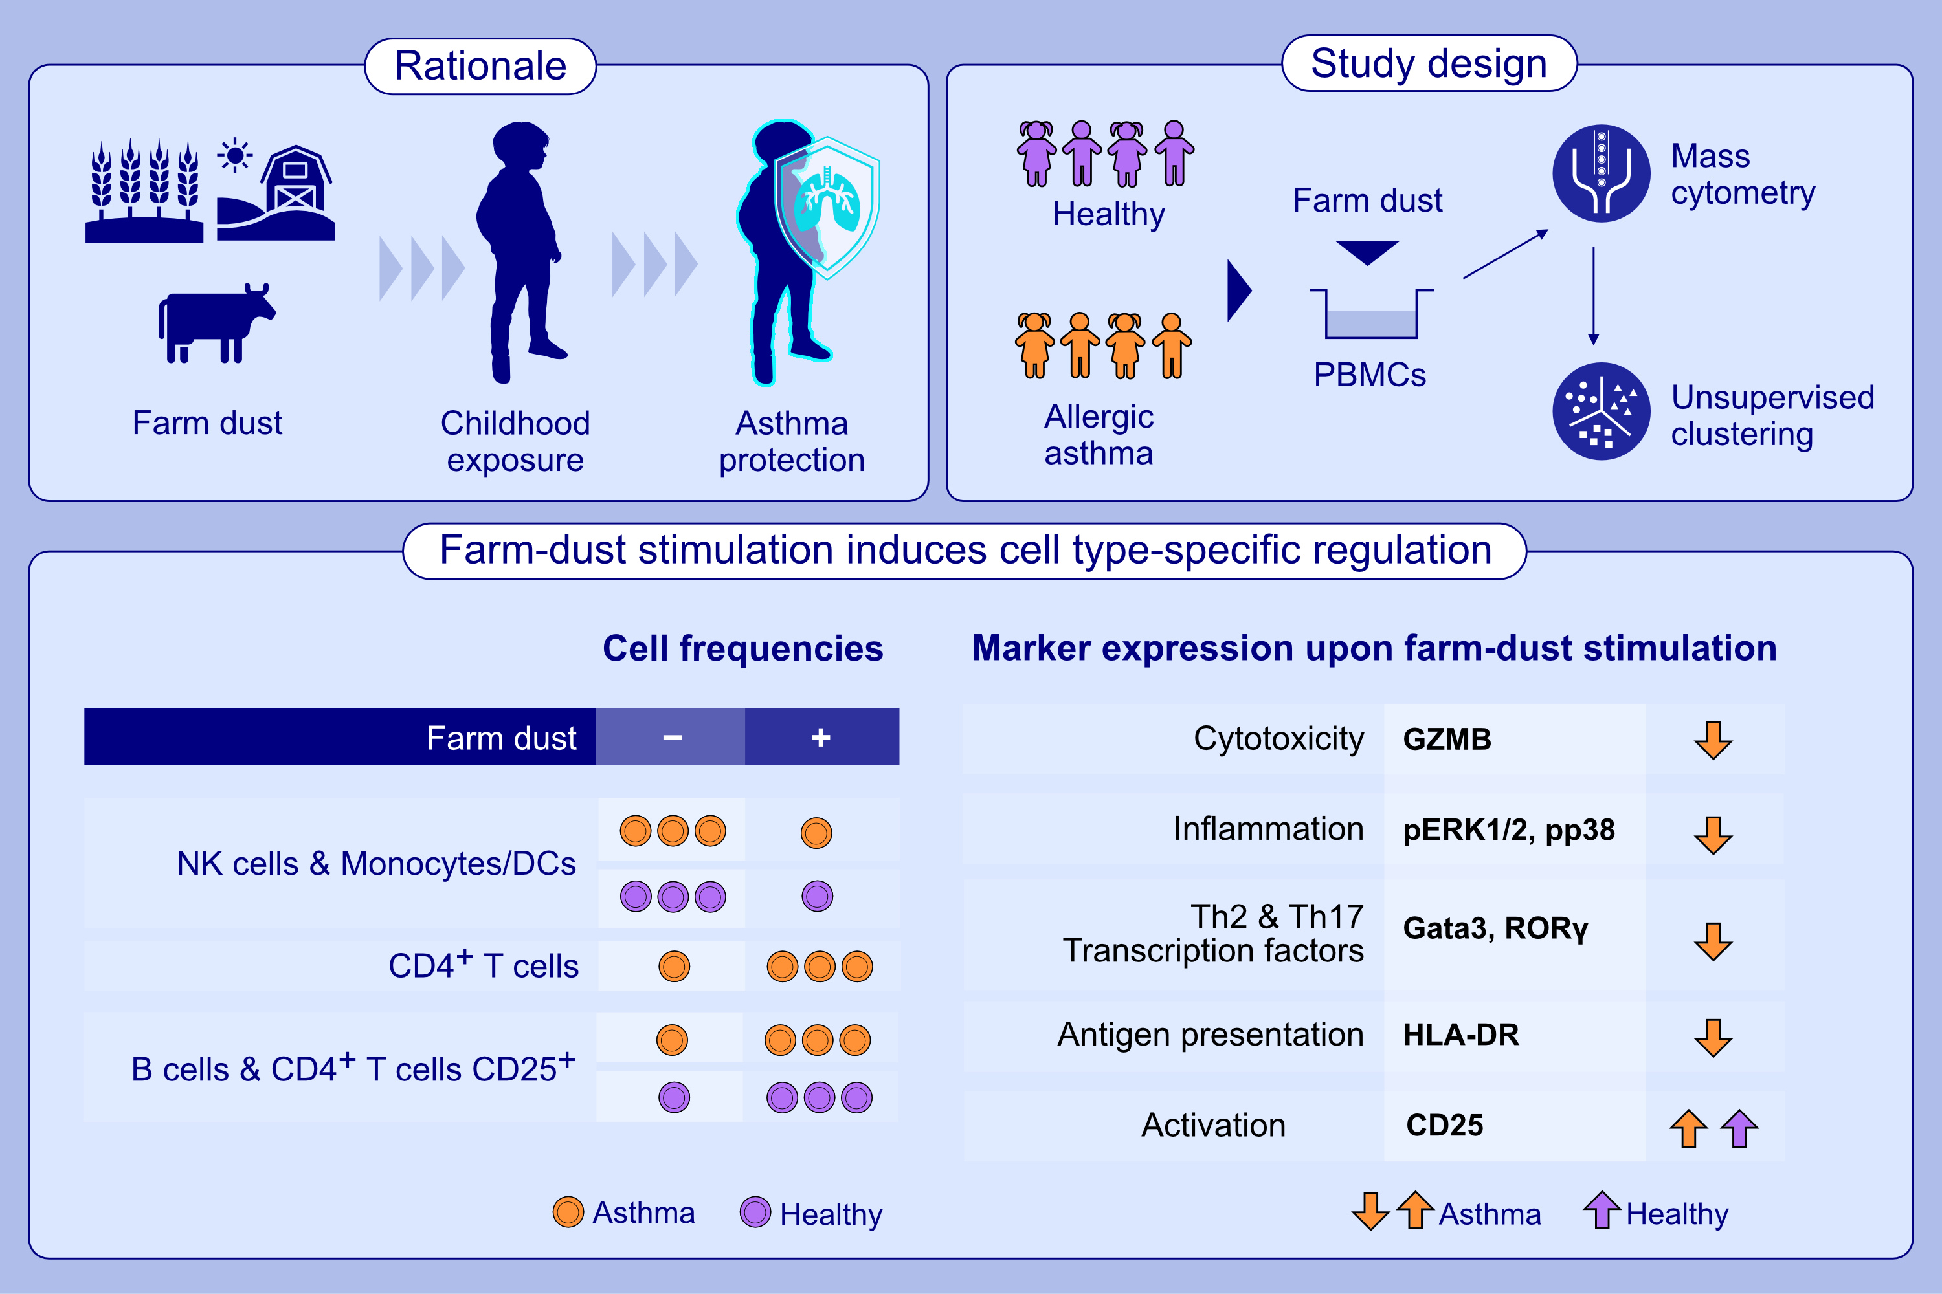
Farm-dust mediated protection of childhood asthma: Mass cytometry reveals novel cellular regulation
Claudia Carina Beerweiler, Michael Salvermoser, Johanna Theodorou, Andreas Böck, Franziska Sattler, et al.
Allergy. 2024; pages:3022-3035
https://doi.org/10.1111/all.16347
© 2019 EAACI and John Wiley and Sons A/S. Published by John Wiley and Sons Ltd.
Notes:
HIGHLIGHTS
• In vitro farm dust stimulation induced cell-type specific regulation.
• Farm-dust stimulation affects cellular frequencies by downregulation of innate (monocytes/DCs and NK-cells) and upregulation of adaptive (B- and T-cells) immune cell-populations.
• Farm-dust stimulation induces downregulation of asthma-associated functional markers of inflammation (pERK1/2, pp38), cytotoxicity (GZMB), antigen-presentation (HLA-DR) as well as Th2- (Gata3) and Th17 (RORγ)- transcription factors in allergic asthmatics.
Abbreviations: Gata3, GATA-binding protein 3; GZMB, granzyme B; HLA-DR, human leukocyte antigen - DR isotype; NK, natural killer cell; PBMC, peripheral blood mononuclear cells; pERK 1/2; phosphorylated extracellular signal regulated rinase 1/2; RORγ, RAR-related orphan receptor gamma; Th, T helper cells.

