Slide 1
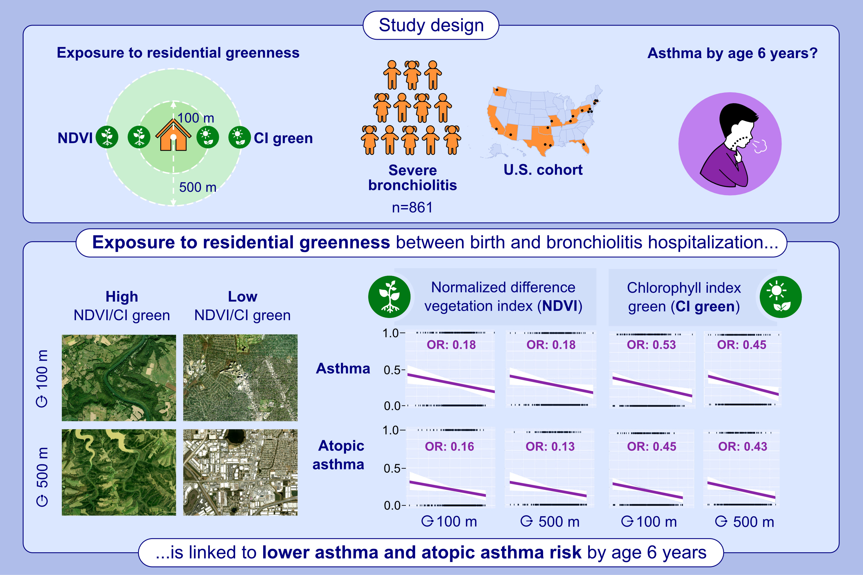
Early-life exposure to residential greenness and risk of asthma in a U.S. bronchiolitis cohort
Wojciech Feleszko, Heidi Makrinioti, Marta Nalej, Tadao Ooka, Zhaozhong Zhu, et al.
Allergy. 2024; pages.3036-3046
https://doi.org/10.1111/all.16359
© 2019 EAACI and John Wiley and Sons A/S. Published by John Wiley and Sons Ltd.
Notes:
HIGHLIGHTS
• This study investigates whether exposure to residential greenness between birth and bronchiolitis hospitalization is associated with asthma and atopic asthma development by age 6 years.
• We analyzed a severe bronchiolitis cohort from hospitalization to age 6 years, assessing how the NDVI and CI green, measured in small (100m) and large (500m) radiuses around homes, relate to asthma and atopic asthma by age 6 years.
• Early-life exposure to residential greenness significantly reduces the risk of developing asthma and atopic asthma by age 6 in infants hospitalized with severe bronchiolitis, highlighting the potential protective role of natural environments in high-risk pediatric populations.
Abbreviations: CI green, chlorophyll index green; NDVI, normalized difference vegetation index; OD, odds ratio.

