Slide 1
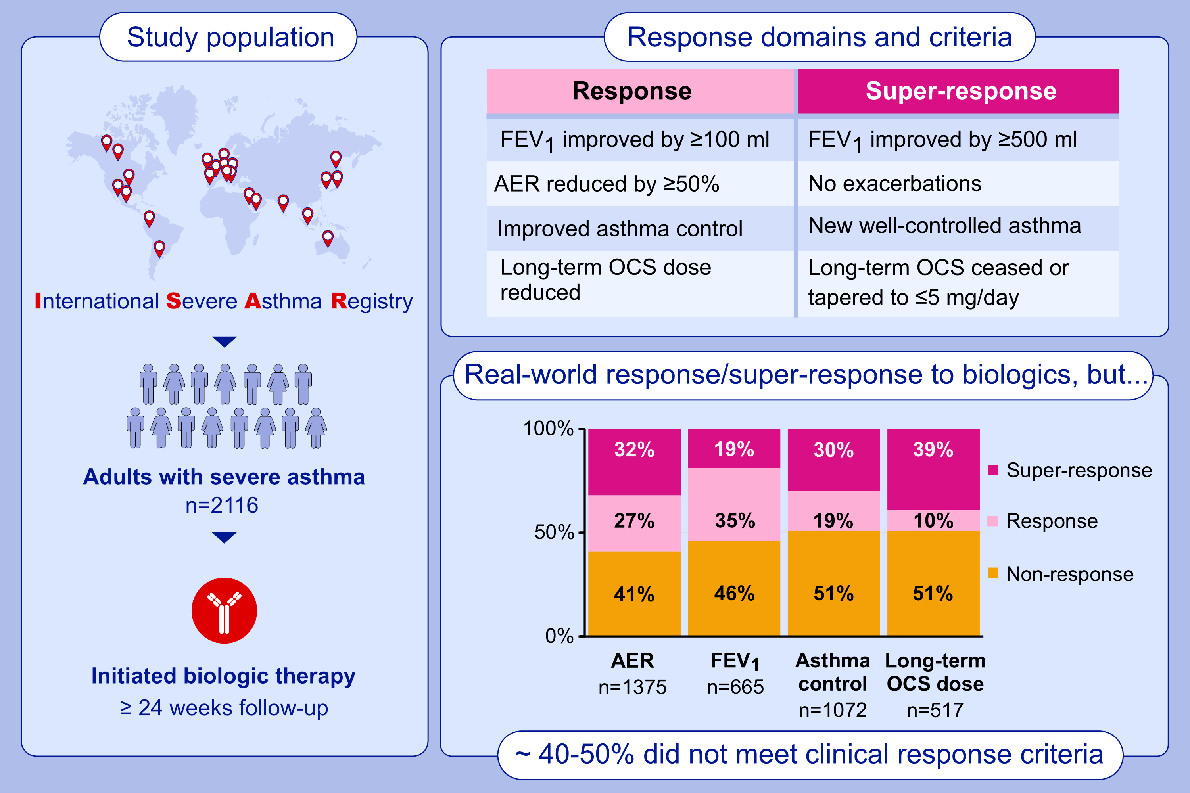
Real-world biologics response and super-response in the International Severe Asthma Registry cohort
Eve Denton, Mark Hew, Matthew J. Peters, John W. Upham, Lakmini Bulathsinhala, et al.
Allergy. 2024; pages: 2700-2716
https://doi.org/10.1111/all.16178
© 2019 EAACI and John Wiley and Sons A/S. Published by John Wiley and Sons Ltd.
Notes:
HIGHLIGHTS
• Data on real-world responsiveness to biologic asthma therapies are lacking.
• Only ~5% of International Severe Asthma Registry (ISAR) patients met biologic randomized controlled trial eligibility criteria.
• Compared with ISAR non-biologic users, biologic initiators had more frequent responses/super-responses (lower exacerbation rate, improved lung function and asthma control, and diminished oral corticosteroids use); nevertheless, 40-50% did not meet clinical response criteria.
.

