Slide 1
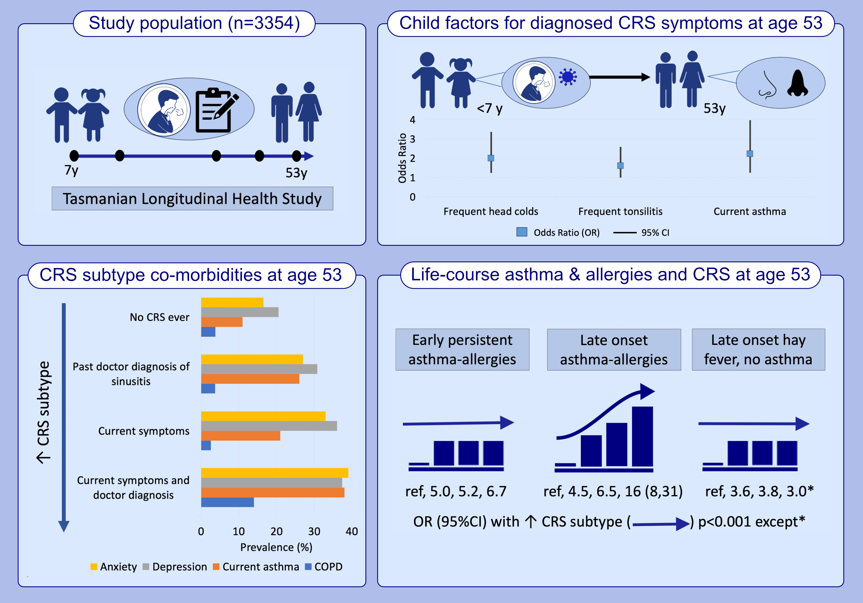
Childhood infections, asthma and allergy trajectories, and chronic rhinosinusitis in middle age: A prospective cohort study across six decades
Jennifer L. Perret, N. Sabrina Idrose, E. Haydn Walters, Dinh S. Bui, Adrian J. Lowe, et al.
Allergy. 2024.Pages: 2717-2731
https://doi.org/10.1111/all.16184
© 2019 EAACI and John Wiley and Sons A/S. Published by John Wiley and Sons Ltd.
Notes:
HIGHLIGHTS
• In this epidemiological study, mid-life CRS was a symptom-based definition that was linked to lower airways disease (atopic asthma, worse asthma severity, COPD) and poorer mental health.
• Childhood upper airway infections (frequent head colds and tonsillitis) were linked to symptomatic doctor-diagnosed CRS in middle-age.
• Late onset allergic asthma was strongly associated with symptomatic doctor-diagnosed CRS in middle-age. .

