Slide 1
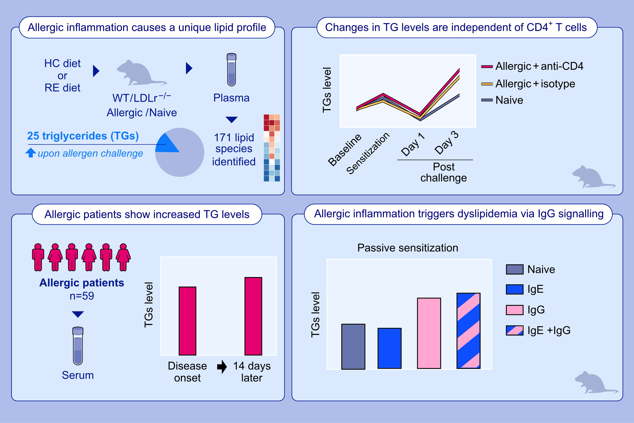
Allergic inflammation triggers dyslipidemia via IgG signalling
Nieves Fernández-Gallego, Raquel Castillo-González, Lucía Moreno-Serna, Antonio J. García-Cívico, Elisa Sánchez-Martínez, et al.
Allergy. 2024.Pages:2680-2699
https://doi.org/10.1111/all.16187
© 2019 EAACI and John Wiley and Sons A/S. Published by John Wiley and Sons Ltd.
Notes:
HIGHLIGHTS
• Allergic inflammation induces a unique lipid signature in circulation that is characterized by triglyceride changes.
• Blood changes in triglyceride levels and composition during allergic inflammation are driven by IgG signalling.
• IgG-mediated allergic inflammation regulates lipid metabolism, which may contribute to atherosclerosis and, ultimately, to cardiovascular events.
.

