Slide 1
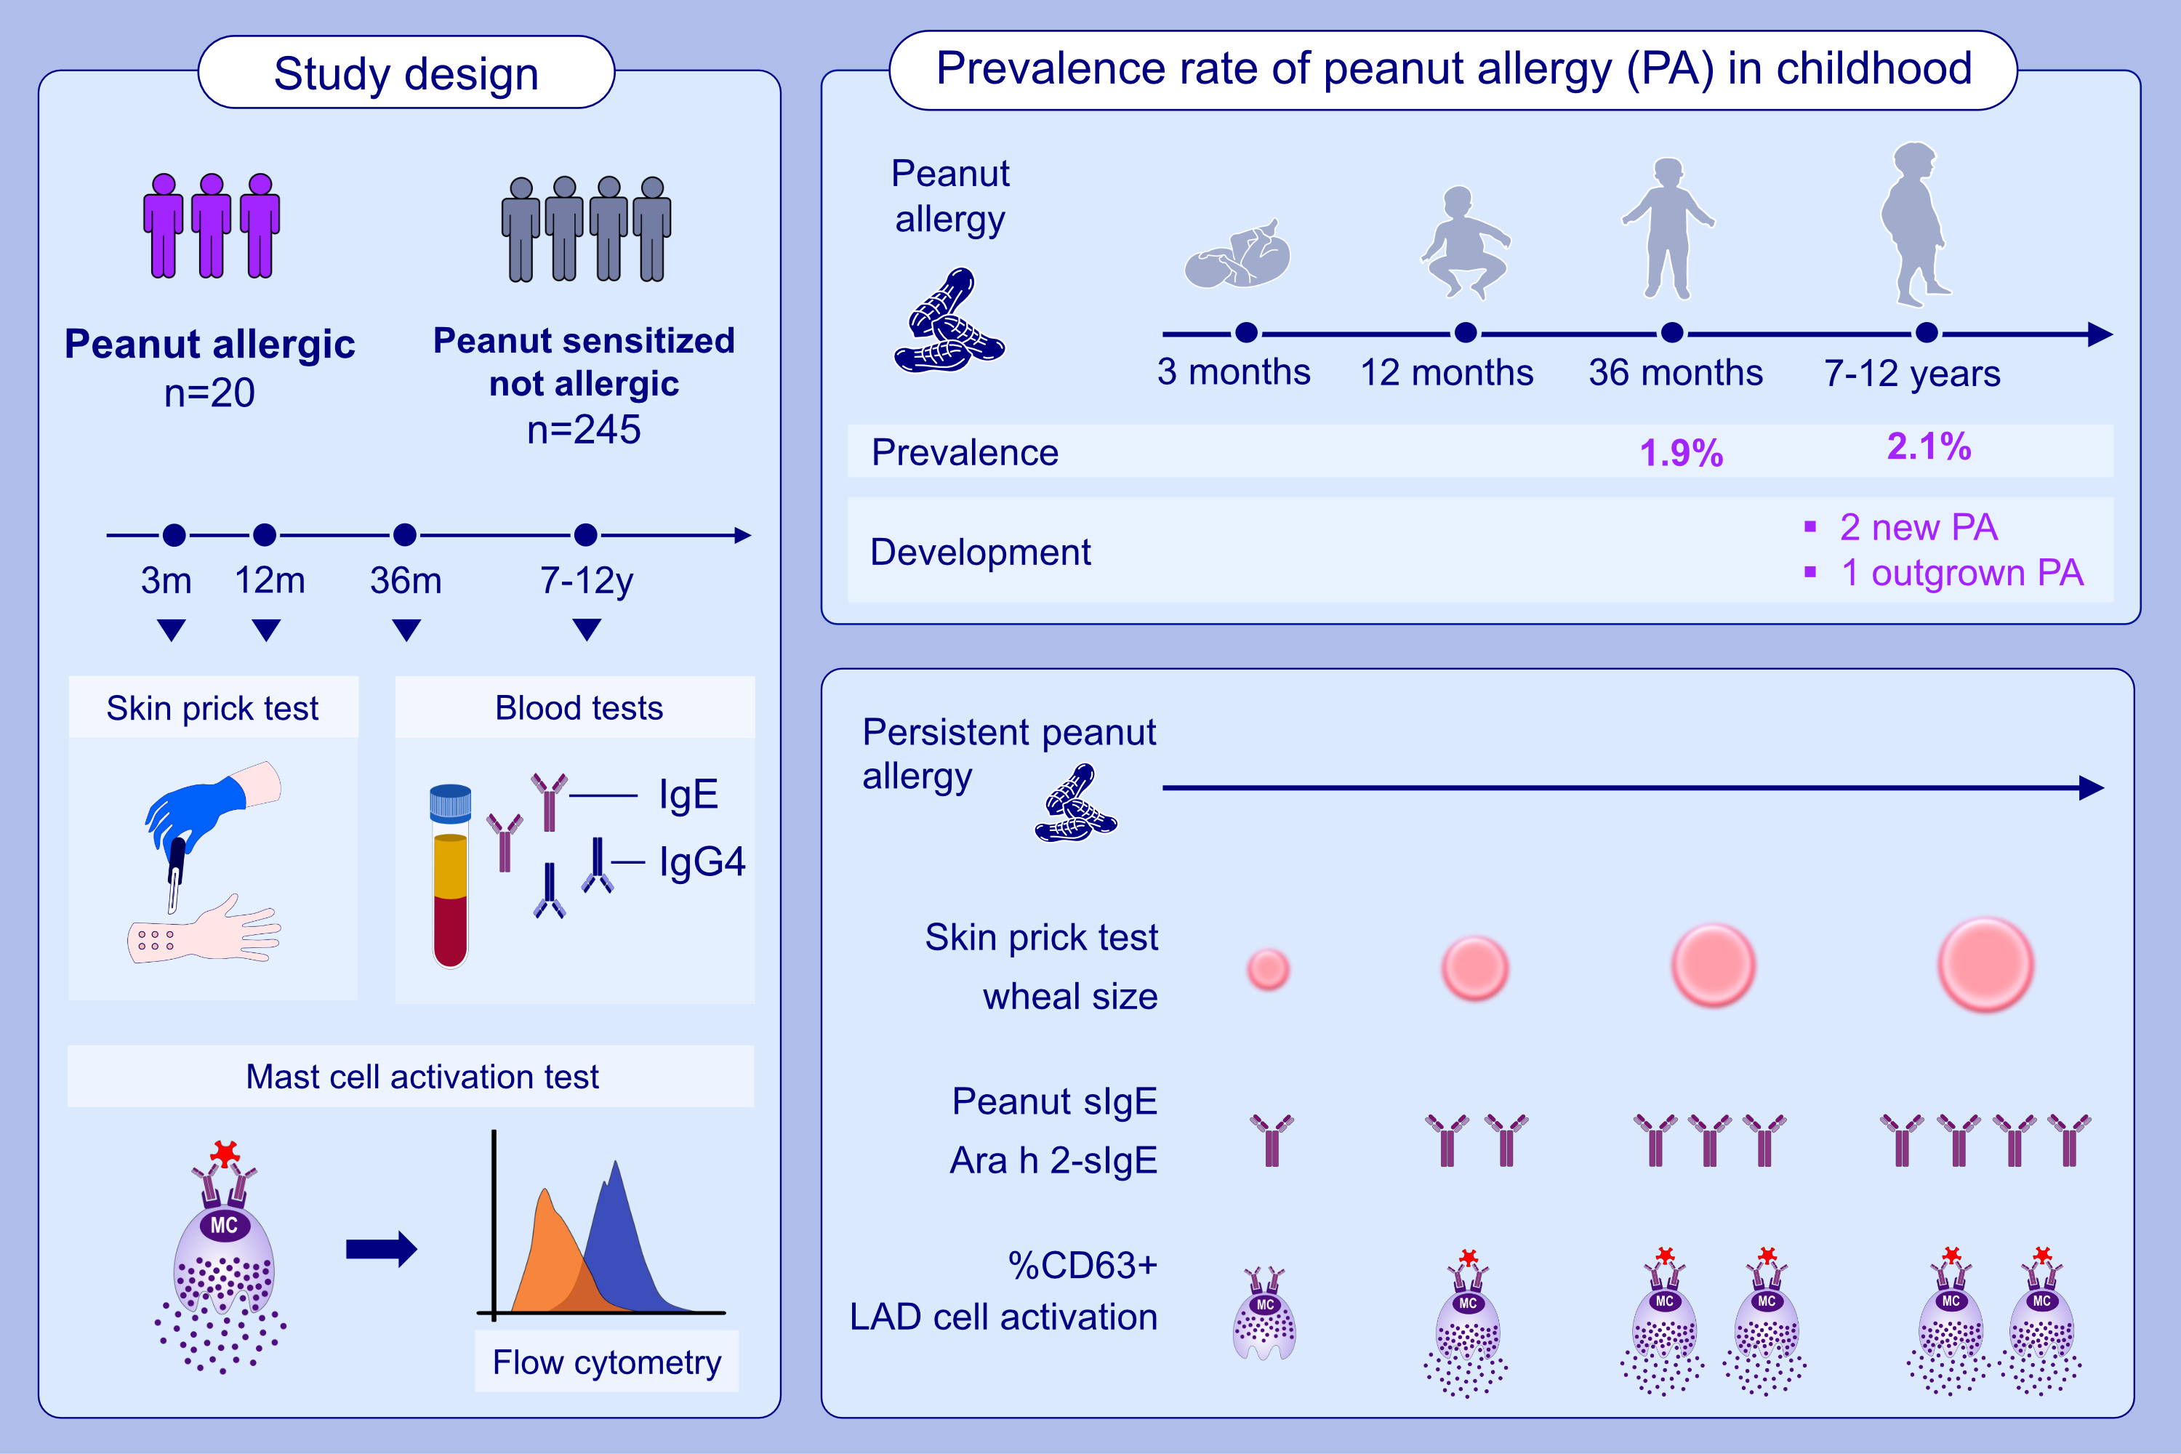
Biomarkers of peanut allergy in children over time
Ru-Xin Foong, George Du Toit, Ronald van Ree, Henry T. Bahnson, Suzana Radulovic, et al.
Allergy. 2024. Pages:2775-2786
https://doi.org/10.1111/all.16193
© 2019 EAACI and John Wiley and Sons A/S. Published by John Wiley and Sons Ltd.
Notes:
HIGHLIGHTS
• Peanut allergy (PA) remains relatively stable in late childhood (7-12-years of age) with few children developing new PA or outgrowing PA.
• We aimed to observe changes in PA resolution and persistence over time.
• Children with persistent peanut allergy have raised SPT, peanut-sIgE, Ara h 2-sIgE and %CD63+ LAD2 cell activation evident from infancy that consistently increase over time.
•
.

