Slide 1
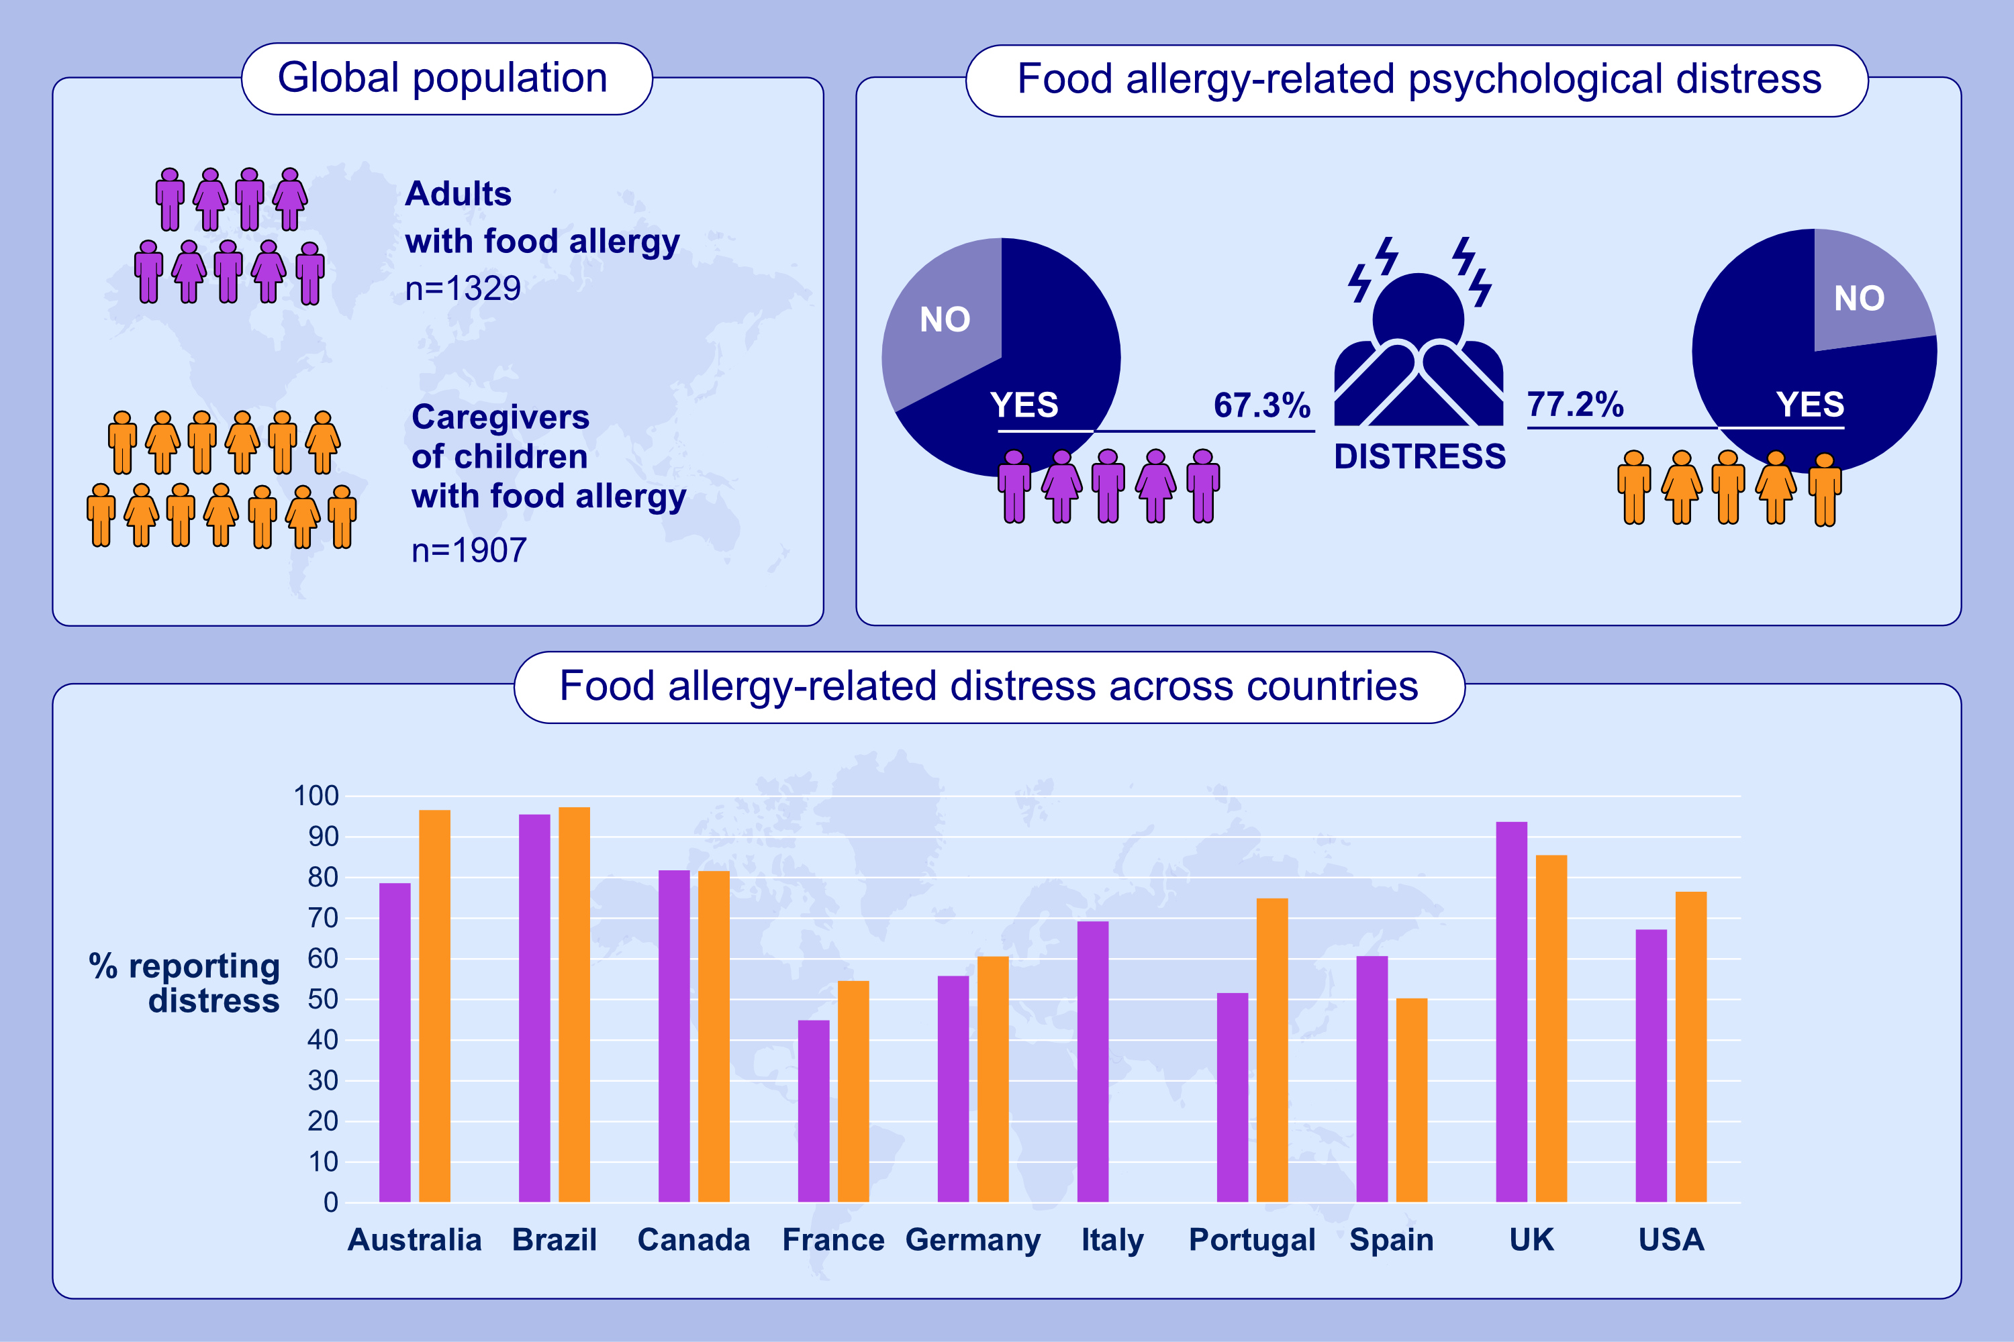
Global availability and uptake of psychological services for adults, caregivers and children with food allergy
R. C. Knibb, L. J. Herbert, C. J. Jones, J. L. P. Protudjer, C. Screti, et al.
Allergy. 2024.Pages:2787-2797
https://doi.org/10.1111/all.16204
© 2019 EAACI and John Wiley and Sons A/S. Published by John Wiley and Sons Ltd.
Notes:
HIGHLIGHTS
• A global survey was completed by 1329 adults and 1907 caregivers of children with food allergy.
• Approximately two-thirds of adults and three-quarters of caregivers reported food allergy-related psychological distress.
• Distress was significantly variable across countries.
• Australia, Brazil, Canada and the UK had the highest numbers of people reporting distress.

