Slide 1
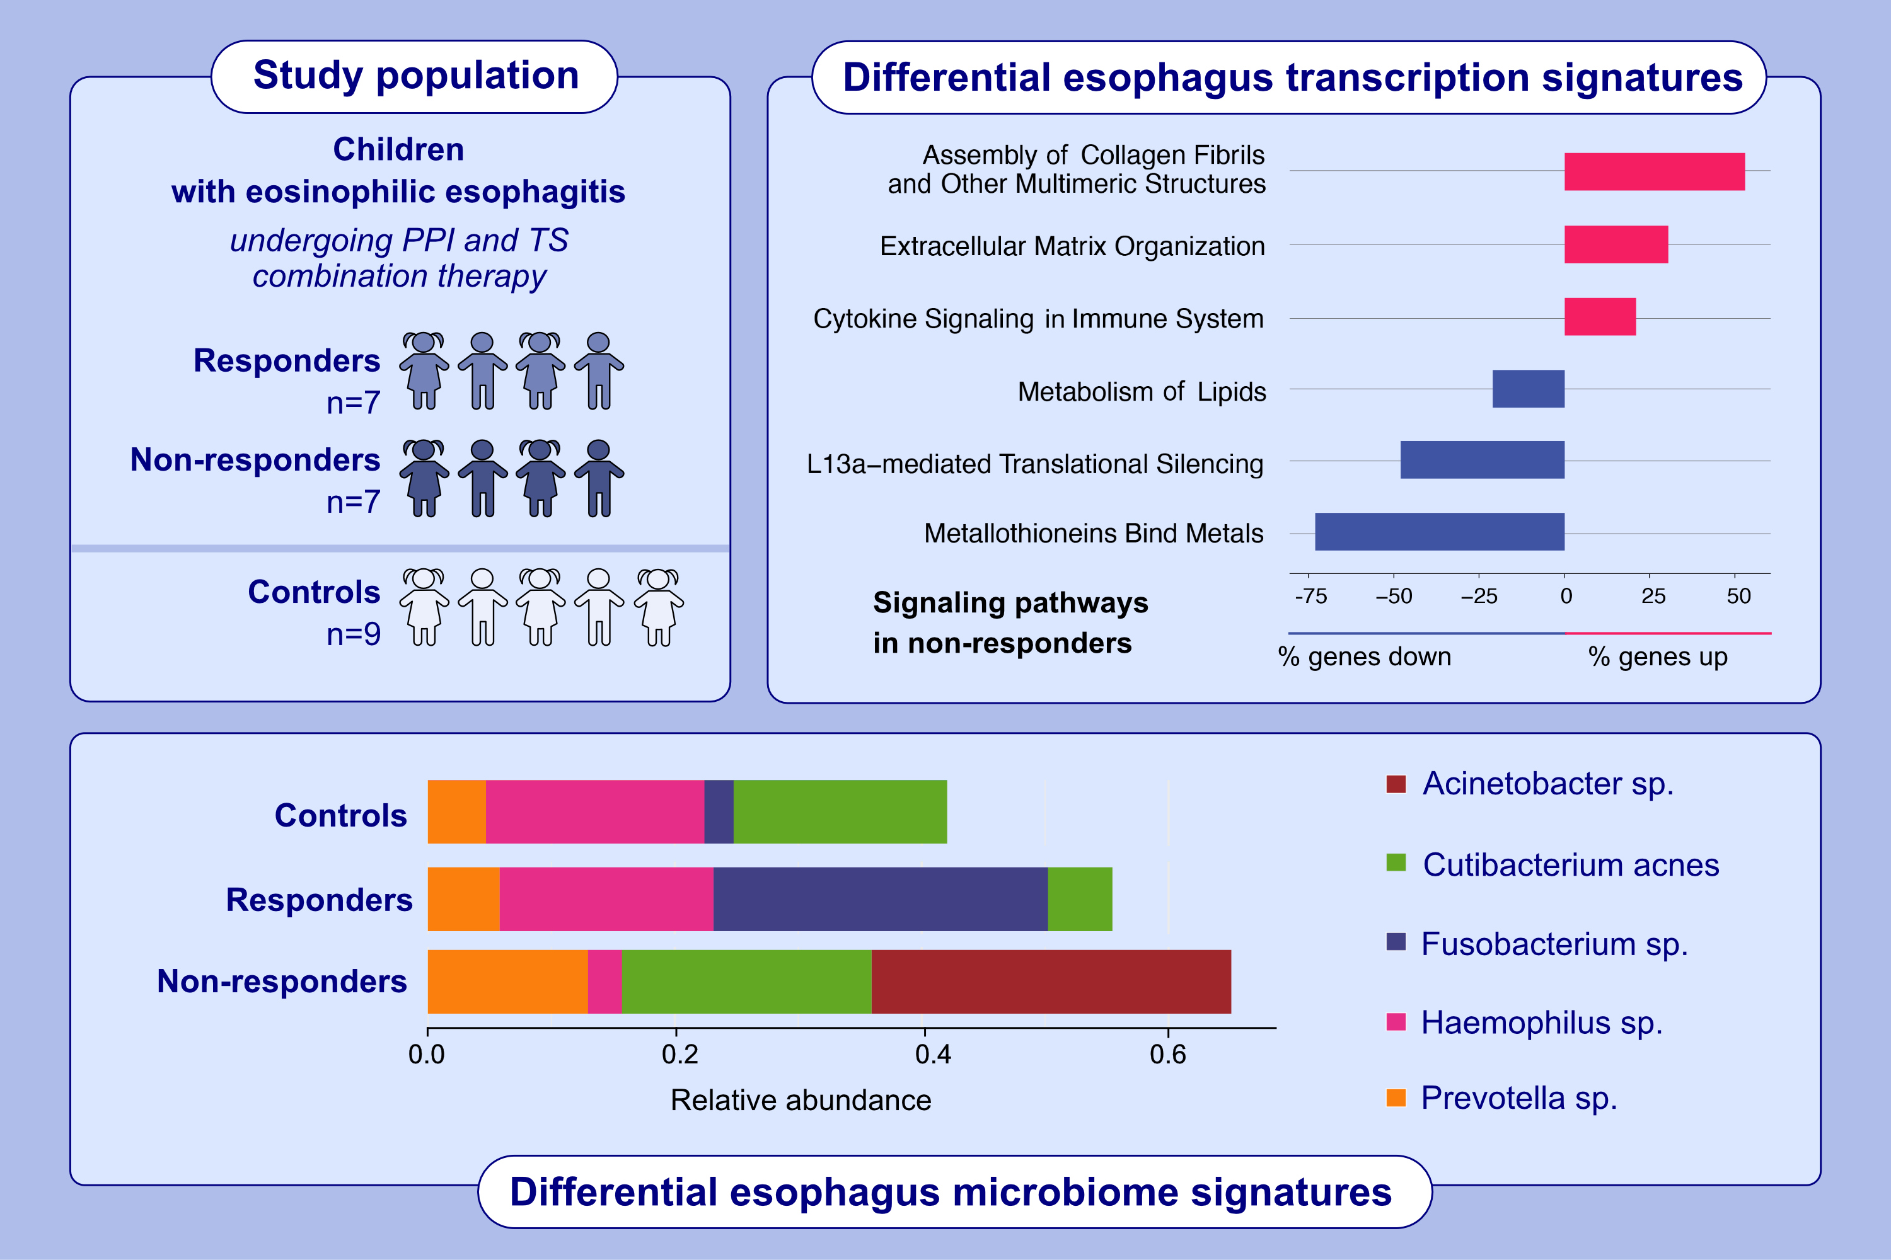
Children with eosinophilic esophagitis non-responsive to combination therapy have distinct esophageal transcriptomic and microbiome profile
Girish Hiremath, Yash Choksi, Hernan Correa, Justin Jacobse, Suman R. Das, et al.
Allergy. 2024,Pages:2798-2811
https://doi.org/10.1111/all.16208
© 2019 EAACI and John Wiley and Sons A/S. Published by John Wiley and Sons Ltd.
Notes:
HIGHLIGHTS
• This study aimed to identify the esophageal transcriptional, cell composition, and microbial differences between the non-responders and responders to the combination therapy for EoE and controls using metatranscriptomics.
• In children with eosinophilic esophagitis and on a combination of proton-pump inhibitors and topical steroids therapy, non-responders show upregulation of cytokine signaling, assembly of collagen fibrils, and extracellular matrix organization, along with downregulation of the L13a-mediated translational silencing and metallothionein pathways.
• Additionally, there are distinct esophageal microbiome signatures that appear to be linked to the differential transcription signatures. .

