Slide 1
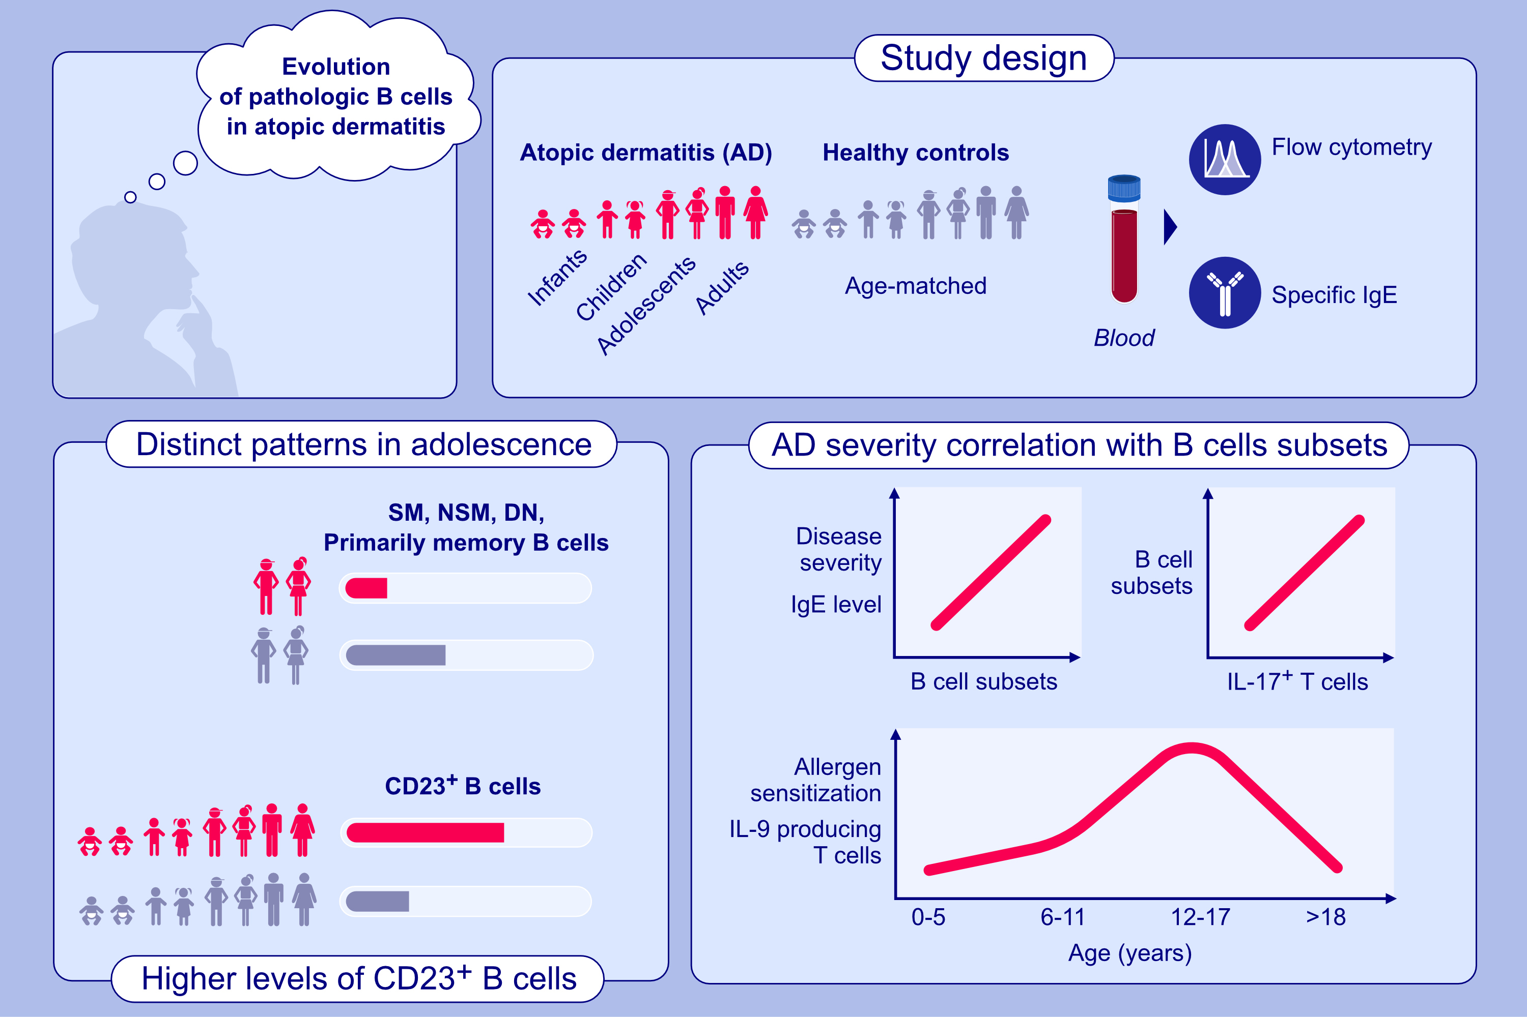
Evolution of pathologic B-cell subsets and serum environment-specific sIgEs in patients with atopic dermatitis and controls, from infancy to adulthood
Tali Czarnowicki, Eden David, Kazuhiko Yamamura, Joseph Han, Helen He, et al.
Allergy. 2024. Pages: 2732-2747
https://doi.org/10.1111/all.16225
© 2019 EAACI and John Wiley and Sons A/S. Published by John Wiley and Sons Ltd.
Notes:
HIGHLIGHTS
• We aimed to profile the development of B cell subsets in healthy and AD subjects from infancy through adulthood.
• Overall, AD patients show differences compared to healthy subjects, with some distinct patterns in AD adolescents.
• Multiple correlations with B-cell subsets were observed in AD.
• IL-9 levels and allergen sensitization peaked in adolescence, suggesting a wider window of opportunity to prevent atopic march progression.
.

