Slide 1
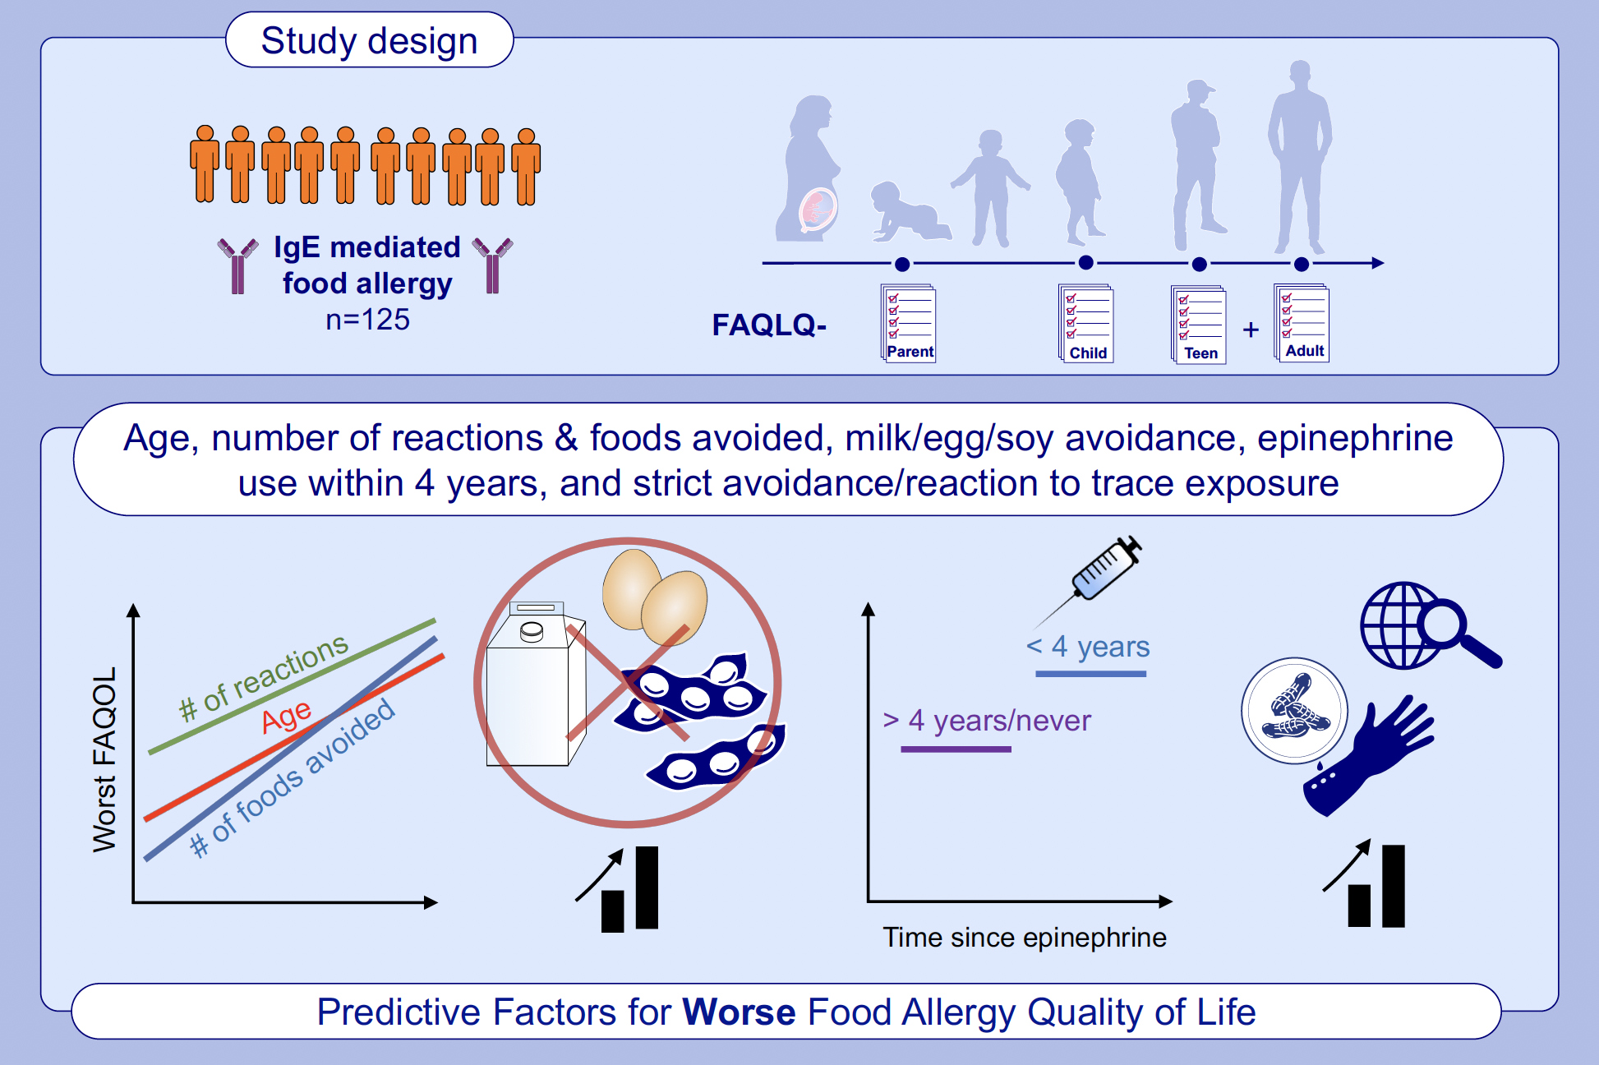
Key factors that influence quality of life in patients with IgE-mediated food allergy vary by age
Stephanie A. Kubala, Fernanda D. Young, Viviane Callier, Marjohn M. Rasooly, Caeden Dempsey, et al.
Allergy. 2024. Pages:2812-2825
https://doi.org/10.1111/all.16253
© 2019 EAACI and John Wiley and Sons A/S. Published by John Wiley and Sons Ltd.
Notes:
HIGHLIGHTS
• 125 food allergic subjects filled out age-specific FAQLQ.
• Age, timing, type, and number of reactions, type and number of food allergies, and food avoidance practices are key factors that affect FAQOL.
• Critical factors impacting FAQOL change at different ages and can be used to guide strategies for improving psychosocial health.
•
.

