Slide 1
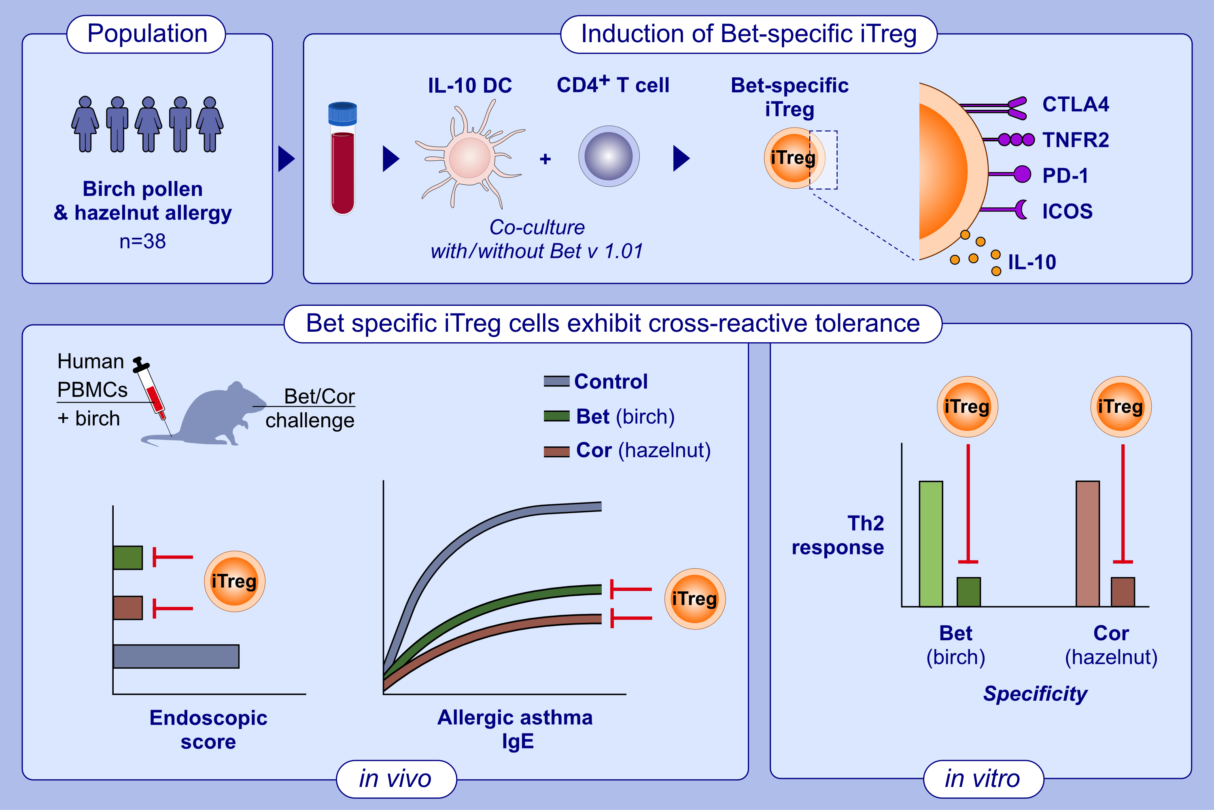
IL-10-modulated dendritic cells from birch pollen- and hazelnut-allergic patients facilitate Treg-mediated allergen-specific and cross-reactive tolerance
Patricia Vanessa Heinl, Edith Graulich, Benno Weigmann, Andrea Wangorsch, Robert Ose, et al.
Allergy. 2024.Pages: 2826-2839
https://doi.org/10.1111/all.16255
© 2019 EAACI and John Wiley and Sons A/S. Published by John Wiley and Sons Ltd.
Notes:
HIGHLIGHTS
• The vast majority of individuals allergic to birch pollen (Bet) develop a secondary food allergy (e.g.
• hazelnut allergen, Cor).
• IL-10 DC induced Bet-specific iTreg exhibit an activated phenotype, thereby suppressing Bet- and Cor-induced responder TH2 cell responses in vitro and in a humanized mouse model of allergic airway and intestinal inflammation in vivo, indicating induction of both allergen-specific (birch) and cross-reactive tolerance (hazelnut).
• .

