Slide 1
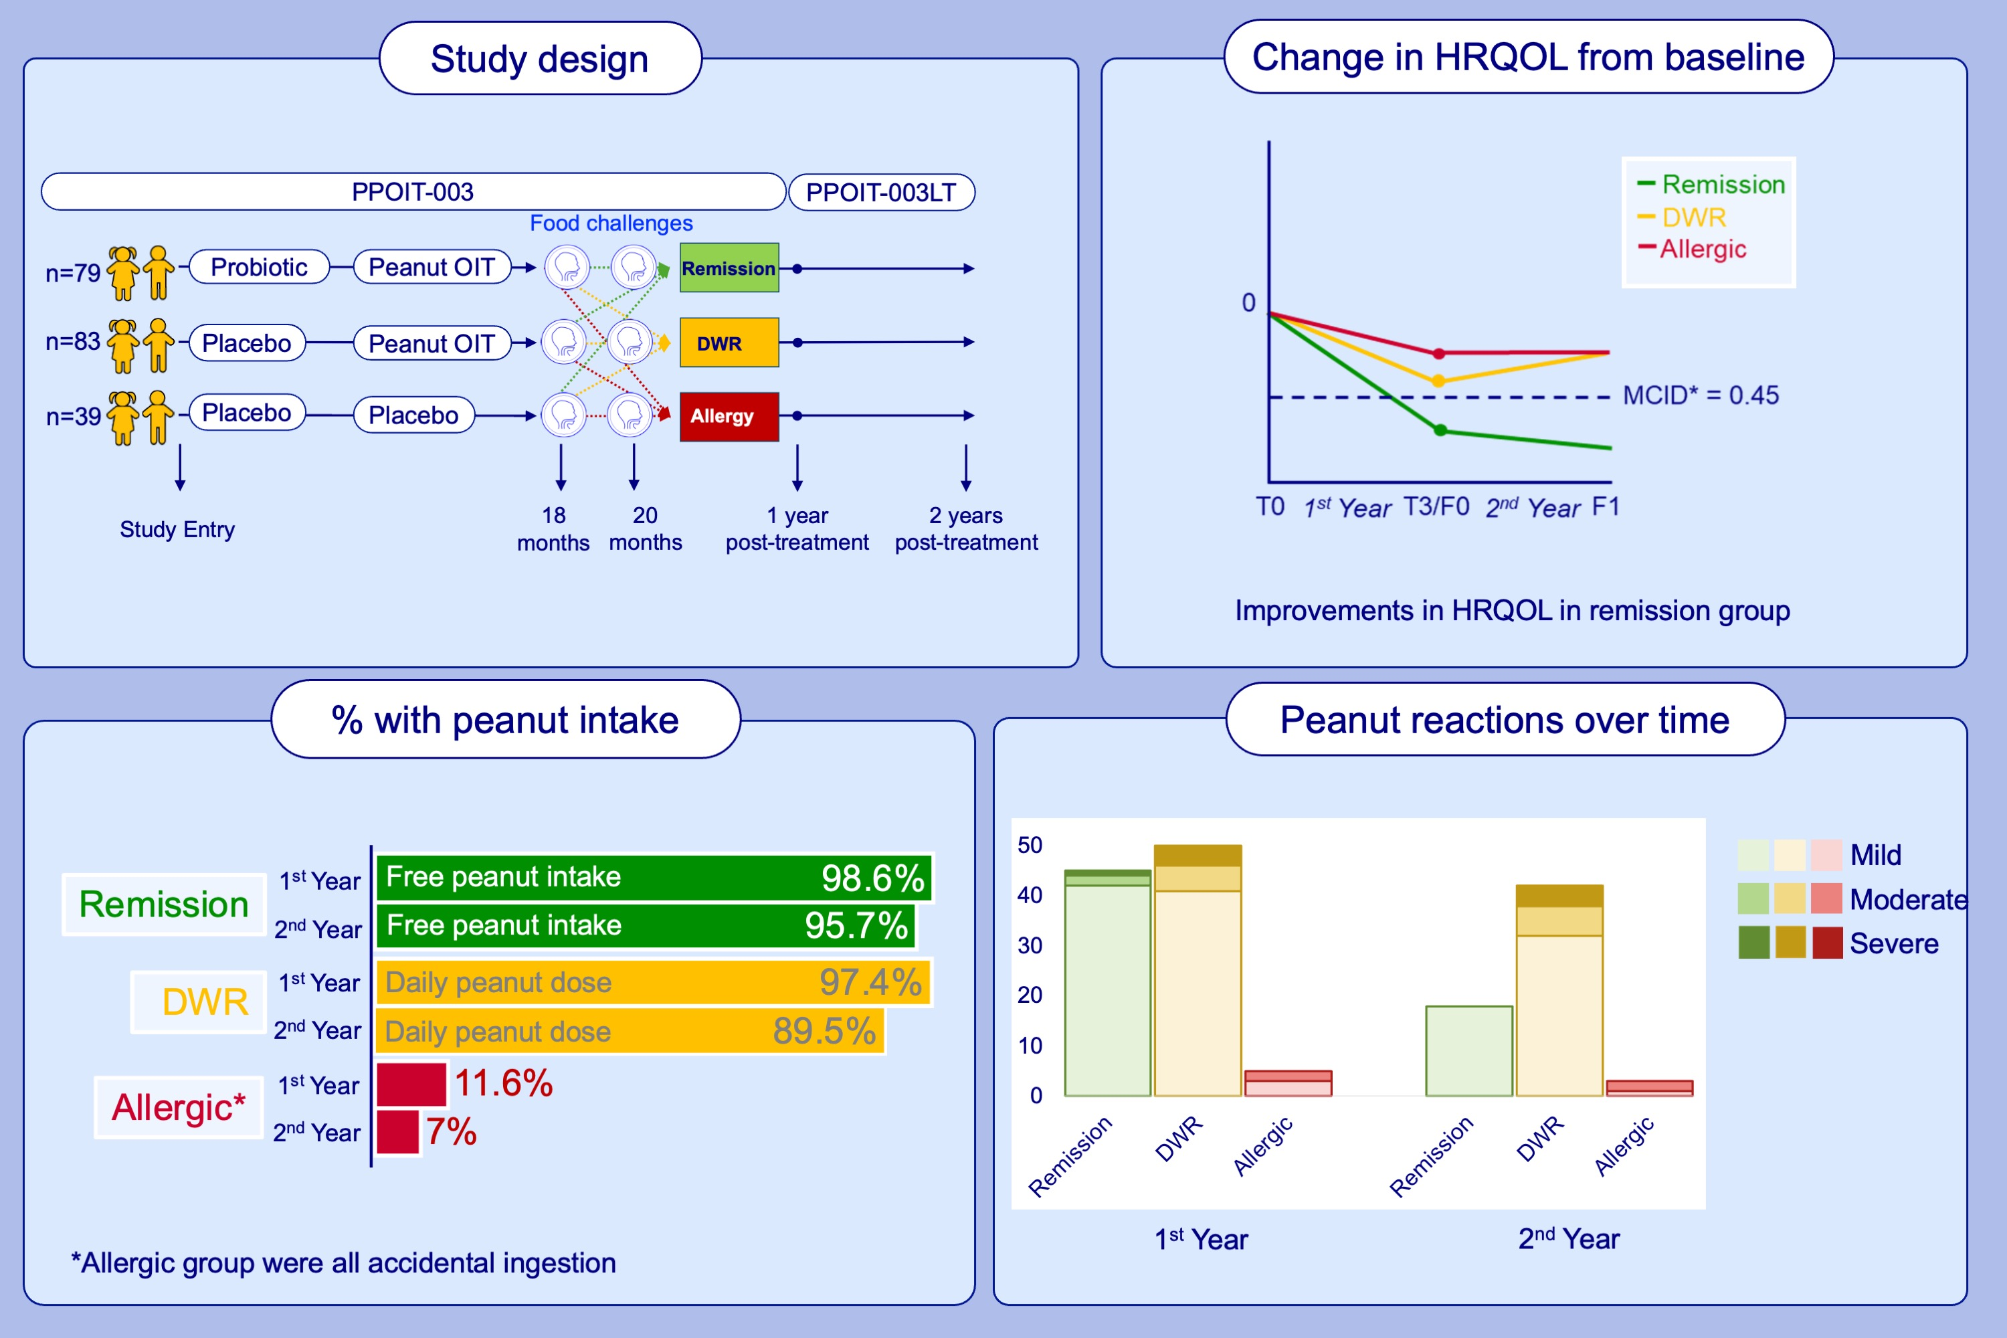
Two-year post-treatment outcomes following peanut oral immunotherapy in the Probiotic and Peanut Oral Immunotherapy-003 Long-Term (PPOIT-003LT) study
Paxton Loke, Xiaofang Wang, Melanie Lloyd, Sarah E. Ashley, Adriana C. Lozinsky, et al.
Allergy. 2024. Pages:2759-2774
https://doi.org/10.1111/all.16262
© 2019 EAACI and John Wiley and Sons A/S. Published by John Wiley and Sons Ltd.
Notes:
HIGHLIGHTS
• 2-years after completing 18-months of peanut OIT, participants with remission experienced fewer and less severe reactions to peanut than those who were desensitized without remission.
• Remission participants had significantly greater improvement in health-related quality of life compared with those who were desensitized without remission and those who remained allergic.
• Remission is the patient-preferred treatment outcome over desensitization or remaining allergic. .

