Slide 1
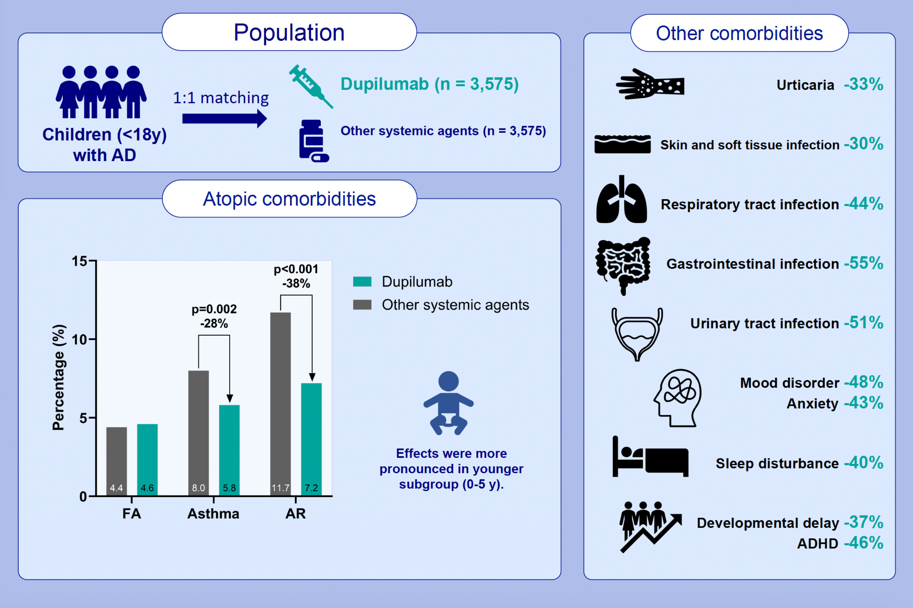
Evaluation of dupilumab on the disease burden in children and adolescents with atopic dermatitis: A population-based cohort study
Serena Yun-Chen Tsai, Jonathan M. Gaffin, Elena B. Hawryluk, Hana B. Ruran, Lisa M. Bartnikas, et al.
Allergy. 2024. Pages:2748-2758
https://doi.org/10.1111/all.16265
© 2019 EAACI and John Wiley and Sons A/S. Published by John Wiley and Sons Ltd.
Notes:
HIGHLIGHTS
• This emulated clinical trial included 7150 pediatric patients with AD evaluated the impact of dupilumab on the occurrence of comorbidities.
• Pediatric patients with AD, treated with dupilumab versus other systemic agents (azathioprine, cyclosporine, methotrexate, mycophenolate mofetil, or systemic corticosteroids) demonstrated a lower risk of atopic comorbidities, including asthma and allergic rhinitis as well as other AD-related comorbidities such as infections, psychiatric, neurologic, and developmental disorders.
• Patients of younger ages (0-5 years) experienced greater benefits of the treatment.
.

