Slide 1
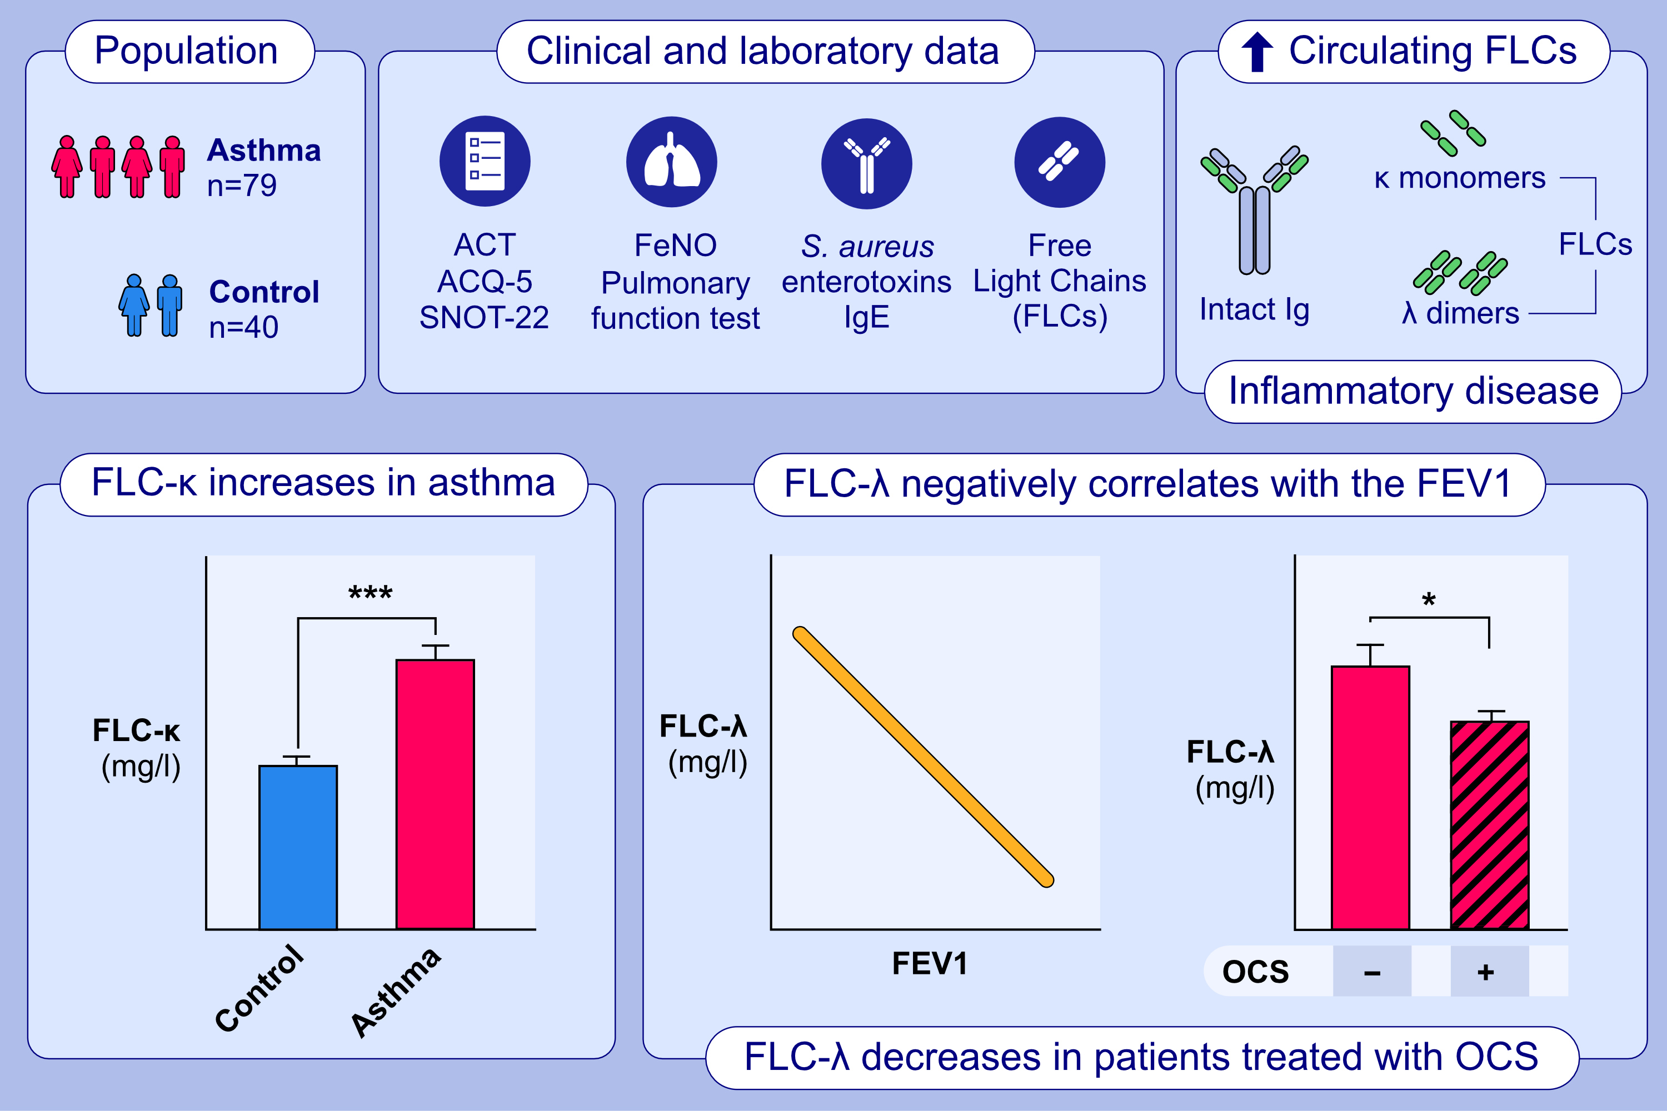
Immunoglobulin free light chains in severe asthma patient: Could they be a new biomarker?
C. Caruso, G. Ciasca, I. Baglivo, R. Di Santo, A. Gasbarrini, et al.
Allergy. 2024; pages:2414-2422 https://doi.org/10.1111/all.16082
© 2019 EAACI and John Wiley and Sons A/S. Published by John Wiley and Sons Ltd.
Notes:
HIGHLIGHTS
• This study aimed to describe clinical and laboratory characteristics of a population of patients with asthma and to investigate the potential role of FLCs as quantitative and objective serum biomarkers.
• FLC-k levels were significantly increased in the asthmatic population, compared to the control group.
• FLC-λ levels displayed a significant negative correlation with the FEV1 value and were significantly decreased in patients treated with OCS.
.

