Slide 1
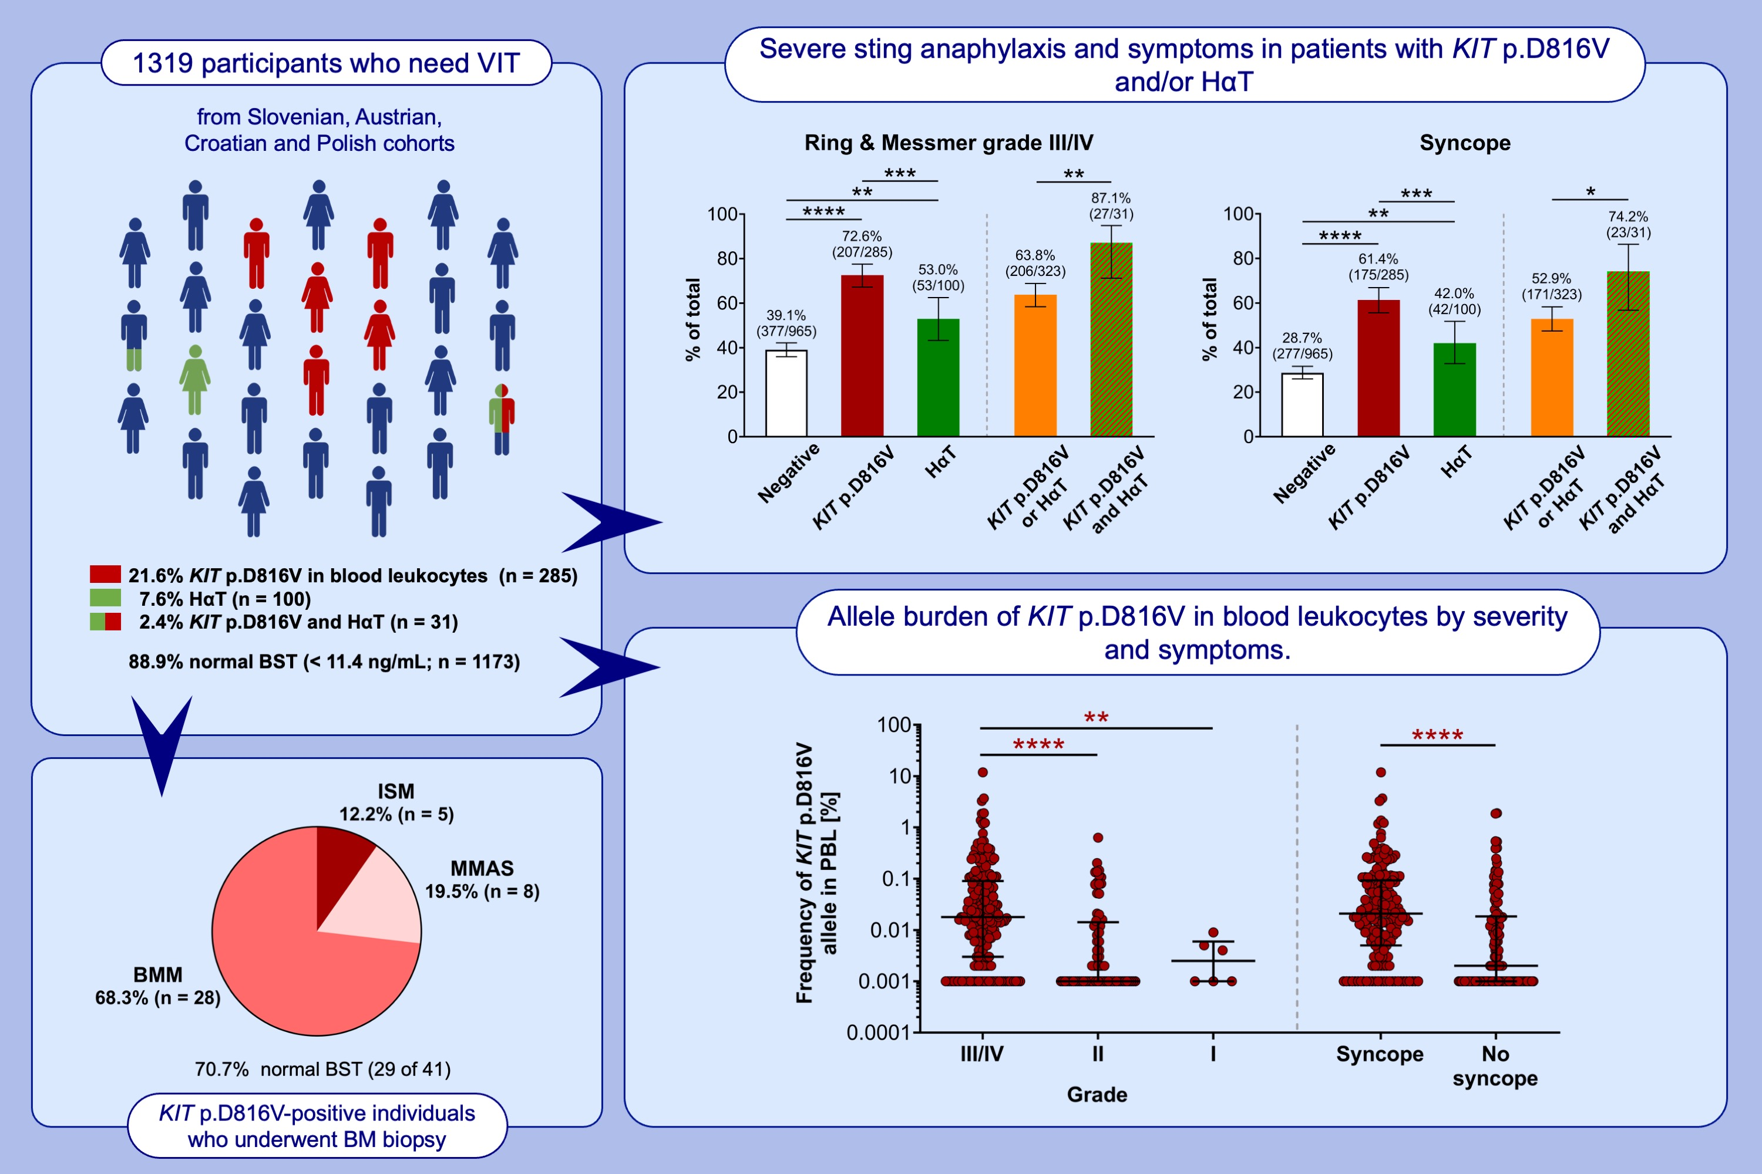
High burden of clonal mast cell disorders and hereditary α-tryptasemia in patients who need Hymenoptera venom immunotherapy
Peter Korošec, Gunter J. Sturm, Jonathan J. Lyons, Tinkara Pirc Marolt, Manca Svetina, et al.
Allergy. 2024; pages:2458-2469 https://doi.org/10.1111/all.16084
© 2019 EAACI and John Wiley and Sons A/S. Published by John Wiley and Sons Ltd.
Notes:
HIGHLIGHTS
• In this multicenter study, we have demonstrated that clonal mast cell disease and HαT are more prevalent among individuals who need VIT; one or both was found in 27% of individuals overall.
• Both diagnoses were highly concentrated among individuals with severe anaphylaxis.
• Higher KIT p.D816V allelic burden was associated with more severe reactions.
• .

