Slide 1
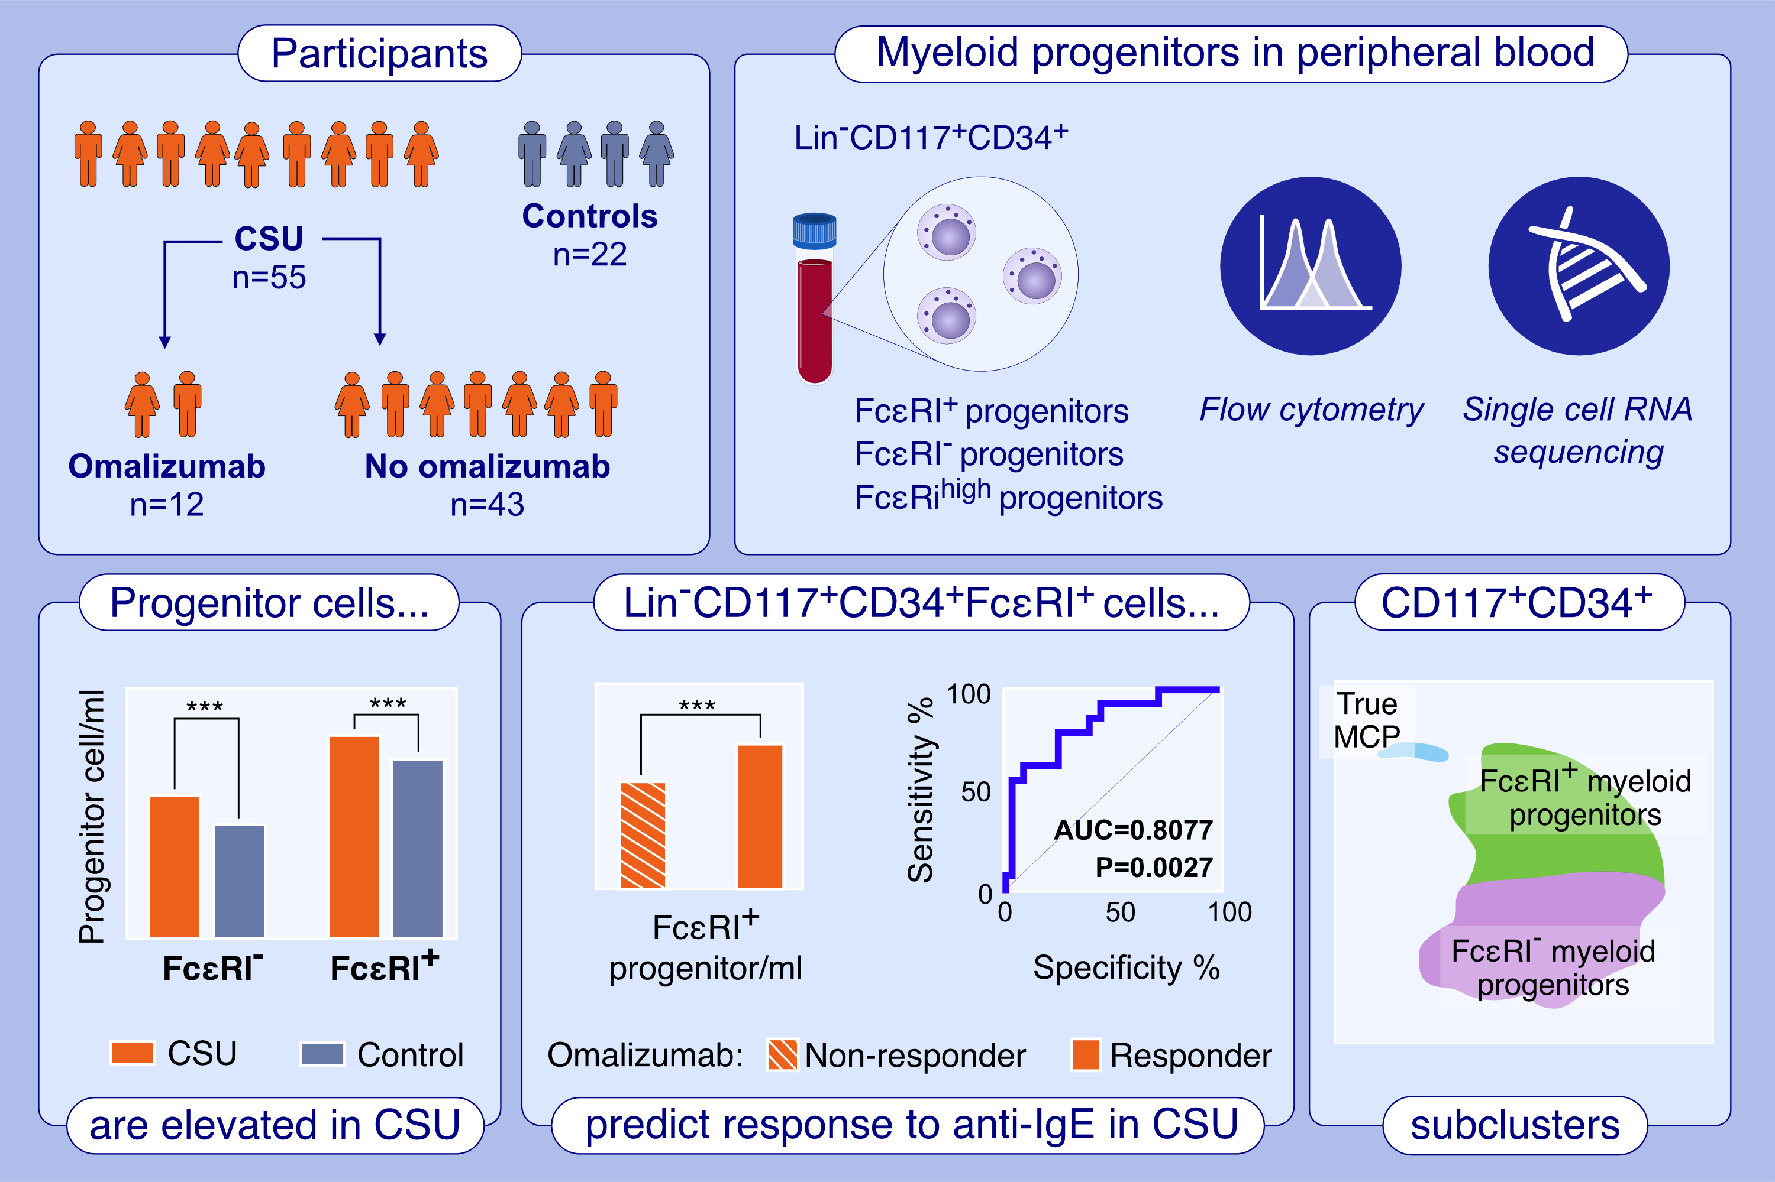
Lin−CD117+CD34+FcεRI+ progenitor cells are increased in chronic spontaneous urticaria and predict clinical responsiveness to anti-IgE therapy
Katie Ridge, Barry Moran, P. Abigail Alvarado-Vazquez, Jenny Hallgren, Mark A. Little, et al.
Allergy. 2024; pages:2423-2434 https://doi.org/10.1111/all.16127
© 2019 EAACI and John Wiley and Sons A/S. Published by John Wiley and Sons Ltd.
Notes:
HIGHLIGHTS
• Patients with chronic spontaneous urticaria (CSU) have higher numbers of CD117+ CD34+FcRI+ progenitors in peripheral blood.
• Higher numbers of CD117+CD34+FcRI+ progenitors are associated with a more rapid response to anti-IgE therapy in CSU patients.
• Single cell RNA-sequencing shows the CD117+CD34+ cells contain mast cell precursors but also related immature FcRI- and FcRI+ progenitors. .

