Slide 1
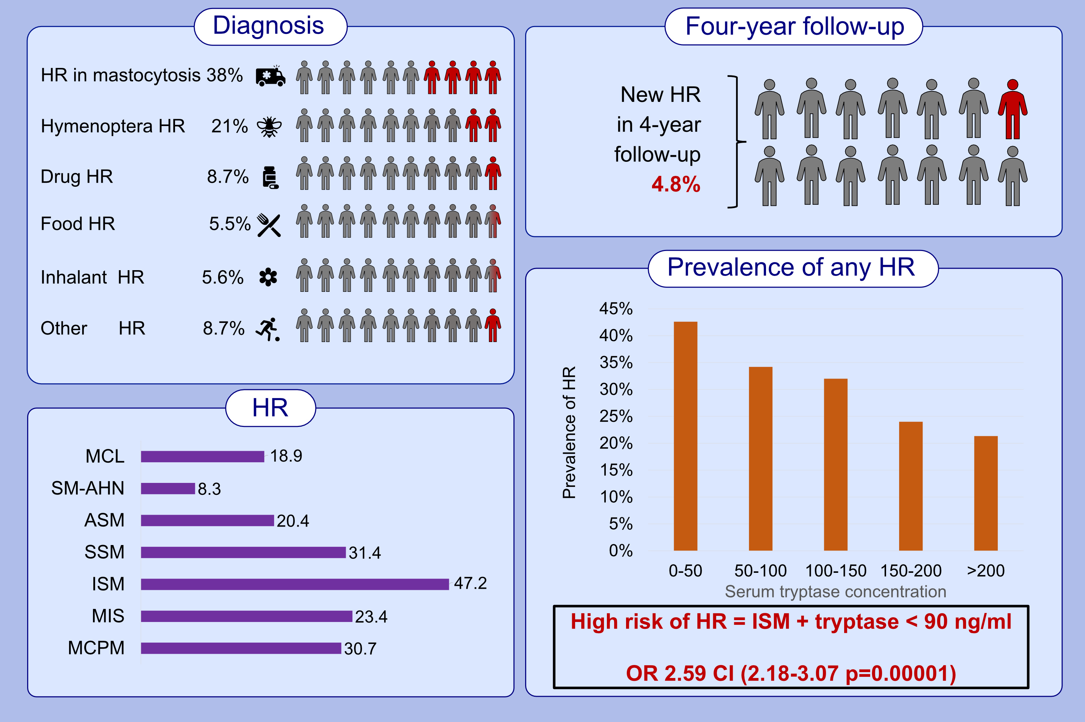
Prevalence of hypersensitivity reactions in various forms of mastocytosis: A pilot study of 2485 adult patients with mastocytosis collected in the ECNM registry
Marek Niedoszytko, Aleksandra Gorska, Knut Brockow, Patrizia Bonadonna, Magdalena Lange, et al.
Allergy. 2024; pages:2470-2481
https://doi.org/10.1111/all.16132
© 2019 EAACI and John Wiley and Sons A/S. Published by John Wiley and Sons Ltd.
Notes:
HIGHLIGHTS
• HR are mainly triggered by Hymenoptera venoms in patients with CM and ISM and by drugs in patients with advSM.
• Tryptase levels <90 ng/ml, mast cell bone marrow infiltration <15%, and WHO category ISM are predictors of HR.
• New HR occur in 4.8% of all patients within 4 years. .

