Slide 1
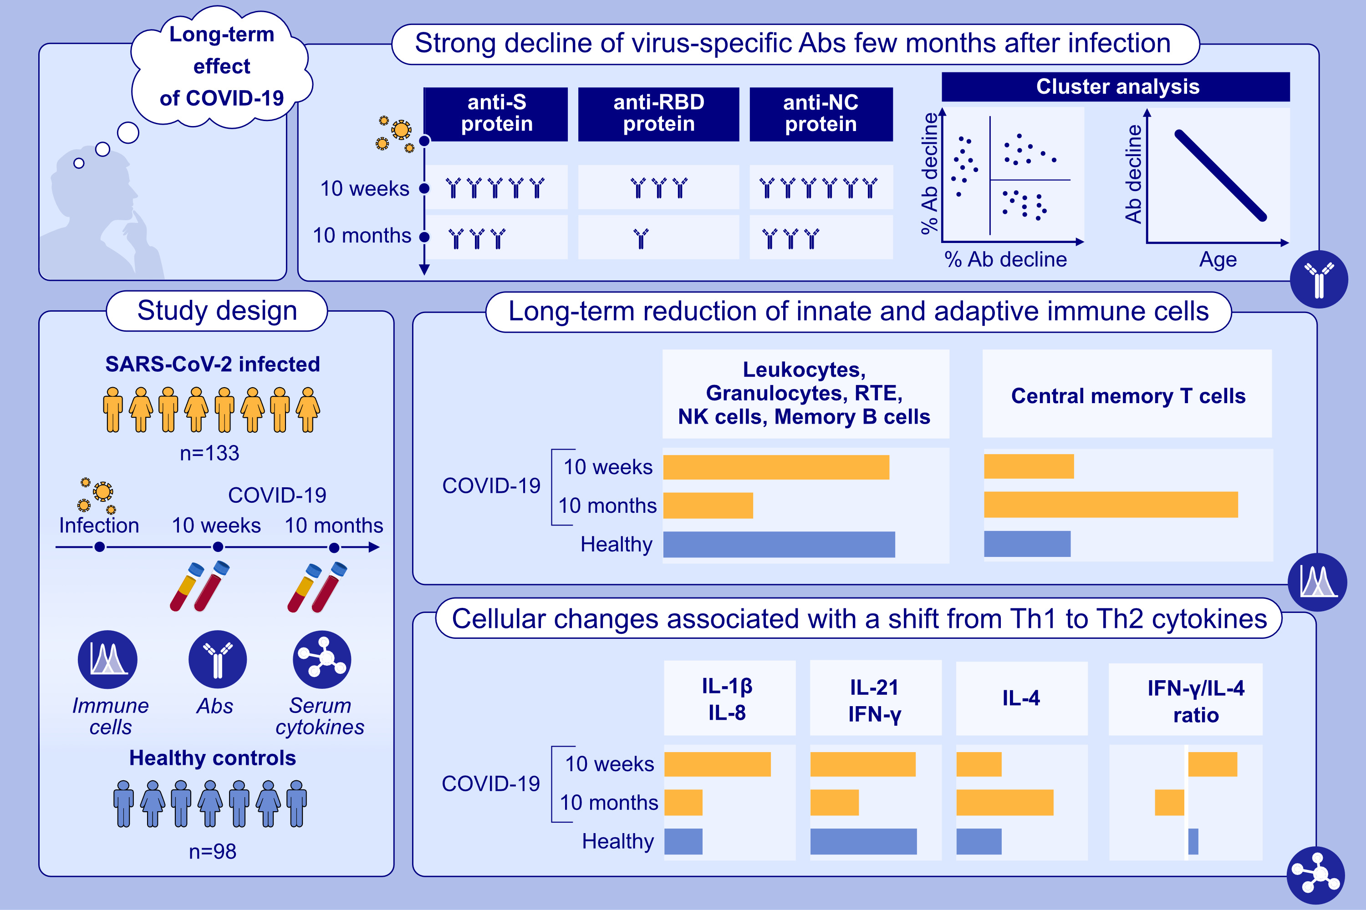
Differential decline of SARS-CoV-2-specific antibody levels, innate and adaptive immune cells, and shift of Th1/inflammatory to Th2 serum cytokine levels long after first COVID-19
Bernhard Kratzer, Pia Gattinger, Doris Trapin, Paul Ettel, Ulrike Körmöczi, et al.
Allergy. 2024; pages:2482-2501
https://doi.org/10.1111/all.16210
© 2019 EAACI and John Wiley and Sons A/S. Published by John Wiley and Sons Ltd.
Notes:
HIGHLIGHTS
• COVID-19 leads to a sustained reduction of immune cells of the myeloid and lymphoid cell lineages even 10 months after the first infection.
• Ten months after the first infection S- and RBD-specific IgG responses declined below the detection limit in almost 18% and in more than 80% in subjects, respectively.
• Anti-NC antibodies remained positive in all subjects 10m after the first infection.
• A shift towards a Th2 cytokine pattern in serum accompanied by an inversion of the IFN-/IL-4-ratio was found between the time point 10 week and 10 months after infection.

