Slide 1
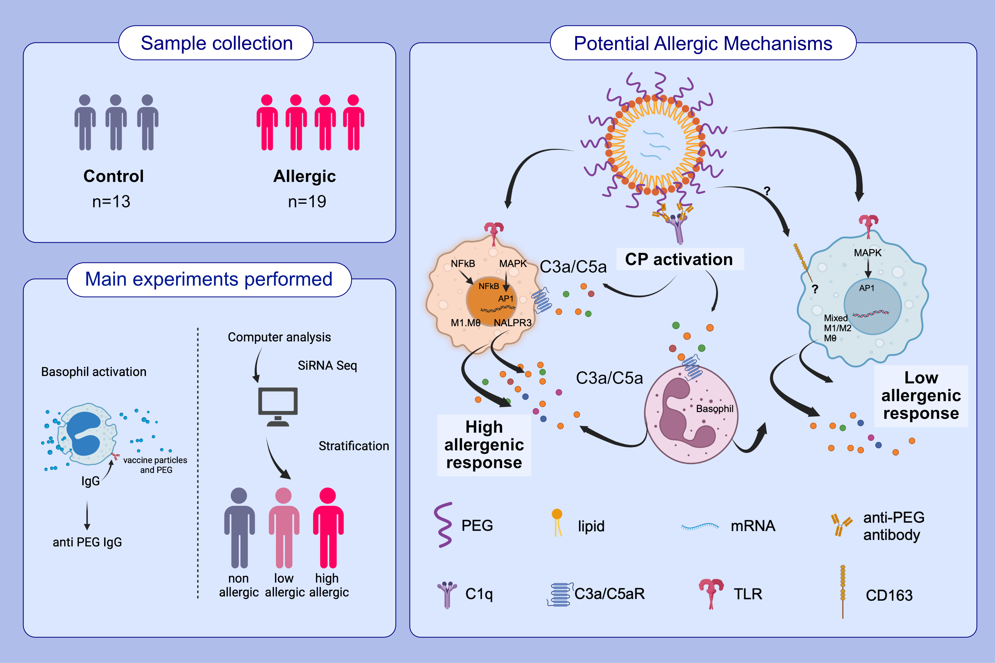
Elucidating allergic reaction mechanisms in response to SARS-CoV-2 mRNA vaccination in adults
Mihir M. Shah, Janice A. Layhadi, Dennis E. Hourcade, William T. Fulton, Tiak Ju Tan, et al.
Allergy. 2024; pages:2502-2523
https://doi.org/10.1111/all.16231
© 2019 EAACI and John Wiley and Sons A/S. Published by John Wiley and Sons Ltd.
Notes:
HIGHLIGHTS
• We analyze some of the mechanisms underlying allergic reactions to COVID-19 mRNA vaccines.
• After performing hemolysis, indirect basophil activation, and single-cell multiome assays, we elucidated certain allergic reaction mechanisms.
• We found anti-PEG IgG correlates with vaccine-mediated complement activation and that epigenetic modulation of mononuclear phagocytes could influence vaccine reaction manifestations.
.

