Slide 1
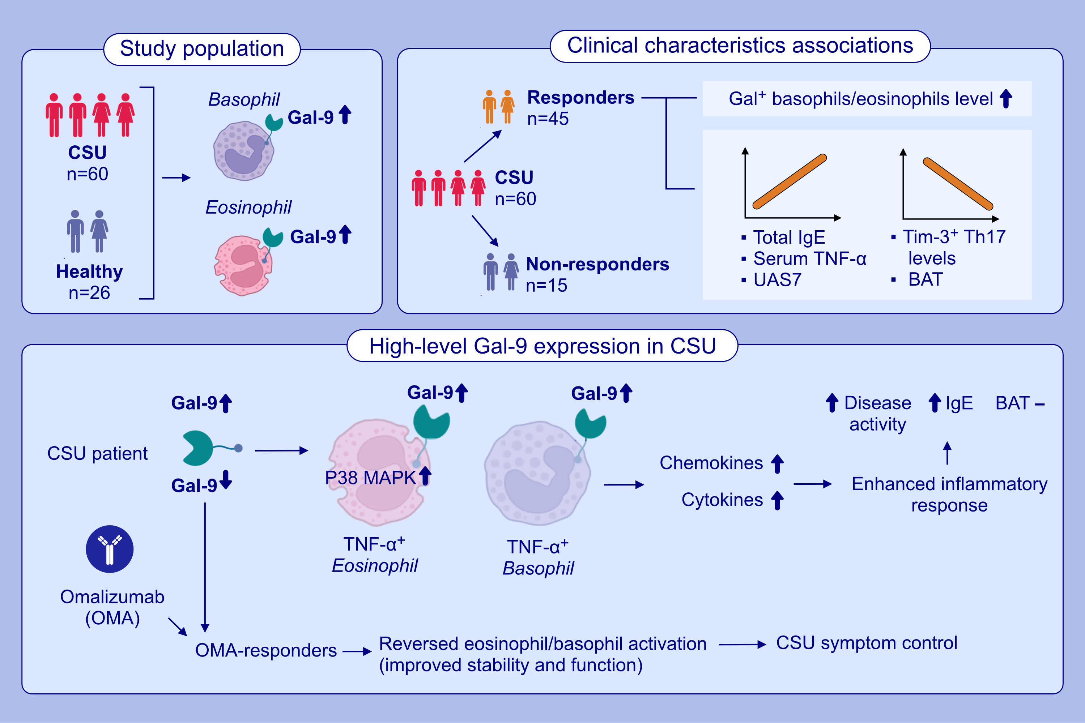
In chronic spontaneous urticaria, increased Galectin-9 expression on basophils and eosinophils is linked to high disease activity, endotype-specific markers, and response to omalizumab treatment
Jiang Ji, Minhui Tang, Yue Zhao, Chuqiao Zhang, Yu Shen, et al.
Allergy. 2024; pages:2435-2447
https://doi.org/10.1111/all.16239
© 2019 EAACI and John Wiley and Sons A/S. Published by John Wiley and Sons Ltd.
Notes:
HIGHLIGHTS
• Increased levels of circulating Gal-9+ eosinophils and Gal-9+ basophils in CSU lined to high disease activity, markers of non-autoimmune CSU, and good response to omalizumab treatment.
• Elevated serum TNF-α levels led to an increase in Gal-9 expression in CSU patients.
• The rates of Gal-9+ eosinophils and basophils were negatively linked to levels of TIM-3+ TH17 cells, suggesting that Gal-9 via TIM-3 protect CSU patients from type IIb autoimmunity. .

