Slide 1
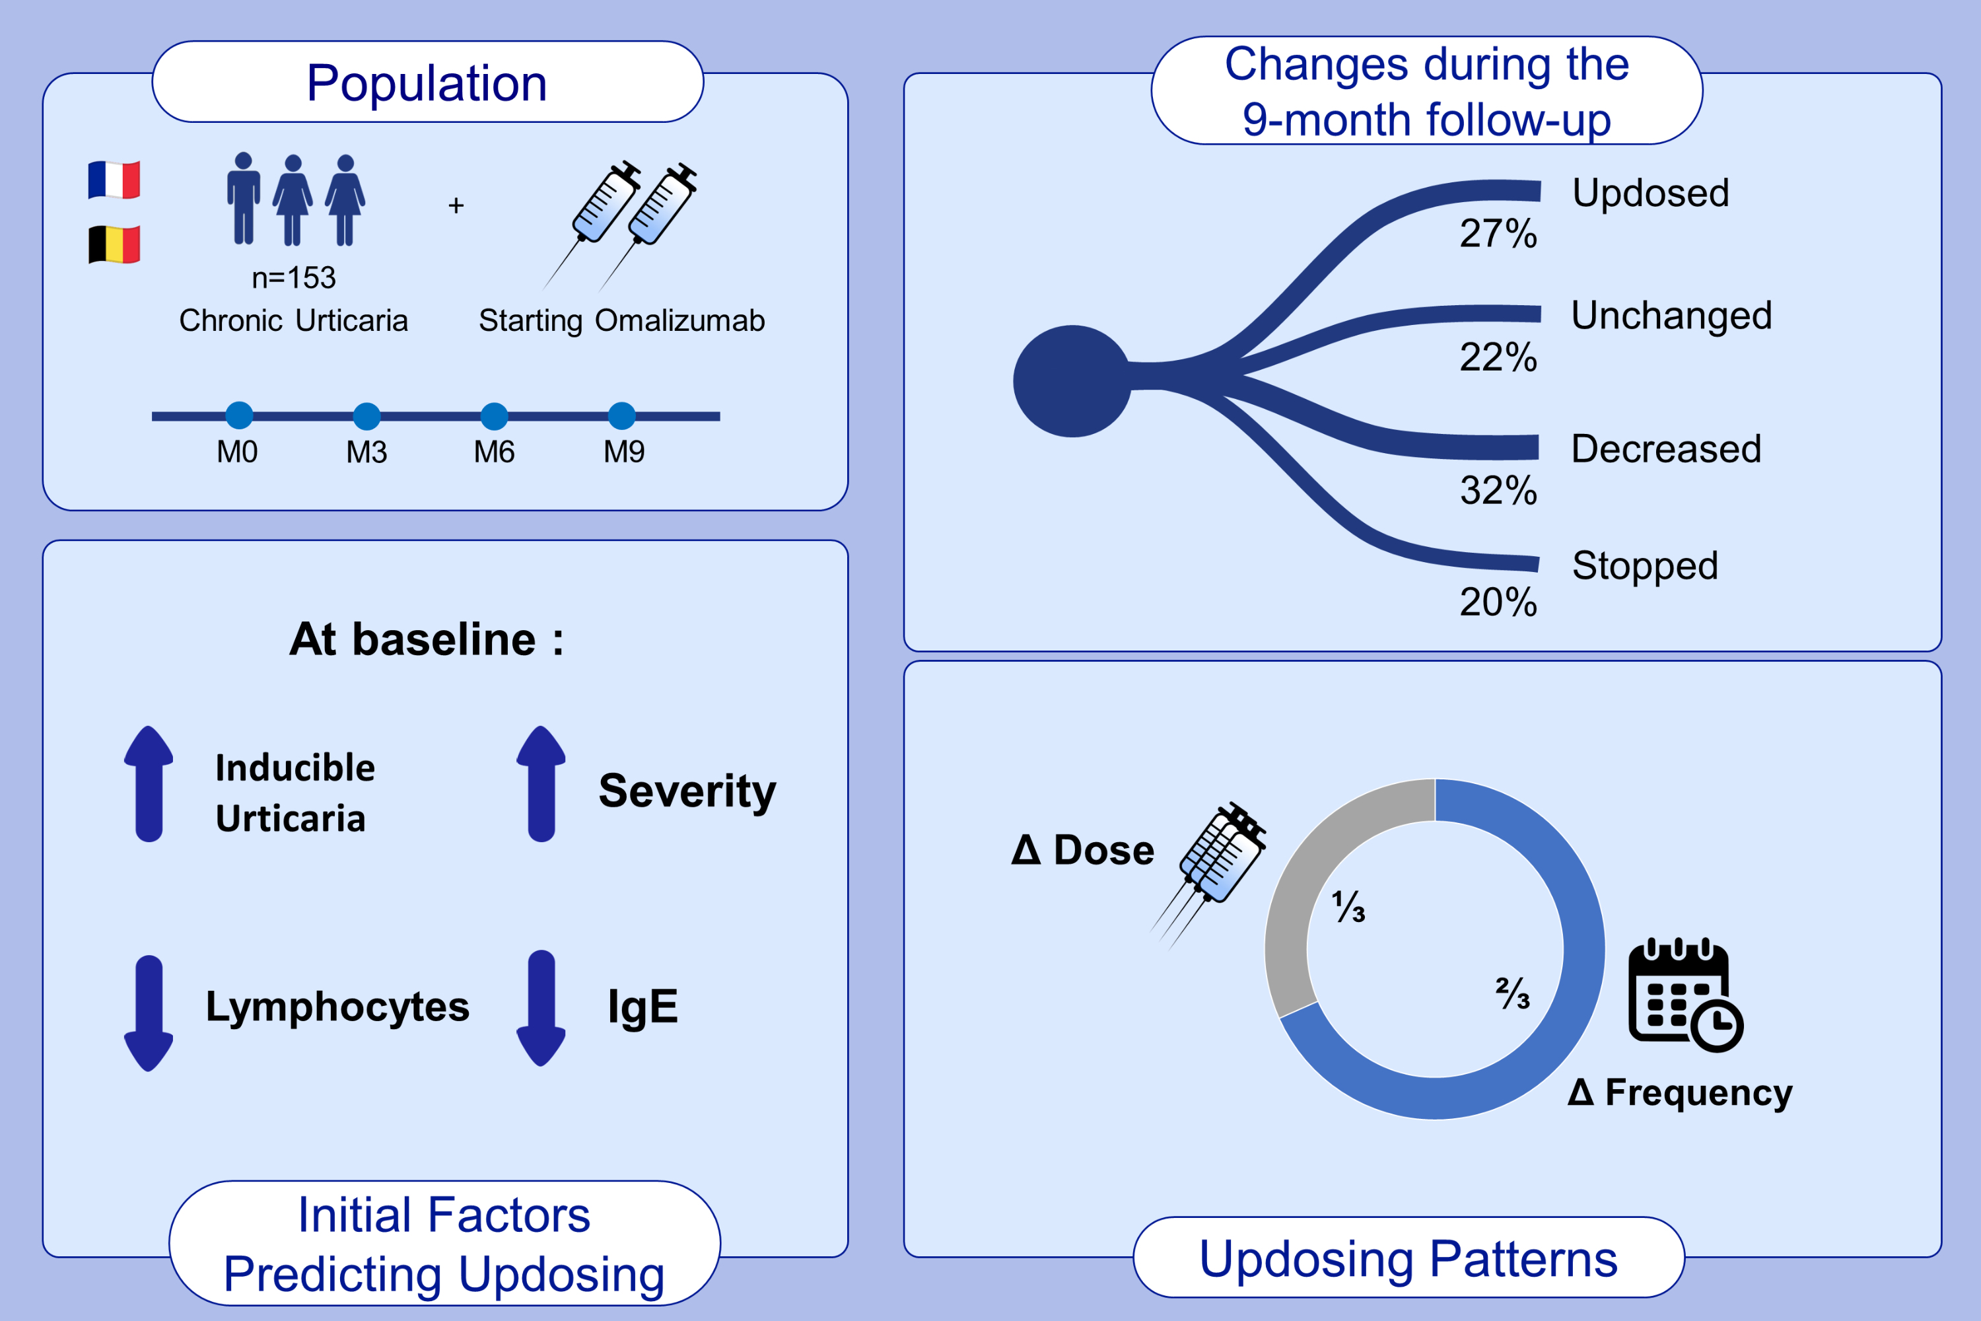
Characterization of omalizumab updosing patterns and predictive factors in chronic spontaneous urticaria: A prospective multicentric observational study
Guillaume Pierrard, Claire Bernier, Aurélie Du-Thanh, Corina Bara, Angèle Soria, et al.
Allergy. 2024; pages:2448-2457
https://doi.org/10.1111/all.16256
© 2019 EAACI and John Wiley and Sons A/S. Published by John Wiley and Sons Ltd.
Notes:
HIGHLIGHTS
• We conducted a prospective, multicentric, observational study, including 153 patients diagnosed with chonic urticaria and starting Omalizumab.
• Twenty percent of patients at M3 were updosed, and 27% during the 9-month follow-up.
• Practitioners mainly chose to increase the frequency of injections (66%).
• At baseline, the updosed patients were more likely, to have inducible urticaria, severe urticaria, lower IgE and lymphocyte count.

