Slide 1
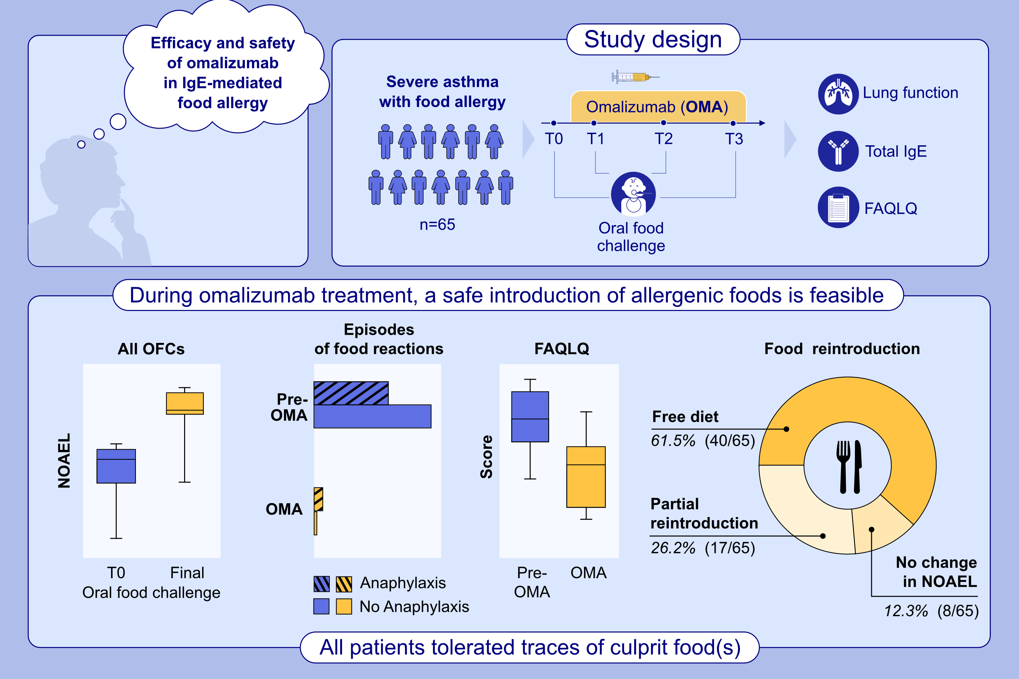
Omalizumab reduces anaphylactic reactions and allows food introduction in food-allergic in children with severe asthma: An observational study
Stefania Arasi, Arianna Cafarotti, Francesca Galletta, Valentina Panetta, Carla Riccardi, et al.
Allergy. 2025.
https://doi.org/10.1111/all.16314
© 2019 EAACI and John Wiley and Sons A/S. Published by John Wiley and Sons Ltd.
Notes:
HIGHLIGHTS
• In Europe, Omalizumab is indicated for the treatment of moderate to severe asthma, but not for IgE-mediated food allergy.
• We assessed the impact of Omalizumab on efficacy, safety, and quality of life (FA-QoL) in patients with moderate to severe asthma and who have a history of anaphylaxis to peanut, tree nuts, fish, egg, milk, and/or wheat.
• Our data showed an increasing in ACT and FAQoL and a allowed safe reintroduction of allergenic foods during Omalizumab therapy. .

