Slide 1
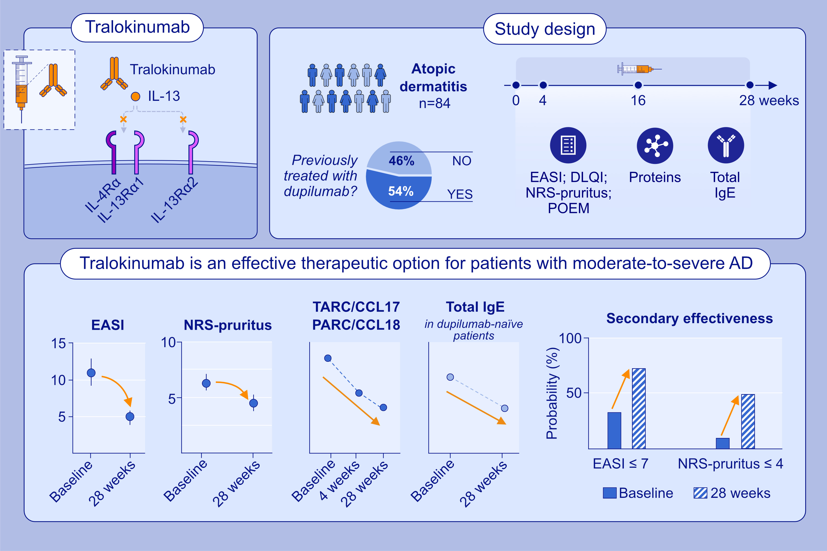
Tralokinumab Treatment in Adult Atopic Dermatitis Patients: 28-Week Evaluation of Clinical Effectiveness, Safety, Serum Proteins and Total IgE Levels
Coco Dekkers, Nicolaas Zuithoff, Daphne Bakker, Edward Knol, Anne Wevers, et al.
Allergy. 2025.
https://doi.org/10.1111/all.16414
© 2019 EAACI and John Wiley and Sons A/S. Published by John Wiley and Sons Ltd.
Notes:
HIGHLIGHTS
• This study evaluated 28-week safety and effectiveness of tralokinumab treatment in patients with atopic dermatitis.
• All primary outcomes significantly improved during 28 weeks of tralokinumab treatment and the probability of achieving EASI≤7 and NRS-pruritis≤4 was 75.8% (56.9 – 88.2) and 51.4% (28.0 – 74.2), respectively.
• Tralokinumab is an effective treatment for moderate-to-severe AD in adult patients, in both dupilumab naïve patients and patients who previously failed on dupilumab treatment.
• The clinical effect is supported by the biological data.

