Slide 1
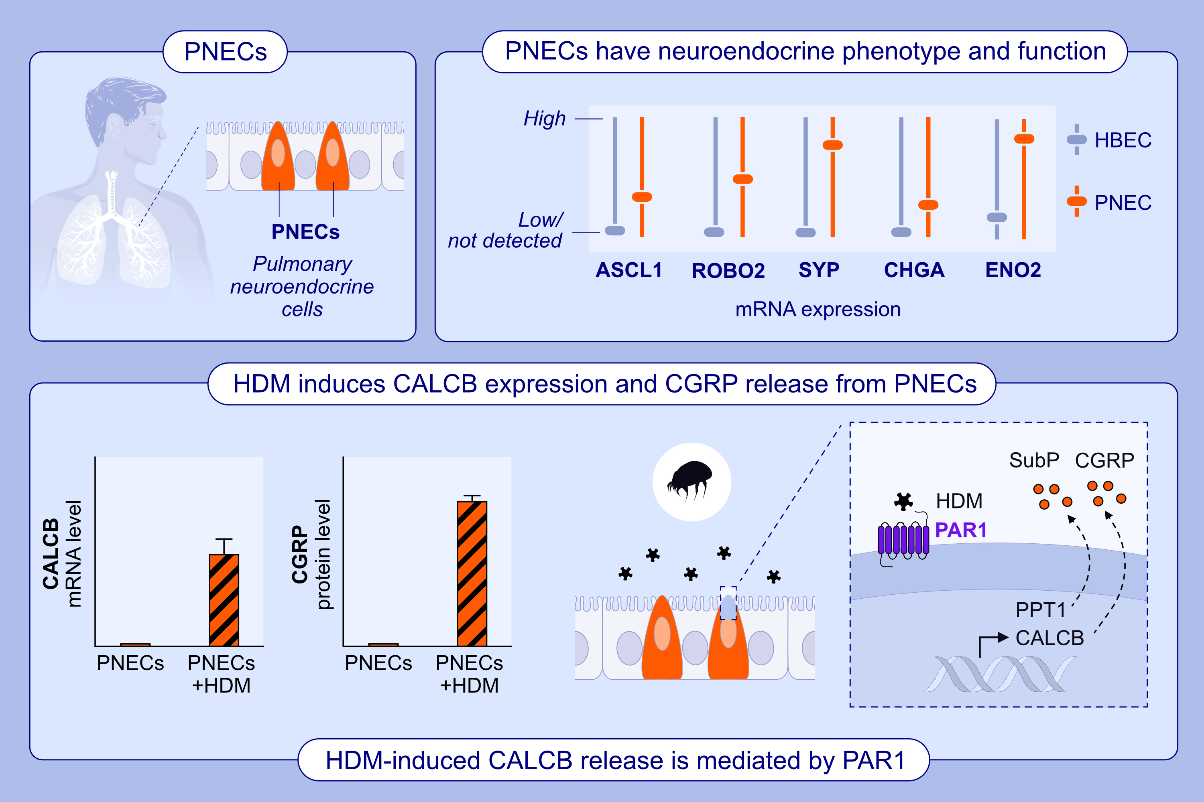
Human Pulmonary Neuroendocrine Cells Respond to House Dust Mite Extract With PAR-1 Dependent Release of CGRP
Ritu Mann-Nüttel, Shivani Mandal, Marie Armbruster, Lakshmi Puttagunta, Paul Forsythe et al.
Allergy. 2025;
https://doi.org/10.1111/all.16416
© 2019 EAACI and John Wiley and Sons A/S. Published by John Wiley and Sons Ltd.
Notes:
HIGHLIGHTS
• This study aimed to develop and characterize an in vitro human PNEC model and investigated the neuroendocrine response to HDM extract.
• Exposure to HDM leads to dose dependent induction of the CGRP encoding gene, CALCB, and corresponding release of the neuropeptide.
• DM-induced CALCB expression and subsequent release of CGRP by PNEC is PAR1-dependent. .

