Slide 1
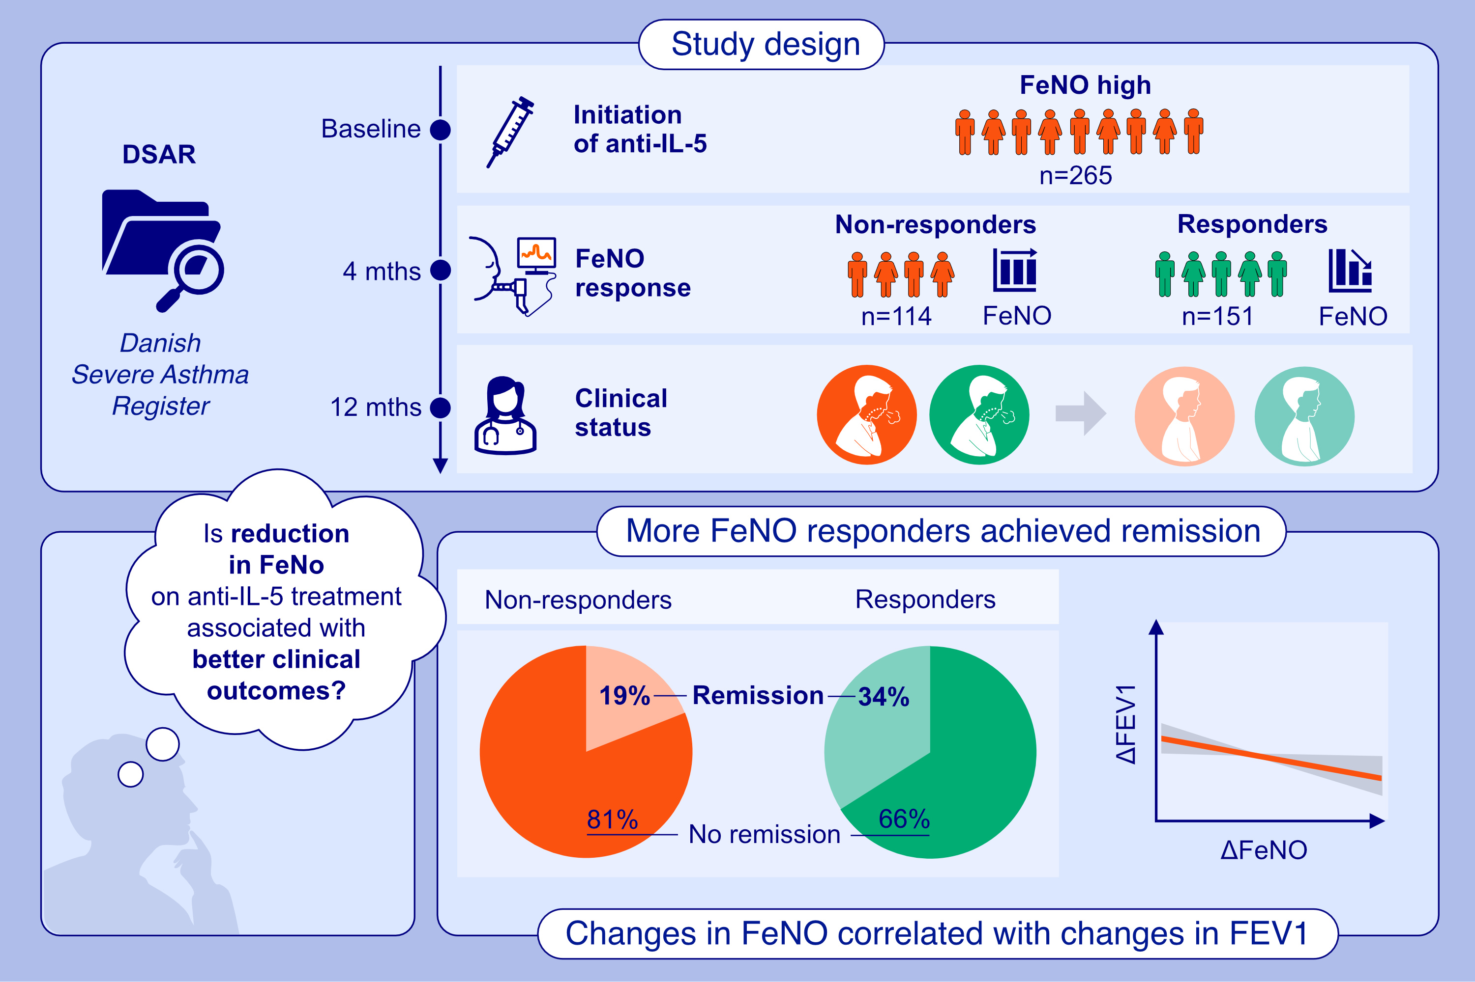
Early Reduction of FeNO on Anti-IL5 Biologics Is Associated With Clinical Remission of Severe Asthma
Marianne Baastrup Soendergaard, Susanne Hansen, Kjell Erik Julius Håkansson, Anna von Bülow, Anne-Sofie Bjerrum, et al.
Allergy. 2025.
https://doi.org/10.1111/all.16425
© 2019 EAACI and John Wiley and Sons A/S. Published by John Wiley and Sons Ltd.
Notes:
HIGHLIGHTS
• Half of patients with an elevated FeNO prior to initiation of an anti-IL5 biologic had a significant reduction of FeNO in response to four months of anti-IL5 treatment.
• FeNO responders were more likely to achieve remission after a year of treatment.
• Improvements in FeNO correlated slightly with improvements in FEV1.
• Early response in FeNO could potentially serve as an early indicator of remission. .

