Slide 1
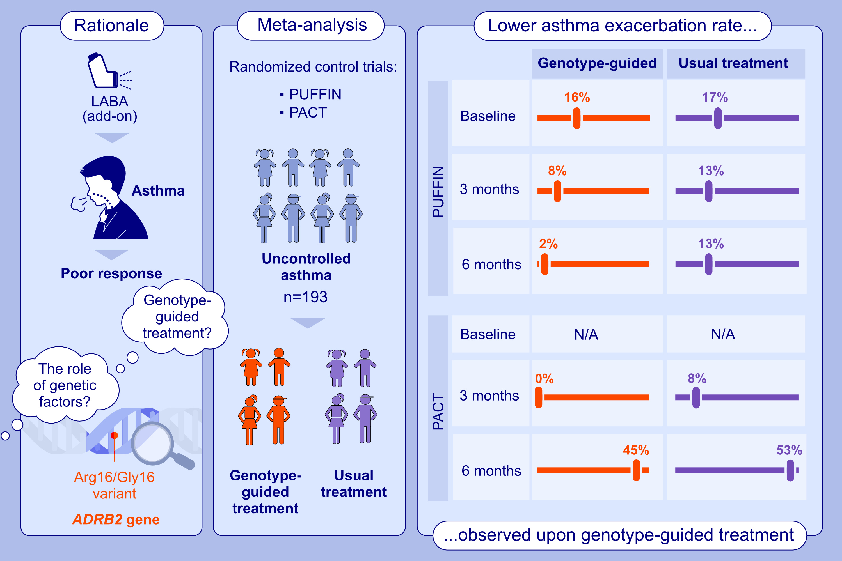
Genotype-Guided Asthma Treatment Reduces Exacerbations in Children: Meta-Analysis of Two Randomized Control Trials
Elise M. A. Slob, Susanne J. H. Vijverberg, Tom Ruffles, Lieke C. E. Noij, Jacqueline Biermann, et al.
Allergy. 2025.
https://doi.org/10.1111/all.16438
© 2019 EAACI and John Wiley and Sons A/S. Published by John Wiley and Sons Ltd.
Notes:
HIGHLIGHTS
• This study investigates whether ADRB2-guided treatment improves asthma control and reduces risk of exacerbations in children with uncontrolled asthma.
• We conducted an individual participant data meta-analysis of two randomised controlled trials: PUFFIN and PACT.
• Genotype-guided step-up treatment for children with uncontrolled asthma on ICS results in lower asthma exacerbation rates compared to the control group. .

