Slide 1
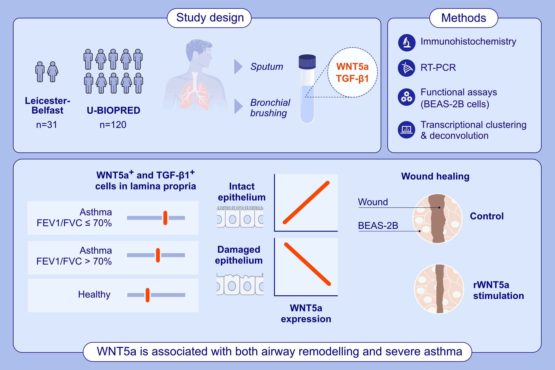
The Role of WNT5a and TGF-β1 in Airway Remodelling and Severe Asthma
Tariq Daud, Sheree Roberts, Nazanin Zounemat Kermani, Matthew Richardson, Liam G. Heaney, et al.
Allergy. 2025.
https://doi.org/10.1111/all.16445
© 2019 EAACI and John Wiley and Sons A/S. Published by John Wiley and Sons Ltd.
Notes:
HIGHLIGHTS
• This study evaluates the role of WNT5a and TGF-β 1 in severe asthma and airway remodelling.
• When compared to healthy, both TGF-β1 and WNT5a are significantly increased in the airway in patients with asthma irrespective of airflow limitation.
• WNT5a correlates with the epithelial barrier integrity and promotes wound healing.
.

