Slide 1
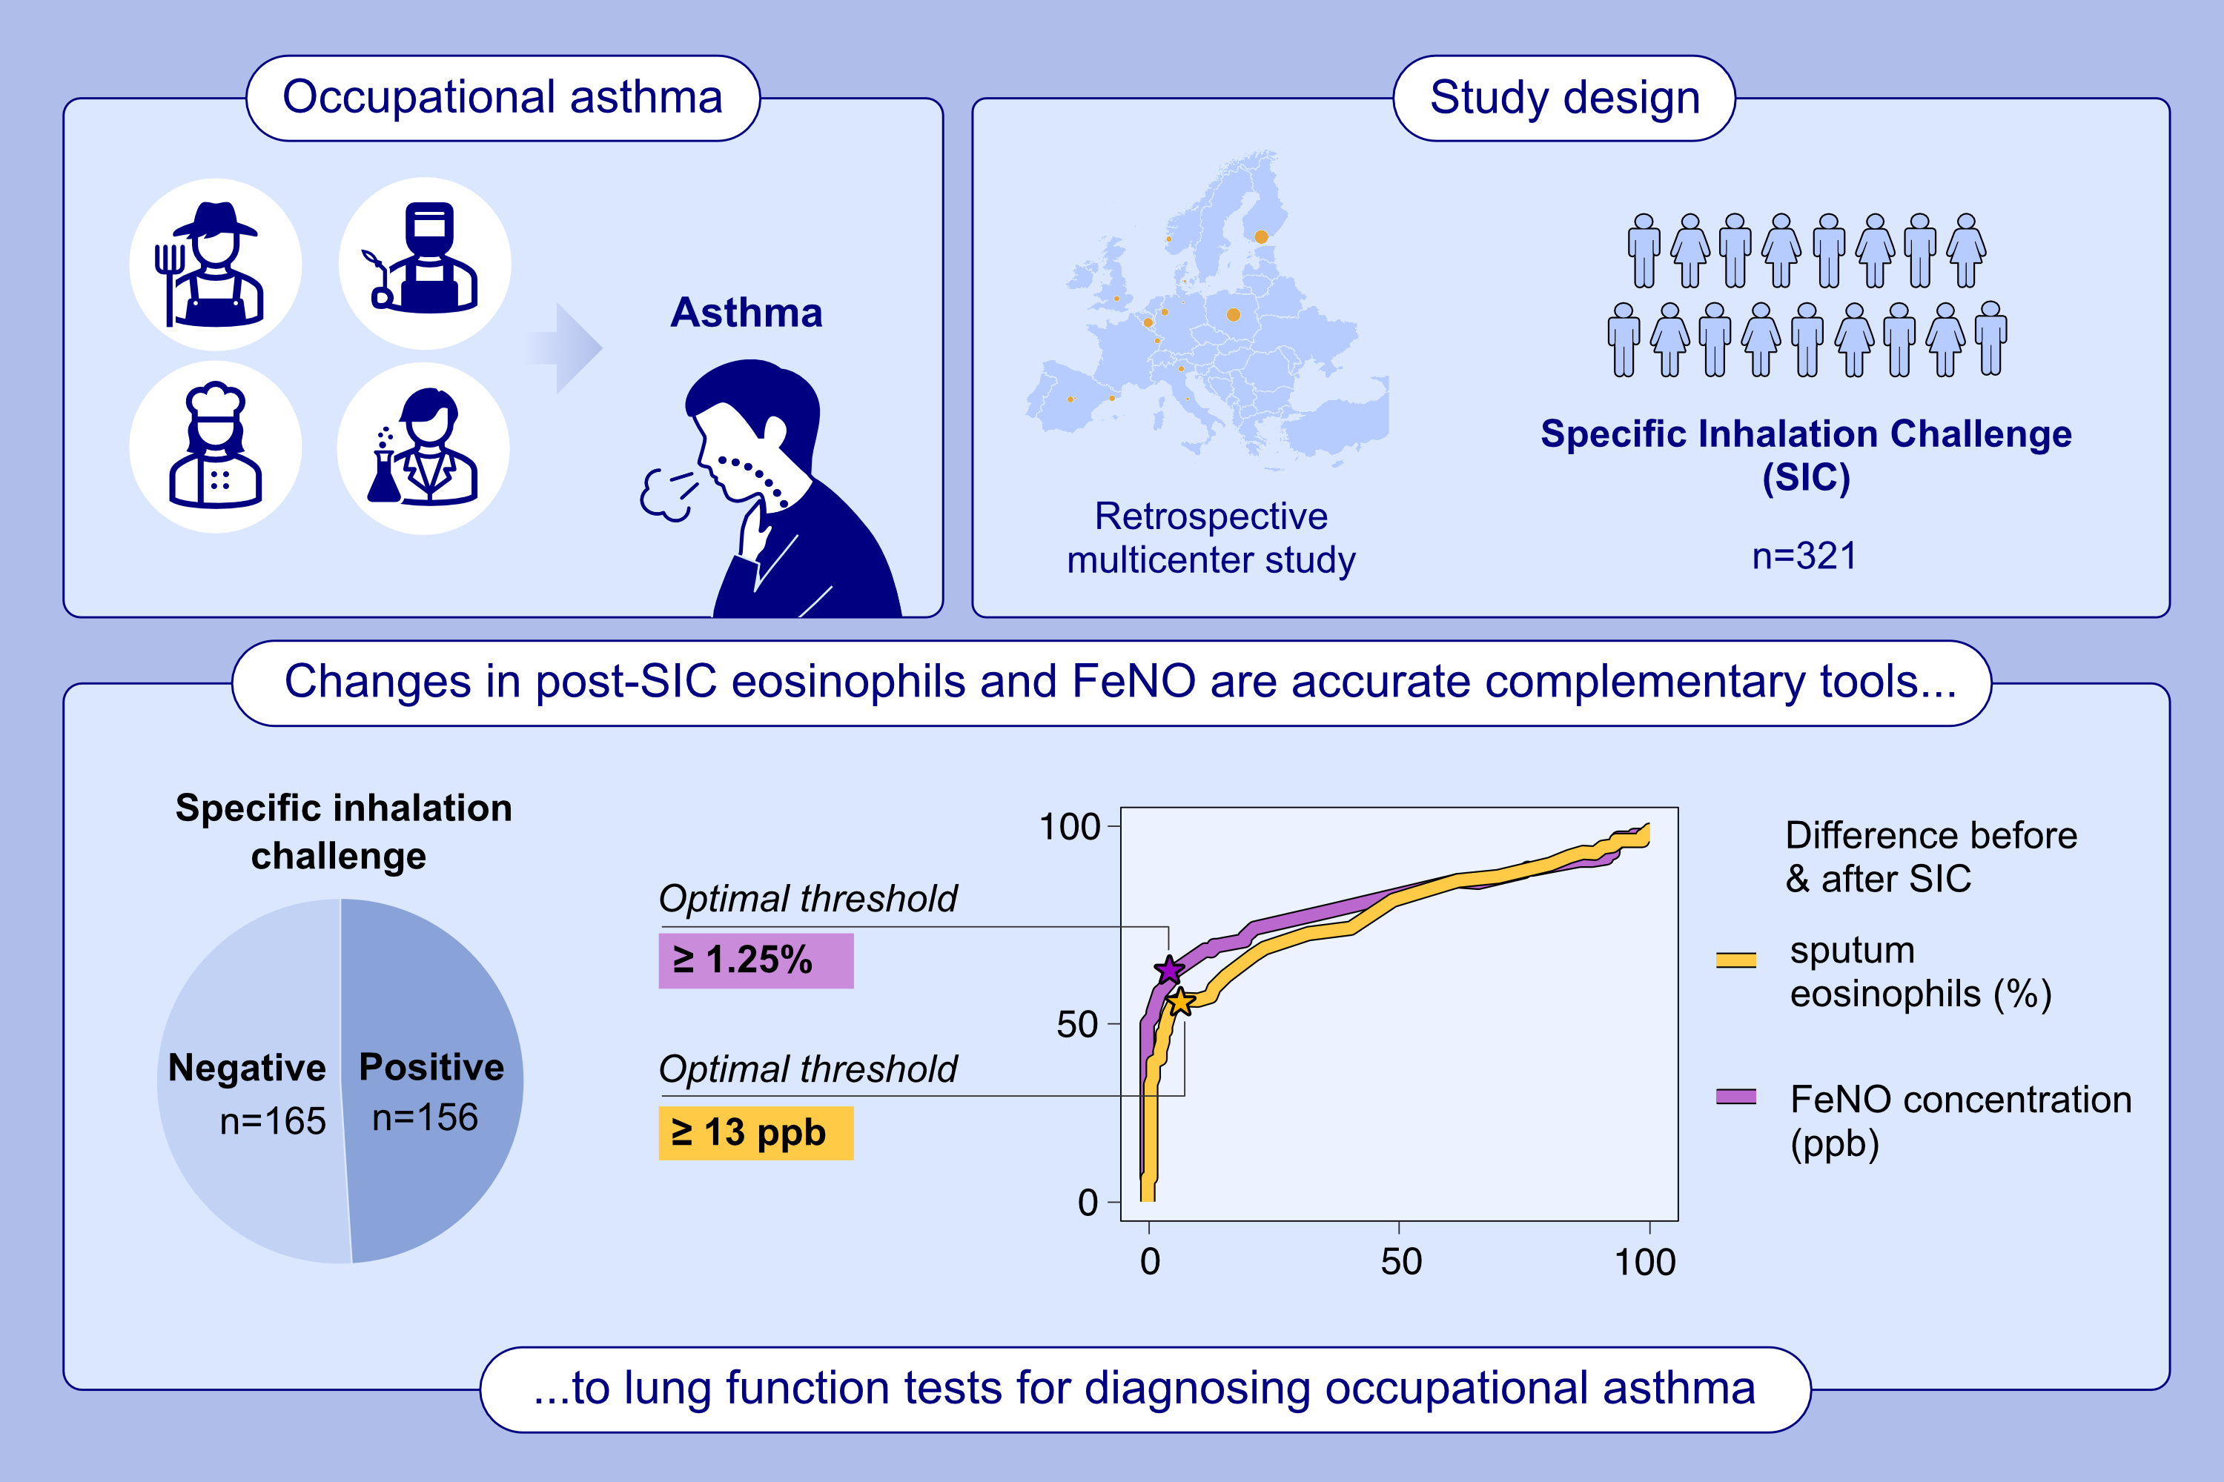
Exhaled Nitric Oxide and Sputum Eosinophils Are Complementary Tools for Diagnosing Occupational Asthma
Virginie Doyen, Nicolas Migueres, Vera van Kampen, Hille Suojalehto, Paola Mason, et al.
Allergy. 2025.
https://doi.org/10.1111/all.16447
© 2019 EAACI and John Wiley and Sons A/S. Published by John Wiley and Sons Ltd.
Notes:
HIGHLIGHTS
• This retrospective multicenter cohort showed that the changes in FeNO and sputum eosinophils after challenge exposure to occupational agents have a similarly high accuracy in differentiating positive from negative SICs.
• The ROC-based optimal thresholds of 13 ppb and 1.25% for the post-challenge changes in FeNO and sputum eosinophils, respectively, provided a high specificity in identifying asthmatic reactions.
• In addition, combining both inflammatory markers substantially increased the sensitivity to 77% (95% CI, 70% to 83%). .

