Slide 1
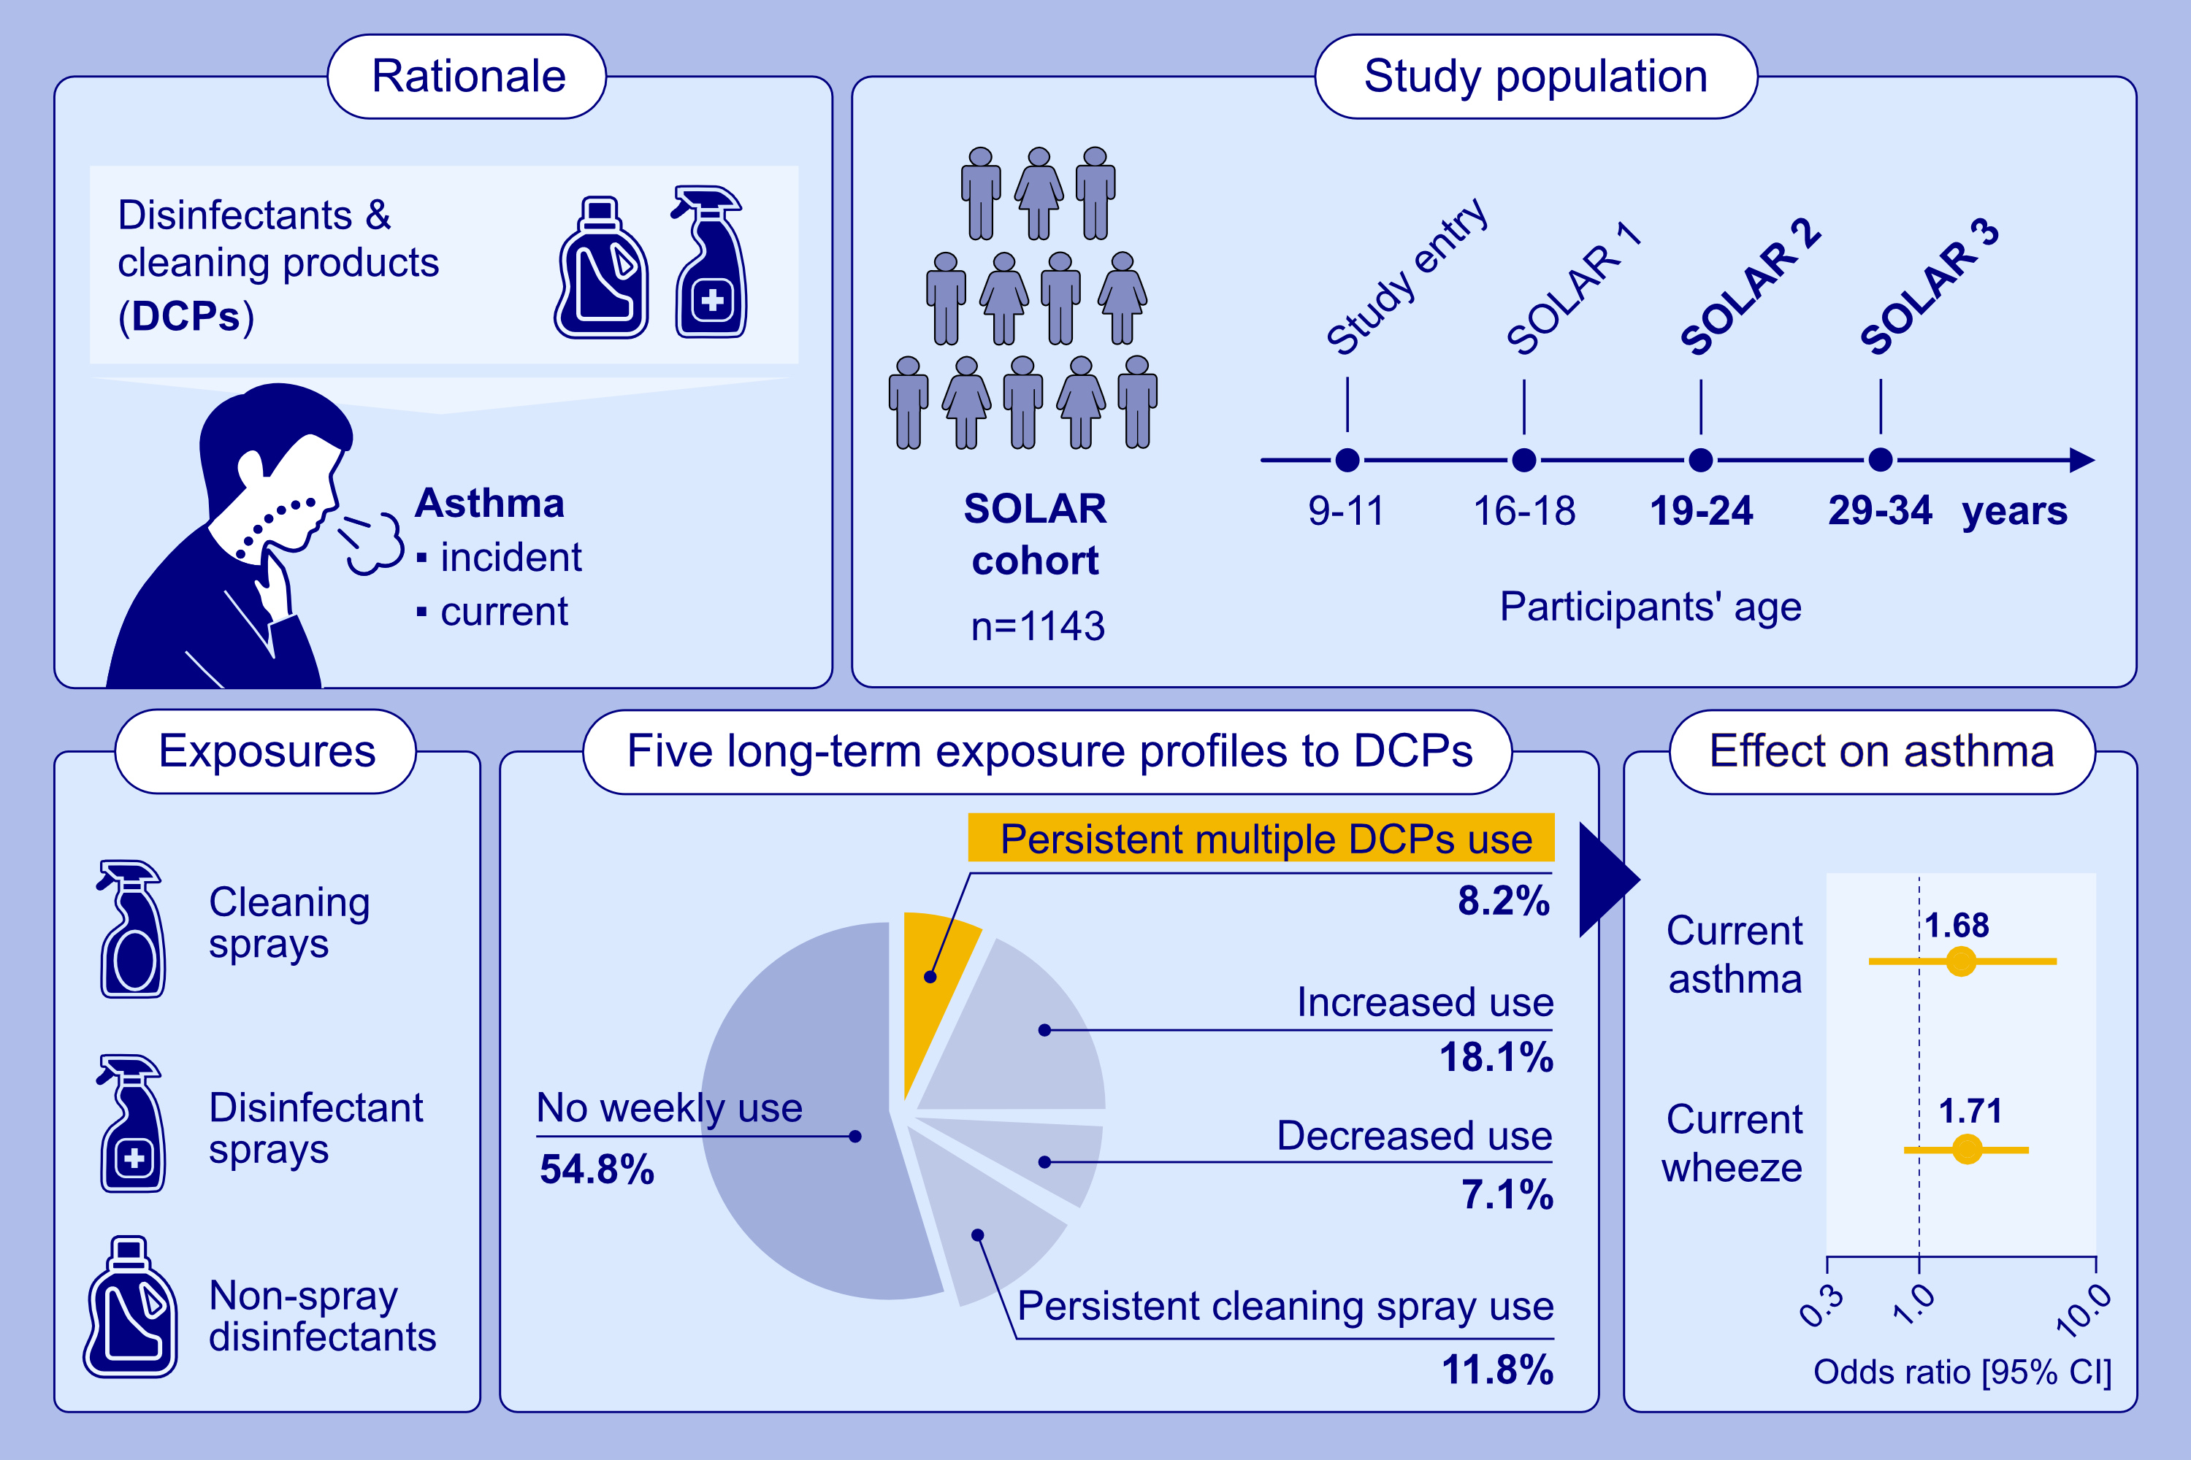
Exposure Profiles for the Long-Term Use of Disinfectants and Cleaning Products and Asthma
Emilie Pacheco Da Silva, Tobias Weinmann, Jessica Gerlich, Gudrun Weinmayr, Jon Genuneit, et al.
Allergy. 2025.
https://doi.org/10.1111/all.16456
© 2019 EAACI and John Wiley and Sons A/S. Published by John Wiley and Sons Ltd.
Notes:
HIGHLIGHTS
• A Latent Class Analysis was conducted in a German cohort of 1143 adults to identify exposure profiles for the long-term use of disinfectants and cleaning products between age 19-34 years.
• We identified five exposure profiles: no weekly use, persistent cleaning sprays use, decreased use, increased use, persistent use.
• Among those, only persistent use of multiple products was associated with asthma. .

