Slide 1
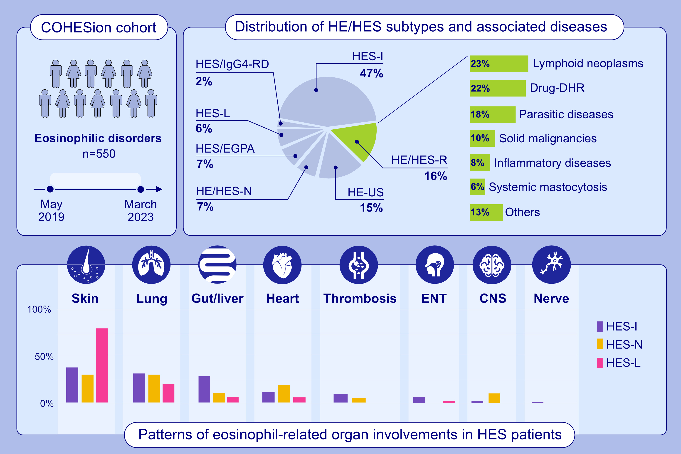
Hypereosinophilia and Hypereosinophilic Syndromes: First Findings From a Nationwide Multicenter Cohort
Guillaume Lefèvre, Séverine Bleuse, Mathieu Puyade, Guillaume Moulis, Antoine Néel, et al.
Allergy. 2025.
https://doi.org/10.1111/all.16463
© 2019 EAACI and John Wiley and Sons A/S. Published by John Wiley and Sons Ltd.
Notes:
HIGHLIGHTS
• The COHESion study is the first prospective large-scale multicenter study dedicated to all HE/HES subtypes.
• The final diagnoses were HES-I (47%), HE/HES-R (16%), HE-US (15%), HE/HES-N (7%), HE/HES-L (6%), IgG4RD (2%), and ANCA-negative EGPA (7%).

