Slide 1
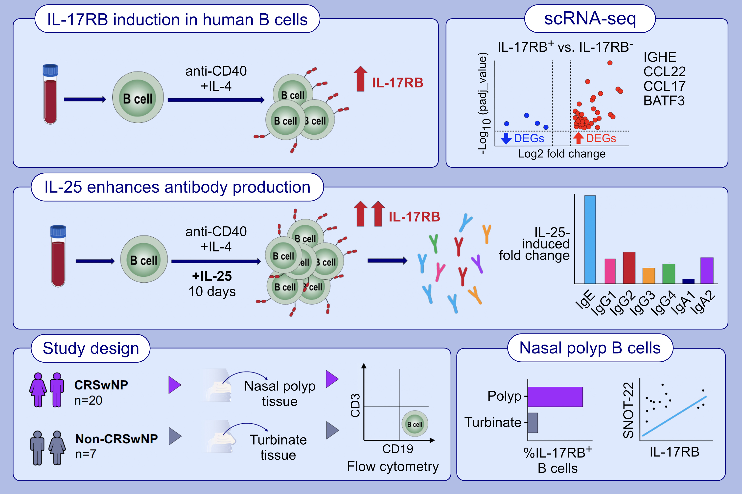
IL-25 Enhances B Cell Responses in Type 2 Inflammation Through IL-17RB Receptor
Semah Abdu, Jiao Xia, Huihui Yuan, Tiak Ju Tan, Janice A. Layhadi, et al.
Allergy. 2025.
https://doi.org/10.1111/all.16472
© 2019 EAACI and John Wiley and Sons A/S. Published by John Wiley and Sons Ltd.
Notes:
HIGHLIGHTS
Human B cells express IL-17RB under IgE inducing conditions (anti-CD40 + IL-4) and respond to IL-25 with enhanced antibody production, particularly IgE.
ScRNA-seq revealed that IL-17RB+ B cells have a distinct transcriptional profile compared to IL-17RB- B cells.
We have identified a population of nasal IL-17RB-expressing B cells present in CRSwNP tissue which correlated with SNOT-22 scores in these patients.

