Slide 1
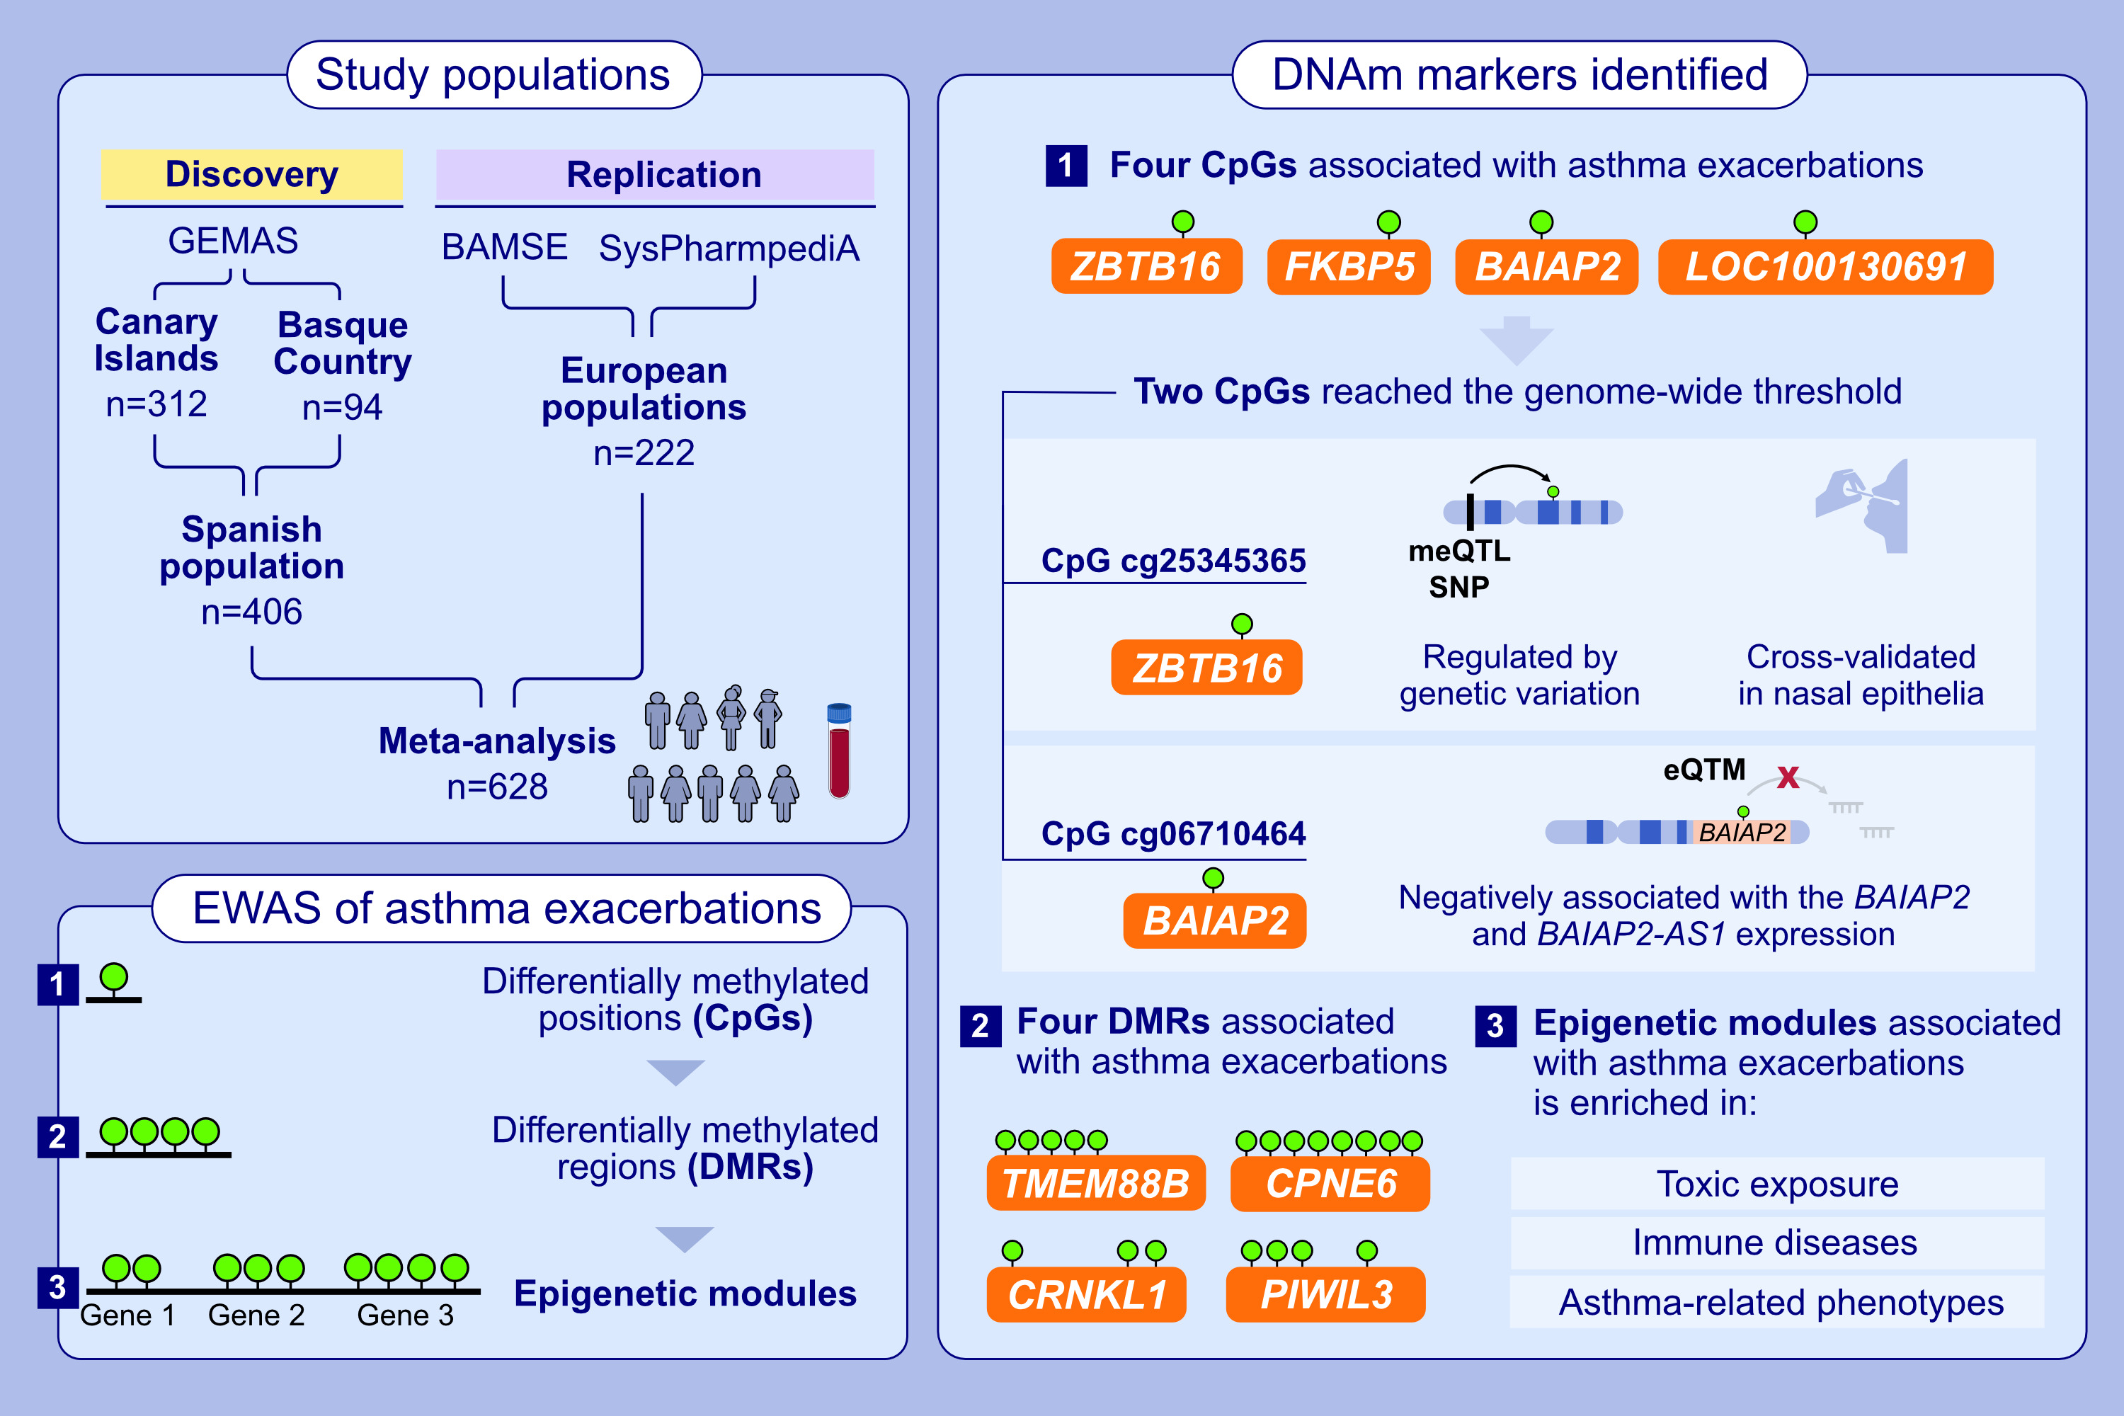
Epigenome-Wide Association Study of Asthma Exacerbations in Europeans
Elena Martin-Gonzalez, Javier Perez-Garcia, Esther Herrera-Luis, Mario Martin-Almeida, Simon Kebede-Merid, et al.
Allergy. 2025
https://doi.org/10.1111/all.16490
© 2019 EAACI and John Wiley and Sons A/S. Published by John Wiley and Sons Ltd.
Notes:
HIGHLIGHTS
• Epigenetic markers were associated with asthma exacerbations at different levels: differentially methylated positions, regions, and modules.
• The top-hit CpG cg25345365 (ZBTB16) was regulated by genetic variants and cross-tissue validated in nasal epithelia.
• Genome-wide epigenetic markers are located in genes involved in asthma tolerance and corticosteroid response, and those suggestive related to prenatal/environmental exposures, immune-mediated diseases, and mortality.
.

