Slide 1
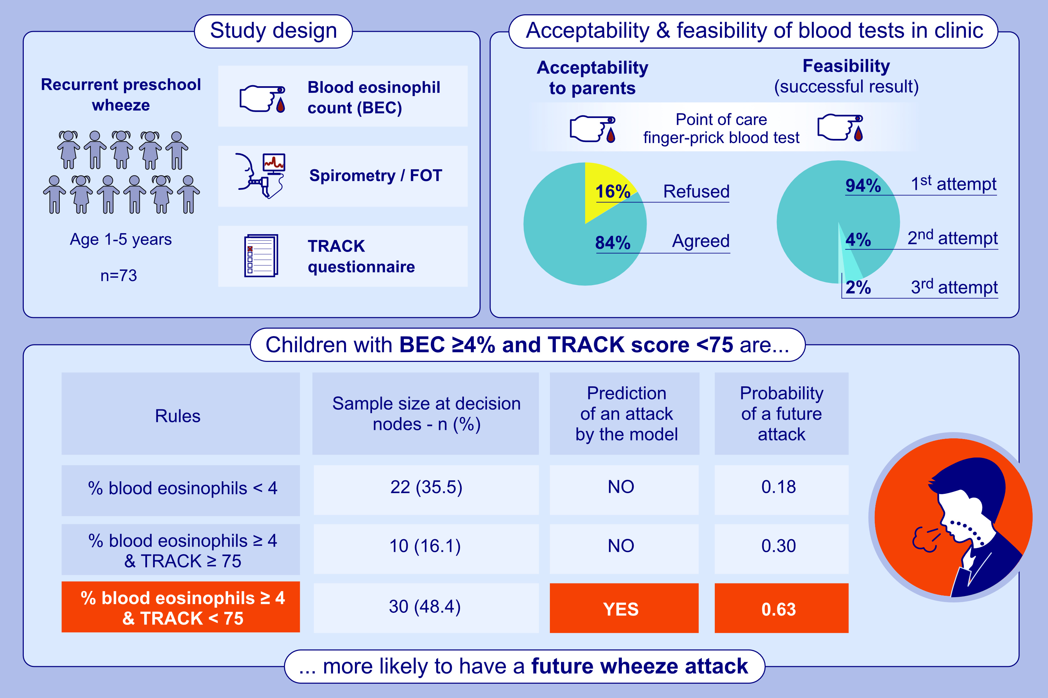
Point-of-Care Blood Eosinophils to Predict Preschool Wheeze Attacks
Kushalinii Hillson, Sara Fontanella, Hernani Almeida, Barbara Pavlou, Katariina Lajunen, et al.
Allergy. 2025;
https://doi.org/10.1111/all.16500
© 2019 EAACI and John Wiley and Sons A/S. Published by John Wiley and Sons Ltd.
Notes:
HIGHLIGHTS
• Absolute and % BEC at baseline are higher in children who had >1 wheeze attack requiring unscheduled healthcare attendance, in follow up period.
• Decision tree model showes children with BEC ≥4% and TRACK score <75 are more likely to have a future attack.
• Preliminary data suggests elevated BEC with low symptom score predicts a wheeze attack within 3 months.
.

