Slide 1
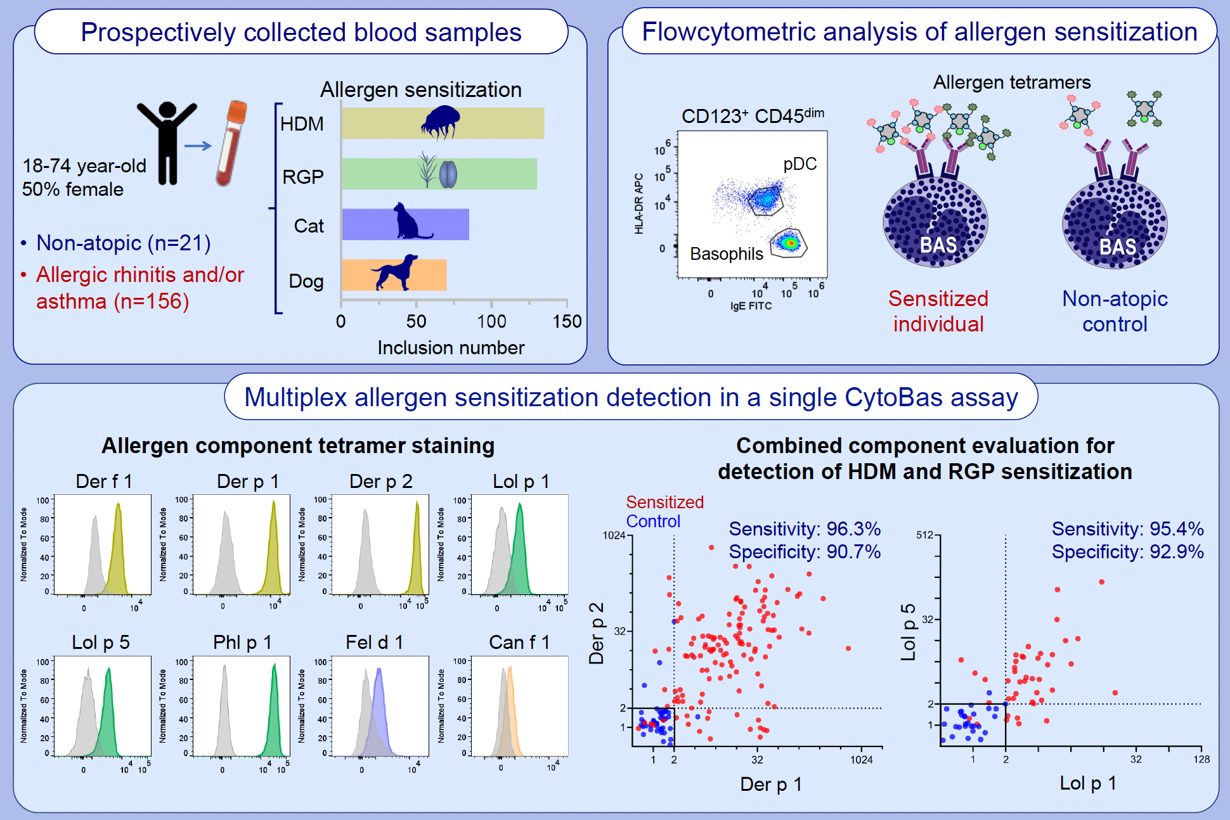
A Single Multiplex CytoBas Assay Incorporating Eight Major Components for Accurate Detection of Allergen Sensitization in Asthma and Allergic Rhinitis
Lin Hsin, Mark Hew, Pei Mun Aui, Kirsten Deckert, P. Mark Hogarth, et al.
Allergy. 2025
https://doi.org/10.1111/all.16513
© 2019 EAACI and John Wiley and Sons A/S. Published by John Wiley and Sons Ltd.
Notes:
HIGHLIGHTS
• Combined evaluation of 8 aeroallergen components in a single flowcytometry assay can differentially detect house dust mite, grass pollen, cat and dog sensitization on blood basophils (AeroDiff CytoBas).
• The AeroDiff CytoBas assay demonstrated similar to superior diagnostic accuracy than singleplex component-specific IgE serology.
• Using two components per allergen, AeroDiff CytoBas accurately detected house dust mite (96% sens. and 91% spec.) and grass pollen sensitization (95% sens.

