Slide 1
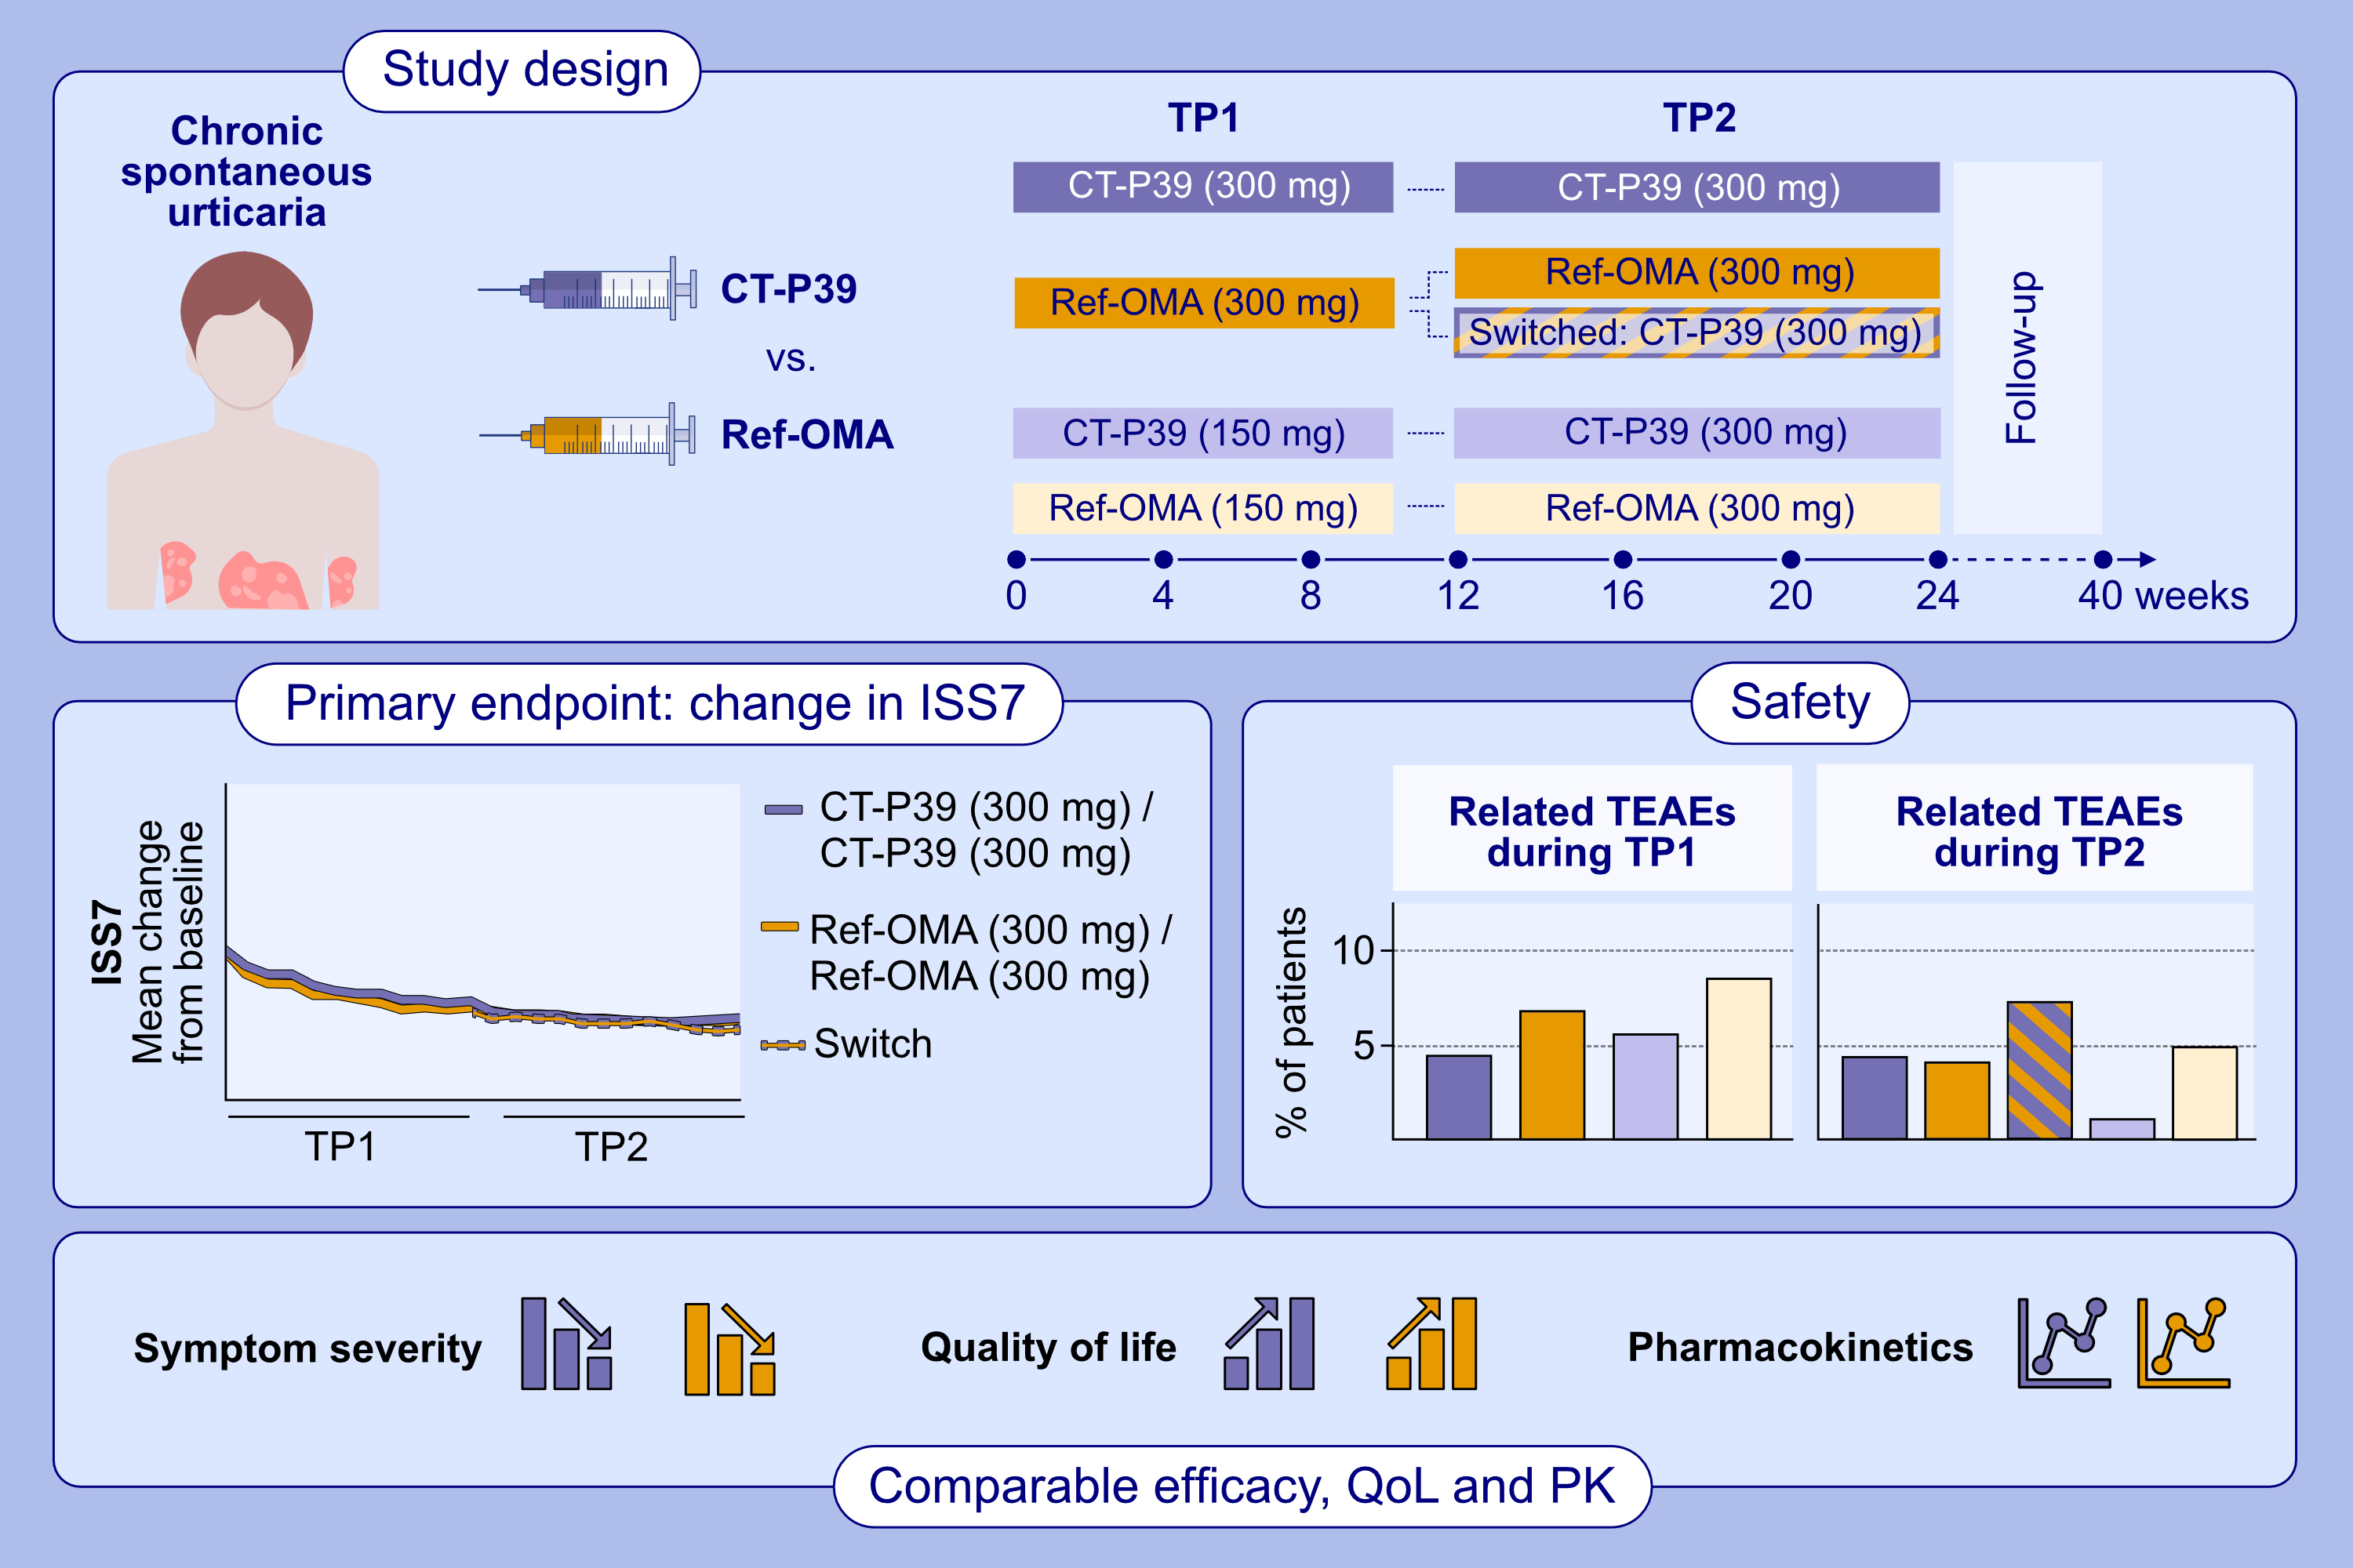
CT-P39 Compared With Reference Omalizumab in Chronic Spontaneous Urticaria: Results From a Double-Blind, Randomized, Active-Controlled, Phase 3 Study
Sarbjit S. Saini, Marcus Maurer, Yevgeniya Dytyatkovska, Ewa Springer, Maria Ratkova, et al.
Allergy. 2025; pages:2167-2177
https://doi.org/10.1111/all.16446
© 2019 EAACI and John Wiley and Sons A/S. Published by John Wiley and Sons Ltd.
Notes:
HIGHLIGHTS
• This study investigated the therapeutic equivalence of CT P39 (an omalizumab biosimilar) and EU-approved reference omalizumab (ref-OMA) in patients with chronic spontaneous urticaria. Therapeutic equivalence between CT-P39 and ref OMA (300 mg) was demonstrated by the primary endpoint – confidence intervals of the treatment difference in mean change from baseline in ISS7 (W12) falling within predefined equivalence margins.
• The percentage of patients experiencing drug-related TEAEs was <10%. Secondary efficacy, QoL, PK, and safety endpoints were comparable between CT-P39 and ref-OMA.
• Switching from ref-OMA to CT-P39 had no noticeable impact. .

