Slide 1
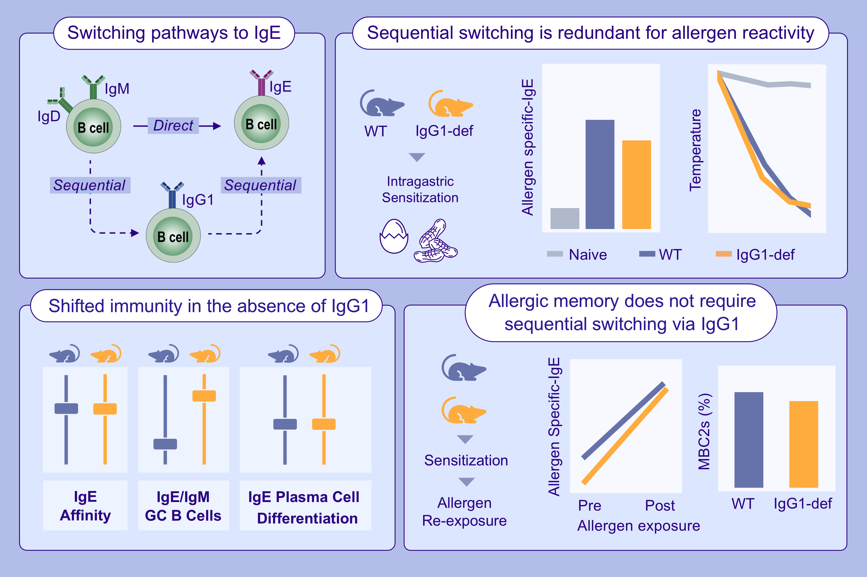
Allergic Reactivity and Memory Occur Independently of Sequential Switching Through IgG1
Joshua F. E. Koenig, Adam K. Wade-Vallance, Rodrigo Jiménez-Saiz, Kelly Bruton, Siyon Gadkar, et al.
Allergy. 2025; pages:2141-2157
https://doi.org/10.1111/all.16460
© 2019 EAACI and John Wiley and Sons A/S. Published by John Wiley and Sons Ltd.
Notes:
HIGHLIGHTS
• Sequential switching through IgG1 is not required to produce IgE with sufficient allergen-binding affinity to cause anaphylaxis against food allergens. Sequential switching through IgG1 does not confer a competitive advantage to become an IgE-expressing cell. IgG1+ memory B cells are not required for IgE memory; IgG1-deficient mice retain type 2 polarized memory B cells. .

