Slide 1
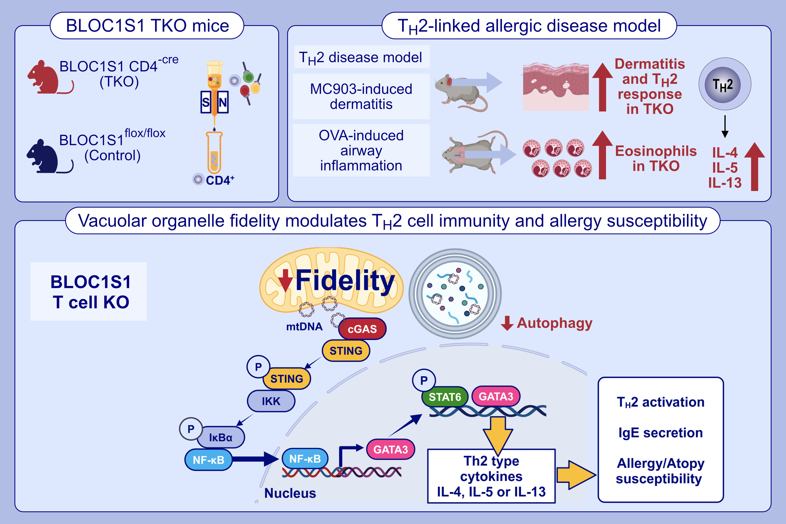
BLOC1S1 Control of Vacuolar Organelle Fidelity Modulates Murine TH2 Cell Immunity and Allergy Susceptibility
Rahul Sharma, Kaiyuan Wu, Kim Han, Anna Chiara Russo, Pradeep K. Dagur, et al.
Allergy. 2025; pages:2128-2140
https://doi.org/10.1111/all.16461
© 2019 EAACI and John Wiley and Sons A/S. Published by John Wiley and Sons Ltd.
Notes:
HIGHLIGHTS
• BLOC1S1 deficiency in CD4+ T-cells disrupts mitochondrial and endolysosomal homeostasis, leading to cytosolic mtDNA leakage and activation of cGAS-STING and NF-kB pathways.
• Loss of BLOC1S1 preferentially induces TH2 polarization, with elevated levels of GATA3, phosphorylated STAT6, and cytokines IL-4, IL-5, and IL-13.
Induction of autophagy with rapamycin reduces cytosolic mtDNA, reversing TH2 signatures, while genetic STING knockdown and NF-kB inhibition ameliorate this immune regulatory cascade.
BLOC1S1-deficient mice show heightened susceptibility to allergic asthma and chemically-induced dermatitis, linking mitochondrial dysfunction to TH2-driven allergic inflammation.
.

