Slide 1
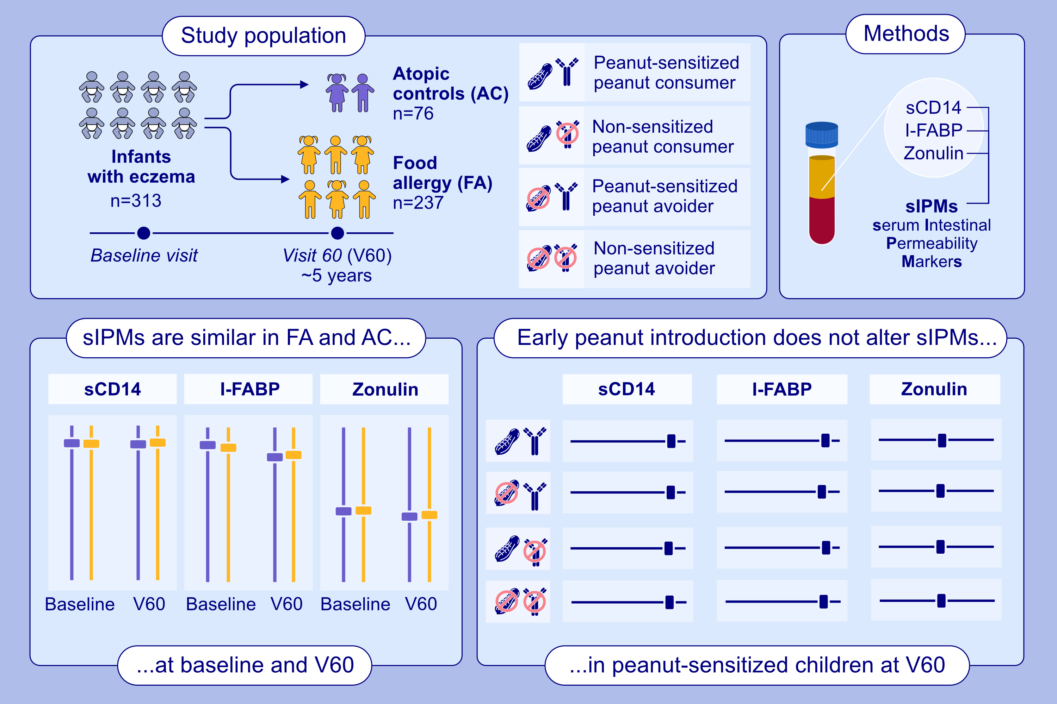
Evaluation of Intestinal Permeability Using Serum Biomarkers in Learning Early About Peanut Allergy Trial
Ozge Nur Aktas, Allyson Mateja, Min (Jenny) Li, Lindsay Chatman, Megan C. Grieco, et al.
Allergy. 2025; pages: 2286-2296
https://doi.org/10.1111/all.16464
© 2019 EAACI and John Wiley and Sons A/S. Published by John Wiley and Sons Ltd.
Notes:
HIGHLIGHTS
• Serum intestinal permeability markers (sIPMs) were similar between infants and children with eczema who did and did not develop food allergy by age 5 years at baseline visit and V60. • Early peanut introduction did not significantly alter intestinal permeability among peanut sensitized children at V60.
• Eczema severity and onset of food allergy were not statistically significantly associated with sIPMs.

